Slide 1
ADRENAL GLAND DISEASE Part II
Volgograd State Medical University
PhD MD Professor A.R .Babaeva

Slide 2
Addison's disease: primary hypoadrenalism
Addison's disease is rare, with an incidence of 3-4/million/year and prevalence of 40-60/million. Primary hypoadrenalism shows a marked female preponderance and is now most often caused by autoimmune disease (> 90% ) rather than tuberculosis (< 10%). All other causes are rare.

Slide 3
Pathophysiology and causes
In this condition there is destruction of the entire adrenal cortex.
Glucocorticoid, mineralocorticoid and sex steroid production are therefore all reduced.
This differs from hypothalamic-pituitary disease, in which mineralocorticoid secretion remains largely intact, being predominantly stimulated by angiotensin II.
Adrenal sex steroid production is also largely independent of pituitary action.
In Addison's disease reduced cortisol levels lead, through feedback, to increased CRH and ACTH production, the latter being directly responsible for the hyperpigmentation.

Slide 4
Addison's disease: primary hypoadrenalism
Pathophysiology
Destruction of the entire adrenal cortex ⇒ reducing of glucocorticoid, mineralocorticoid and sex steroid production.
Reduced cortisol levels ⇒ increased CRH and ACTH production ⇒ hyperpigmentation.

Slide 5
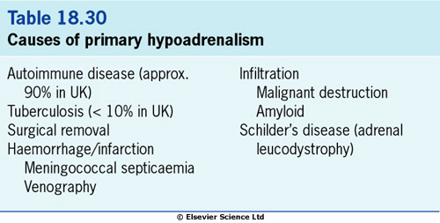

Slide 6
Pathophysiology
Common antigen - 21-hydroxylase.
Antibodies against 21-hydroxylase are pathogenic in autoimmune adrenalitis
There are associations with other autoimmune conditions in the polyglandular autoimmune syndromes Types I and II :
type I diabetes mellitus
pernicious anaemia
thyroiditis
hypoparathyroidism
premature ovarian failure

Slide 7
Clinical features
The symptoms and signs of primary hypoadrenalism
(Addison's disease).

Slide 8
Clinical features
The symptomatology of Addison's disease is often vague and non-specific. These symptoms may be the prelude to an Addisonian crisis with severe hypotension and dehydration precipitated by intercurrent illness, accident or operation.
Pigmentation (dull, slaty, grey-brown) is the predominant sign in over 90% of cases.
Postural systolic hypotension, due to hypovolaemia and sodium loss, is present in 80-90% of cases, even if supine blood pressure is normal. Mineralocorticoid deficiency is the cause.

Slide 9
Investigations
Single cortisol measurements are of little value, although a random cortisol below 100 nmol/L during the day is highly suggestive, and a random cortisol > 550 nmol/L makes the diagnosis unlikely (but not impossible).
The short ACTH stimulation test. An absent or impaired cortisol response is seen, confirmed if necessary by a long ACTH stimulation test to exclude adrenal suppression by steroids or ACTH deficiency.
A 0900h plasma ACTH level - a high level (> 80 ng/L) with low or low-normal cortisol confirms primary hypoadrenalism.
Electrolytes and urea classically show hyponatraemia, hyperkalaemia and a high urea, but they can be normal.
Blood glucose may be low, with symptomatic hypoglycaemia.
Adrenal antibodies are present in many cases of autoimmune adrenalitis.

Slide 10
Investigations
Chest and abdominal X-rays may show evidence of tuberculosis and/or calcified adrenals.
Serum aldosterone is reduced with high plasma renin activity.
Hypercalcaemia and anaemia (after rehydration) are sometimes seen. They resolve on treatment, but are occasionally the first clue to the diagnosis.

Slide 11
TREATMENT
GC replacement therapy is the principle method

Slide 12
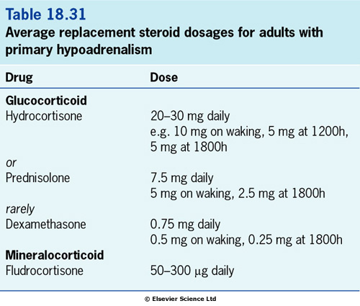

Slide 13
Adequacy of glucocorticoid dose is judged by:
clinical well-being and restoration of normal, but not excessive, weight
normal cortisol levels during the day while on replacement hydrocortisone (this cannot be used for synthetic steroids).
Fludrocortisone replacement is assessed by:
restoration of serum electrolytes to normal
blood pressure response to posture (it should not fall > 10 mmHg systolic after 2 minutes' standing)
suppression of plasma renin activity to normal.

Slide 14
Patient advice
All patients requiring replacement steroids should:
know how to increase steroid replacement dose for intercurrent illness
carry a 'Steroid Card'
wear a Medic-Alert bracelet (or similar), which gives details of their condition so that emergency replacement therapy can be given if found unconscious
keep an (up-to-date) ampoule of hydrocortisone at home in case oral therapy is impossible, and the general practitioner has to be called.

Slide 15
Management of acute hypoadrenalism
Clinical context: hypotension, hyponatraemia, hyperkalaemia, hypoglycaemia, dehydration, pigmentation often with precipitating infection, infarction, trauma or operation.
The major deficiencies are of fluid, salt, steroid and glucose.
Assuming normal cardiovascular function, the following are required:
One litre of normal saline should be given over 30-60 minutes with 100 mg of intravenous bolus hydrocortisone.
Subsequent requirements are several litres of saline within 24 hours (assessing with central venous pressure line if necessary) plus hydrocortisone, 100 mg i.m., 6-hourly, until the patient is clinically stable.
Glucose should be infused if there is hypoglycaemia.
Oral replacement medication is then started, unless unable to take oral medication, initially hydrocortisone 20 mg, 8-hourly, reducing to 20-30 mg in divided doses over a few days.
Fludrocortisone is unnecessary acutely as the high cortisol doses provide sufficient mineralocorticoid activity - it should be introduced later.

Slide 16
Secondary hypoadrenalism
This may arise from hypothalamic-pituitary disease (inadequate ACTH production) or from long-term steroid therapy leading to hypothalamic-pituitary-adrenal suppression

Slide 17
Phaeochromocytoma

Slide 18
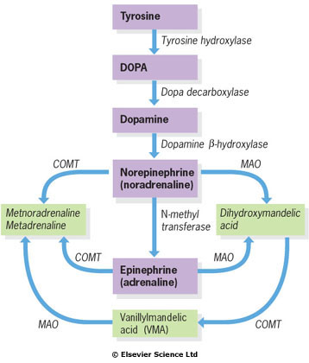
Synthesis and metabolism
of catecholamines.
COMT, catechol-O-methyl transferase;
MAO, monoamine oxidase.
dihydroxyphenylalanine

Slide 20
Diagnosis Specific tests are:
1. Measurement of urinary metabolites preferably metanephrines rather than vanillylmandelic acid (VMA) - screening test;
Normal levels on three 24-hour collections of metanephrines virtually exclude the diagnosis.
2. Plasma and urinary catecholamines are measured directly.

Slide 21
Diagnosis
3. Clonidine suppression and glucagon stimulation tests may be appropriate, but should only be performed in specialist centers.
4. CT scans, initially of the abdomen, are helpful to localize the tumours which are often large.
5. MRI usually shows the lesion clearly.
6. Scanning with [131I] metaiodobenzylguanidine (mIBG) produces specific uptake in sites of sympathetic activity with about 90% success. It is particularly useful with extra-adrenal tumours.

Slide 22
Treatment
1. Tumours should be removed if this is possible.
Medical preoperative and perioperative treatment:
complete alpha- and beta-blockade with phenoxybenzamine (20-80 mg daily initially in divided doses), then propranolol (120-240 mg daily), plus transfusion of whole blood to re-expand the contracted plasma volume.
2. When operation is not possible - combined alpha- and beta-blockade.

Slide 23
Aldosteronism
Aldosteronism is a syndrome associated with hypersecretion of the mineralocorticoid aldosterone.
In primary aldosteronism the cause for the excessive aldosterone production resides within the adrenal gland;
in secondary aldosteronism the stimulus is extraadrenal.

Slide 24
Primary Aldosteronism.
Causes:
aldosterone-producing adrenal adenoma (Conn's syndrome).
adrenal carcinoma.
bilateral cortical nodular hyperplasia (idiopathic hyperaldosteronism, and/or nodular hyperplasia) - solitary adenoma is not found at surgery.

Slide 25
Aldosteronism
Aldosteronism is twice as common in women as in men, usually occurs between the ages of 30 and 50, and is present in approximately 1% of unselected hypertensive patients.
However, the prevalence may be as high as 10%, depending on the criteria and study population. Most of this difference is not secondary to the prevalence of patients with an aldosteronoma but rather because of the inclusion of those with bilateral hyperplasia.
In many patients with clinical and biochemical features of primary aldosteronism, a solitary adenoma is not found at surgery. Instead, these patients have bilateral cortical nodular hyperplasia. In the literature, this disease is also termed idiopathic hyperaldosteronism, and/or nodular hyperplasia. The cause is unknown.

Slide 26
Pathophysiology
Hypersecretion of aldosterone increases the renal distal tubular exchange of intratubular sodium for secreted potassium and hydrogen ions, with progressive depletion of body potassium and development of hypokalemia.
Most patients have diastolic hypertension, which may be very severe, and headaches. The hypertension is probably due to the increased sodium reabsorption and extracellular volume expansion.
Potassium depletion is responsible for the muscle weakness and fatigue and is due to the effect of potassium depletion on the muscle cell membrane. The polyuria results from impairment of urinary concentrating ability and is often associated with polydipsia.

Slide 27
Signs and Symptoms
Hypokalemia
Diastolic hypertension (due to the increased sodium reabsorption and extracellular volume expansion)
Headaches
Muscle weakness and fatigue (potassium depletion)
Polyuria (impairment of urinary concentrating ability)
Polydipsia
Electrocardiographic and roentgenographic signs of left ventricular enlargement
Electrocardiographic signs of potassium depletion:
include prominent U waves
cardiac arrhythmias, premature contractions
ST depression, T wave invertion
Edema is absent (in the absence of associated diseases)
Structural damage to the cerebral circulation, retinal vasculature, and kidney occurs.
Proteinuria (50% of patients)
Renal failure (15%)

Slide 28
Laboratory Findings.
Hypokalemia may be severe (<3 mmol/L) and reflects body potassium depletion, usually >300 mmol.
Hypernatremia is due to sodium retention, a concomitant water loss from polyuria, and a resetting of the osmostat.
Metabolic alkalosis and elevation of serum bicarbonate are a result of hydrogen ion loss into the urine and migration into potassium-depleted cells.
Serum magnesium levels may be reduced if hypokalemia is severe.

Slide 29
Diagnosis.
The criteria for the diagnosis
of primary aldosteronism are:
diastolic hypertension without edema,
hyposecretion of renin (as judged by low plasma renin activity levels) that fails to increase appropriately during volume depletion (upright posture, sodium depletion),
hypersecretion of aldosterone that does not suppress appropriately in response to volume expansion.

Slide 30
Differential Diagnosis
Patients with hypertension and hypokalemia may have either primary or secondary hyperaldosteronism .
A useful maneuver to distinguish between these conditions is the measurement of plasma renin activity.
Secondary hyperaldosteronism in patients with accelerated hypertension is due to elevated plasma renin levels; in contrast, patients with primary aldosteronism have suppressed plasma renin levels.
Indeed, in patients with a serum potassium concentration of <2.5 mmol/L, a high ratio of plasma aldosterone to plasma renin activity in a random sample is usually sufficient to establish the diagnosis of primary aldosteronism without additional testing.

Slide 31
Differential Diagnosis.
Primary aldosteronism - suppressed plasma renin levels and high aldosterone levels.
Secondary hyperaldosteronism - elevated plasma renin levels.
Nonaldosterone mineralocorticoid states - suppressed plasma renin activity but low aldosterone levels.
Idiopathic bilateral nodular hyperplasia - less severe hypokalemia, lower aldosterone secretion, and higher plasma renin activity than in patients with primary aldosteronism.
Unilateral lesion - postural decrease in plasma aldosterone and elevated plasma 18-hydroxycorticosterone levels
Adenomas that secrete deoxycorticosterone (DOC) - reduced plasma renin activity levels, but aldosterone levels are either normal or reduced.

Slide 32
TREATMENT
surgical excision of the adenoma (laparoscopic approach is favored).
dietary sodium restriction
aldosterone antagonist, e.g., spironolactone (25-100 mg every 8 h), eplerenone (mineralocorticoid receptor blocker)
Side effects of spironolactone:
gynecomastia
decreased libido
impotence.

