Slide 1
Diabetes Mellitus
Volgograd State Medical University
The Internal Disease Department
PhD, MD, Prof. AR Babaeva

Slide 2
DEFINITION
Diabetes mellitus (DM) refers to the group of metabolic disorders characterized by chronic hyperglycemia which is a result of impaired insulin secretion or insulin action or both. Chronic hyperglycemia leads to damage, dysfunction and failure of vital organs (kidneys, heart, blood vessels, eyes)
Acad. I.I.Dedov (National guidelines on DM)

Slide 3
DIABETES MELLITUS EPIDEMIOLOGY
• Diabetes mellitus (DM) is a chronic debilitating condition that affected more than 150 million adults worldwide in the year 2000, and this number is expected to reach 300 millions in the year 2025.
• At present, approximately 17 million adults in the United States have diabetes, with 5 to 6 million unaware of their disease.
In RF DM prevalence is accounted for 5-7% of population

Slide 4
PHYSIOLOGY
• In the postabsorptive state, the majority of glucose metabolism takes place in insulin-independent tissues with 50% occurring in the brain, 25% in the splanchnic area (liver plus gastrointestinal tissues), and the remaining 25% in insulin-dependent tissues (primarily muscle and to a lesser extent, adipose tissue).
Approximately 85% of endogenous glucose production is derived from the liver, and the remaining 15% is produced by the kidney. Following glucose ingestion, the increase in plasma glucose concentration stimulates insulin release, leading to increased glucose uptake by splanchnic and peripheral tissues and suppression of endogenous glucose production (gluconeogenesis and glycogenolysis).
Insulin inhibits lipolysis, causing a decrease in the plasma level of free fatty acid, and further enhancement of muscle glucose uptake and inhibition of hepatic glucose production.
• In the absence of insulin, gluconeogenesis and glycogenolysis proceed unchecked, and lipolysis liberates free fatty acids, which will undergo â-oxidation and produce ketone bodies.

Slide 5
An outline of glucose metabolism
Blood glucose levels in health rarely stray outside the range- 3.5-8.0 mmol/L (63-144 mg/dL). Fasting blood glucose range is 3.5-5.5mmol/L
Liver is the principal organ of glucose homeostasis.
Glucose utilization
The brain is the major consumer of glucose.
Other tissues, such as muscle and fat, are facultative glucose consumers.
Hormonal regulation
In the fasting state insulin regulates glucose release by the liver.
In the postprandial state it additionally facilitates glucose uptake by fat and muscle.

Slide 6
Fasting and postprandial effects of insulin

Slide 7
Glucose transport
Glucose-transporter (GLUT) proteins carry glucose through the membrane into cells.
The insulin receptor
Glycoprotein (400 kDa) straddle the cell membrane of many cells.
One consequence of insulin receptor activation is migration of the GLUT-4 glucose transporter to the cell surface and increased transport of glucose into the cell.
The insulin-receptor complex is then internalized by the cell, insulin is degraded, and the receptor is recycled to the cell surface.

Slide 8
CLASSIFICATION
1. Type 1- IDDM (autoimmune – type 1a, idiopathic – type 1b)
2. Type 2- NIDDM
3. Miscellaneous types (MODY 1-6 subtypes, secondary DM)
4. Gestational DM
5. Prediabetes (IGT, IFG)

Slide 9
CLASSIFICATION
• Type 1 (previously designated insulin-dependent diabetes mellitus [IDDM])
An immune-mediated disease (type 1a) in which the β-islet cells of the pancreas are destroyed, resulting in severe insulin deficiency; antibodies to insulin and β-cell components (eg, glutamic acid decarboxylase [GAD] antibodies) are often present. Associated with HLA DR3, DR4 genotype; DR2 appears to be protective. Patients are ketosis prone without treatment and usually younger than 35 years of age at onset. Less than 50% of monozygotic twins and 10% to 15% of siblings develop type 1 diabetes.
Idiopathic type 1 (type 1b) diabetes has the same characteristics without the autoimmune components.

Slide 10
CLASSIFICATION
Type 2 (previously designated noninsulin-dependent diabetes [NIDDM])
A disease of insulin resistance with beta-cell dysfunction. Resistance occurs at the level of muscle and adipose tissue resulting in defective glucose disposition and increased fasting and postprandial gluconeogenesis and glycogenolysis.
Insulin levels can be elevated, normal, or low; 30% to 40% of patients require insulin treatment. Eighty percent of patients are obese (except in Asian populations where obesity is <60%). Patients are usually older than 40 years of age, but there is an increasing prevalence in young obese people. 25% of probands have an affected parent or sibling.

Slide 11
CLASSIFICATION
Gestational diabetes mellitus (GDM) refers to diabetes diagnosed during pregnancy.
The glucose level usually returns to normal in the postpartum period.
GDM is associated with a higher risk for DM later in life.

Slide 12
CLASSIFICATION
Specific /Miscellaneous types
Can be caused by genetic defects in b-cell function (maturity-onset diabetes in the young [MODY] 1-6 subtypes) and in insulin action, or associated with some genetic syndromes.
Can be secondary to trauma or primary disease of the pancreas (chronic pancreatitis, pancreonecrosis, tumor, pancreatectomy).
Some endocrinopathies are associated with insulin resistance (ie, acromegaly, Cushing’s syndrome, glucagonoma, hyperthyroidism, and pheochromocytoma).
Can be drug or chemical induced (pentamidine, glucocorticoids,
phenytoin, thiazides, beta-blockers, nicotinic acid)
Can be secondary to certain infections (congenital rubella, parotitis virus, cytomegalovirus).

Slide 14
CLASSIFICATION
• Prediabetes
Impaired glucose uptake by cells but with blood glucose levels below the criteria for diabetes
Classified as either impaired glucose tolerance (IGT) or impaired fasting glucose (IFG)

Slide 15
Types of diabetes
Primary
Secondary
Type 1 diabetes (insulin-dependent diabetes mellitus)
Type 2 diabetes (non-insulin-dependent diabetes mellitus)

Slide 16
The spectrum of diabetes:
a comparison of type 1 and type 2 diabetes mellitus.
 | Type 1 (insulin depend) | Type 2 (non-insulin depend)
Epidemiology | Younger (usually <30 years of age) Usually lean Increased in those of N.European ancestry Seasonal incidence | Older (usually >30 years of age) Often overweight All racial groups, increased in peoples of Asian, African, Polynesian and American-Indian ancestry
Heredity | HLA-DR3 or DR4 in >90% 30-50 % concordance in identical twins | No HLA links 50 % concordance in identical twins
Pathogenesis | Autoimmune disease: Islet cell antibodies Autoimmunity to glutamic acid decarboxylase (GAD) Insulitis Association with other autoimmune disease Immunosuppression after diagnosis delays beta-cell destraction | No immune disturbance Insulin resistance
Clinical | Insulin deficiency May develop ketoacidosis Always need insulin | Partial insulin deficiency May develop hyperosmolar state 50% come to need insulin when beta-cells fail after many years
Biochemical | Eventual disappearance of C-peptide | C-peptide persists

Slide 17
SIGNS AND SYMPTOMS AT PRESENTATION
• Classic triad is polyuria, polydipsia, and polyphagia.
• Type 1 and some type 2 patients with concurrent illness can present with diabetic ketoacidosis (DKA)
DKA symptoms include nausea, vomiting, abdominal pain, hyperventilation (Kussmaul breathing), lethargy, and fruity breath.
• Blurred vision occurs when glucose in the lens is converted to sorbitol which produces an osmotic changeand results in lens swelling.
• Type 2 diabetes can present as an incidental laboratory finding without signs or symptoms; in contrast, some patients with type 2 diabetes can present with long-term sequelae such as neuropathy, dermopathy, and retinal or renal pathology.

Slide 18
Type 1 diabetes mellitus
Epidemiology
Type 1 diabetes is a disease resulting in insulin deficiency.
Type 1 diabetes is prominent as a disease of childhood.
A 'slow-burning' variant with slower progression to insulin deficiency occurs in later life and is sometimes called latent autoimmune diabetes of adults (LADA).

Slide 19
Clinical clues for distinguishing LADA from NIDDM:
weight loss
hyperglycaemia which fails to correct with diet and tablet treatment
the presence of 3+ or more ketonuria
autoantibody tests indicating autoimmune disease.

Slide 20
Type 2 diabetes mellitus
Epidemiology
Is common in all populations.
The disease may be present in a subclinical form for years before diagnosis.
The incidence increases with age and degree of obesity.
Diabetes prevalence increases with age.

Slide 21
Causes of type 2 diabetes
Type 2 diabetes is a polygenic disorder, but the genes responsible for the great majority of cases of type 2 diabetes have yet to be identified.
A rare variant of type 2 diabetes is referred to as 'maturity-onset diabetes of the young' (MODY).
This is dominantly inherited.
Six variants have been described.
The different MODY genotypes are associated with different clinical phenotypes.

Slide 22
Clinical presentation of diabetes
Acute and subacute presentations often overlap.
Acute presentation
polyuria (osmotic diuresis)
thirst (loss of fluid and electrolytes)
weight loss (fluid depletion and the accelerated breakdown of fat and muscle)
ketoacidosis

Slide 23
Subacute presentation
thirst, polyuria and weight loss are usual features
lack of energy
visual blurring (owing to glucose-induced changes in refraction)
pruritus vulvae
balanitis (Candida infection)

Slide 24
Complications as the presenting feature
staphylococcal skin infections
retinopathy noted during a visit to the optician
a polyneuropathy causing tingling and numbness in the feet and hands
impotence
arterial disease, resulting in myocardial infarction or peripheral gangrene.

Slide 25
DIAGNOSIS
CRITERIA FOR NONPREGNANT INDIVIDUALS
Fasting blood glucose (FBG) greater than 126 mg/dL (7.0 mmol/l) on two separate days, or overt symptoms of diabetes with random glucose levels elevated above 200 mg/dL (11.0 mmol/l),
or a blood glucose level greater than 200 mg/dL (11.0 mmol/l) following an oral glucose tolerance test (OGTT) using a 75-gram glucose challenge. (The two hour OGTT is rarely required.)

Slide 26
The glucose tolerance test is only required for
borderline cases and for diagnosis
of gestational diabetes
The glucose tolerance test - WHO criteria
Adult: 75 g glucose in 300 mL water.
Child: 1.75 g glucose/kg bodyweight.
Only a fasting and a 120-min sample are needed.
Results are for venous plasma - whole blood values are lower.
Note: There is no such thing as mild diabetes.
All patients who meet the criteria for diabetes are liable to disabling long-term complications.

Slide 27
CRITERIA FOR PREDIABETES
• IGT is defined by a blood glucose greater than40 mg/dL but less than 200 mg/dL 2 hours after a 75-gram OGTT.
• IFG is defined by a FBG greater than 100 mg/dL but less than 126 mg/dL

Slide 28
Impaired glucose tolerance and impaired fasting glucose
'Impaired glucose tolerance' (IGT) is not a clinical entity but a risk factor for future diabetes and cardiovascular disease.
Impaired fasting glucose (IFG) is also considered as a risk factor or prediabetes

Slide 29
Asymptomatic diabetes
Glycosuria or a raised blood glucose may be detected on routine examination in individuals who have no symptoms of ill-health.
Glycosuria is not diagnostic of diabetes but indicates the need for further investigations.
About 1% of the population have renal glycosuria.

Slide 30
Physical examination at diagnosis
New WHO diagnostic criteria - 1999
New WHO criteria are:
Fasting plasma glucose > 7.0 mmol/L (126 mg/dL)
Random plasma glucose > 11.0 mmol/L (200 mg/dL)
One abnormal laboratory value is diagnostic in symptomatic individuals; two values are needed in asymptomatic people.

Slide 31
Diagnosis and investigation of diabetes
The diagnosis is usually simple. Blood glucose is so closely controlled by the body that even small deviations become important.
In symptomatic patients, a single elevated plasma glucose ≥ 11 mmol/L, measured by a reliable method, indicates diabetes.
In asymptomatic or mildly symptomatic patients, the diagnosis is made on:
two, fasting venous plasma glucose levels above 7.0 mmol/L (126 mg/dL); OR
two, random values ≥11.1 mmol/L (200 mg/dL) in venous plasma.
A glucose tolerance test is only needed for borderline cases.

Slide 32
CRITERIA FOR DIAGNOSIS OF GDM
• Pregnant women with a fasting plasma glucose (FPG) greater than 95 mg/dL or with a 1-hour postprandial glucose greater than 130 mg/dL following 50 grams of oral glucose should receive a 3-hour OGTT using a 100-gram glucose bolus.
The diagnosis of GDM requires any two of the four plasma glucose values at fasting, 1, 2, and 3 hours to exceed 95 mg/dL, 180 mg/dL, 155 mg/dL, and 140 mg/dL, respectively.
Women with GDM should be screened 6 to 12 weeks postpartum for diabetes or prediabetes

Slide 33
CRITERIA FOR SCREENING ASYMPTOMATIC INDIVIDUALS
• Testing for DM should be considered in all individuals at age 45 years and older, and, if normal, it should be repeated at 3-year intervals.
• Testing should be considered at a younger age or more frequently in individuals who match the following criteria:
Obese (body mass index [BMI] >25 kg/m2)
First-degree relative with a diagnosis of diabetes
Member of a high-risk ethnic population (African American, Hispanic, and Native American)
Delivered a baby weighing > 4 kg or diagnosed with GDM
Hypertension (>140/90 mm Hg), peripheral vascular disease, acanthosis nigricans, or polycystic ovarysyndrome
High-density lipoprotein (HDL) cholesterol level <35 mg/dL and/or triglyceride level >250 mg/dL
IGT or IFG on previous testing

Slide 34
CHRONIC COMPLICATIONS
FACTORS CONTRIBUTING TO DEVELOPMENT OF COMPLICATIONS
• Glycemic control correlates with complications
• Duration of diabetes
• Genetic factors
• Coexisting medical problems: eg, hypertension, dyslipidemia, obesity

Slide 35
Microvascular complications
The disease process is of particular danger in three sites:
retina
renal glomerulus
nerve sheaths

Slide 36
1. Diabetic eye disease
the most common is diabetic retinopathy
cataracts
glaucoma
external ocular palsies
(a mononeuritis)

Slide 37
RETINOPATHY: Staged as mild, moderate, severe, or very severe
• Nonproliferative diabetic retinopathy (NPDR) occurs eventually in all type 1 and >60% of type 2 diabetes. Usually subclinical with microaneurysms, dot-blot hemorrhages and hard exudates. Macular edema or hemorrhages near the fovea may cause severe vision impairment.
• Proliferative diabetic retinopathy (PDR) occurs in 25% of type 1 diabetes after 15 years, and in >70% of type 1 and 25% of type 2 diabetes over the lifetime of the patient. Neovascularization with retinal tears, detachments, and scarring can lead to severe vision impairment or blindness. Can be associated with neovascular glaucoma (caused by neovascularization of the iris or rubeosis).
• Clinically significant macular edema can coexist with either NPDR or PDR Secondary to thickening with impaired perfusion of the central macula, threatening central vision
DR Major cause of vision loss especially in type 2 diabetes
Responds to early photocoagulation therapy

Slide 38
Pathological changes in the peripheral retina (excluding
the macula) in diabetic retinopathy: the action needed.
 | Fundoscopy/photography findings | Action needed
Background retinopathy | Microaneurysms ( not haemorrhages) Blot haemorrhages Hard exudates | Annual screening only
Pre-proliferative retinopathy | Cotton wool spots Venous beading Venous loops Intraretinal microvascular abnormalities | Non-urgent referral to an ophthalmologist
Proliferative retinopathy | New blood vessel formation Preretinal haemorrhage Vitreous heamorrhage | Urgent referral to an ophthalmologist
Advanced retinopathy | Retinal fibrosis Traction retinal detachment | Urgent referral to an ophthalmologist – but much vision already lost.

Slide 39
Cataracts
Senile cataracts develop some 10-15 years earlier in diabetic patients than in the remainder of the population.

Slide 40
2. The diabetic kidney
The kidney may be damaged by diabetes in three main ways:
glomerular damage (Kimmelstiel-Wilson lesion - both diffuse and nodular glomerulosclerosis)
ischaemia resulting from hypertrophy of afferent and efferent arterioles
ascending infection.
DN occurs in 20-40% of pts and is the main cause of end-stage renal disease.

Slide 41
NEPHROPATHY
• Diabetic nephropathy occurs in 20% to 40% of patients with diabetes and is the leading cause of end-stage renal disease (ESRD) in industrialized nations.
• Clinical course
Hyperfiltration at the onset of diabetes.
Silent phase with no albuminuria, but early glomerular lesions may last for 10-15 years.
Microalbuminuria is the first clinical sign after 5–15 years: 30 to 300 mg/24 h (20–200 mcg/min)
After an additional 5-10 years, patients will develop nephrotic range proteinuria and decreasing glomerular filtration rate (GFR)
End-stage renal failure occurs in almost all patients with nephrotic range proteinuria.

Slide 42
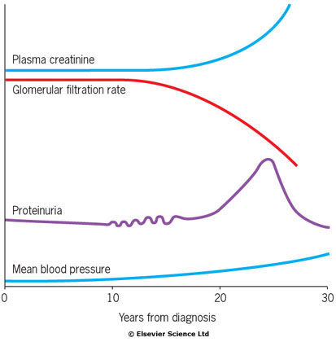
Schematic representation of the natural history of nephropathy
The typical onset is 15 years after diagnosis. Intermittent proteinuria leads to persistent proteinuria.In time, the plasma creatinine rises as the glomerular filtration rate falls.

Slide 43
Clinical course of DN (C.E.Mogensen)
1. Hyperfiltration
2. Silent phase with no albuminuria
3. Microalbuminuria (30-300 mg/24h) is the first clinical sign after 5-15 years
4. Proteinuria and decreased glomerular filtration rate (GFR)
5. Renal failure

Slide 44
Albuminuria
Microalbuminuria may be tested for by radioimmunoassay or by using special dipsticks.
Proteinuria:
plasma creatinine is normal
the average patient is only some 5-10 years from end-stage renal failure
may induce a transient nephrotic syndrome, with peripheral oedema and hypoalbuminaemia.

Slide 45
Patients with nephropathy
typically show:
a normochromic normocytic anaemia
a raised erythrocyte sedimentation rate (ESR)
hypertension
a rise in plasma creatinine on late stage

Slide 46
ДИАБЕТИЧЕСКАЯ НЕФРОПАТИЯ
Диабетическая нефропатия (ДН) - специфическое поражение почек при СД, сопровождающееся формированием узелкового или диффузного гломерулосклероза, терминальная стадия которого характеризуется развитием хронической почечной недостаточности (ХПН).
СТАДИИ ХРОНИЧЕСКОЙ БОЛЕЗНИ ПОЧЕК (ХБП) У БОЛЬНЫХ СД
СКФ* (мл/мин/1,73 м²) | Больные СД
 | С признаками поражения почек (по анализам мочи и/или данным визуализирующих методов исследования) | Без признаков поражения почек
> 90 | 1 | Норма
89 - 60 | 2 | Норма
59 - 30 | 3 | 3
29 - 15 | 4 | 4
< 15 или диализ | 5 | 5
* СКФ - скорость клубочковой фильтрации.

Slide 47
Диагноз ДН в соответствии с классификацией ХБП
При выявлении у больного СД микроальбуминурии или протеинурии будет ставиться диагноз с уточнением стадии ХБП (в зависимости от СКФ):
ДН, стадия микроальбуминурии, ХБП 1,2,3 или 4;
ДН, стадия протеинурии, ХБП 1,2,3 или 4;
ДН, ХБП 5 (лечение заместительной почечной терапией).
При выявлении у больного СД снижения СКФ < 60 мл/мин, в отсутствие других признаков поражения почек (микроальбуминурии, протеинурии) будет ставиться диагноз:
ХБП 3 или 4;
ХБП 5 (лечение заместительной почечной терапией).

Slide 48
Ischaemic lesions
Arteriolar lesions with hypertrophy and hyalinization of the vessels.
It leads to ischaemic damage to the kidneys.
Infective lesions
Urinary tract infections ( more common in women)
Untreated infections in diabetics can result in renal papillary necrosis, in which renal papillae are shed in the urine.

Slide 49
Macrovascular complications
Diabetes is a risk factor
in the development of atherosclerosis!

Slide 50
'Syndrome X' or 'the metabolic syndrome':
type 2 diabetes+ hypertension+ central obesity+ lipid abnormalities

Slide 51
MACROVASCULAR DISEASE
• Coronary artery disease (CAD) is the major cause of mortality in patients with diabetes, develops prematurely and is equally prevalent in men and women. The United Kingdom Prospective Diabetes Study (UKPDS) showed an 11% increased CAD risk for each 1% increase in HbA1c.
• Diabetes is independently correlated with an increased incidence of cerebrovascular disease.
• Peripheral vascular disease, when present, is associated with an increased incidence of infection, gangrene, and amputation.

Slide 52
The excess risk to diabetics compared
with the general population increases as one moves down the body:
Stroke is twice as likely.
Myocardial infarction is 3-5 times as likely and women with diabetes lose their premenopausal protection from coronary artery disease.
Amputation of a foot for gangrene is 50 times as likely.

Slide 53
NEUROPATHY
• Can be focal or diffuse
• Usually presents as sensorimotor neuropathy and/or autonomic neuropathy
• Sensorimotor neuropathy:
Distal symmetric polyneuropathy is the most
common form of diabetic neuropathy and is characterized by paresthesias, sensory loss, and motor weakness of the distal nerves.

Slide 54
Neuropathy
The following varieties of neuropathy occur:
symmetrical mainly sensory polyneuropathy (distal) – most common
acute painful neuropathy
mononeuropathy and mononeuritis multiplex
cranial nerve lesions
isolated peripheral nerve lesions
diabetic amyotrophy
autonomic neuropathy

Slide 55
Diabetic autonomic neuropathy
Major clinical manifestations of diabetic autonomic neuropathy include the following:
Cardiovascular: resting tachycardia, exercise intolerance, orthostatic hypotension, and lack of variation in heart rate during activities.
Gastrointestinal: mild dysphagia, nausea, vomiting, early satiety, constipation, diarrhea, fecal incontinence.
Genitourinary: urinary retention and/or incontinence;urinary tract infections; erectile dysfunction in men; and vaginal dryness, decreased perineal sensation, and dyspareunia in women.
Sudomotor: hyperhidrosis and heat intolerance in the upper torso or anhidrosis in the lower extremities and neurovascular dysfunction.

Slide 56
The cardiovascular system
Vagal neuropathy results in:
tachycardia at rest
loss of sinus arrhythmia
the heart become denervated (resembling a transplanted heart)
cardiovascular reflexes such as the Valsalva manoeuvre are impaired
postural hypotension (loss of sympathetic tone to peripheral arterioles)
a warm foot with a bounding pulse is sometimes seen in a polyneuropathy (peripheral vasodilatation)

Slide 57
Gastrointestinal tract
Vagal damage can lead to:
gastroparesis, often asymptomatic
diarrhoea
diarrhoea and steatorrhoea may occur owing to small bowel bacterial overgrowth; treatment is with antibiotics is effective

Slide 58
Bladder involvement
Loss of tone, incomplete emptying, and stasis (predisposing to infection) can occur, and may ultimately result in an atonic, painless, distended bladder.
Impotence
This is common. The first manifestation is incomplete erection which may in time progress to total impotence.

Slide 59
FOOT COMPLICATIONS
Sensorimotor and autonomic neuropathy and peripheral arterial disease (PAD) contribute to diabetic foot complications including
skin breakdown,
altered foot structure,
with redistribution of weight-bearing,
and subsequent proclivity to ulcers, infection, and amputation

Slide 60
The diabetic foot
Ischaemia, infection and neuropathy combine to produce tissue necrosis. Although all these factors may coexist, the ischaemic and the neuropathic foot (Table) can be distinguished

Slide 62
4. Infections
Skin
staphylococcal infections (boils, abscesses, carbuncles)
mucocutaneous candidiasis
Gastrointestinal tract
chronic periodontitis
rectal and ischiorectal abscess formation (when control very poor)
Urinary tract
urinary tract infections (in women)
pyelonephritis
perinephric abscess
Lungs
staphylococcal and pneumococcal pneumonia
Gram-negative bacterial pneumonia
tuberculosis

Slide 63
OTHER COMPLICATIONS
• Dermopathy Shin spots, necrobiosis lipoidica diabeticorum (NLD), bullous diabeticorum, carbuncles, and folliculitis
• Connective tissue abnormalities (Reduced flexibility, Dupuytren contractures, shoulder capsulitis)
• Common and unusual infections
Vaginal candidiasis, oral candidiasis, intertriginous infections
Mucormycosis
Malignant otitis externa
Emphysematous cholecystitis and pyelonephritis
Abscesses and necrotizing soft tissue infections

Slide 64
Chemotaxis and phagocytosis by polymorphonuclear leucocytes is impaired because at high blood glucose concentrations neutrophil superoxide generation is impaired.
Infections may lead to loss of glycaemic control, and are a common cause of ketoacidosis.

Slide 65
5. Skin and joints
Joint contractures in the hands are a common consequence of childhood diabetes.
Thickened, waxy skin can be noted on the backs of the fingers (due to glycosylation of collagen ).
The condition is sometimes referred to as diabetic cheiroarthropathy.
Osteopenia in the extremities is also described in type 1 diabetes but rarely leads to clinical consequences

Slide 66
Treatment
Тhe principles of treatment:
remove of the consequences of the insulin deficiency
prevent the chronic complications of the diabetes

Slide 67
1. Patient education
The patient must:
know the signs of the diabetic decompensation, hypoglycaemia.
check blood and urine glucose levels with stripes.
compose diet
control physical activity
regulate the dose of the hypoglycemic drugs

Slide 68
2. Diet
2.1. Calories.
On the ideal weight (height-100):
Decreased weight – 25 cal/kg
Normal weight – 20 cal/kg
Obesity 1-2 degree – 17 cal/kg
Obesity 3 degree – 15 cal/kg

Slide 69
2.2. Regimen – 4-6 meals.
2.3. Composition of the food
Carbohydrate – 50-60 % of total calories
Protein – 15-20 % of total calories
Fat – 25-30 % of total calories
Saturated fat+ trans fat < 7% of total calories
Cholesterol < 200 mg/d
Sodium < 2300 mg/d
2.4. Fiber-rich products (fiber>130g/1000cal
2.5. Artificial sugars

Slide 70
2.6. No alcohol
2.7. Calculation of the diet calories by the bread units (BU)
1 BU contains 10-12g of carbohydrate = 25g of the white or 30g of the black bread
1 BU requires 1-2 Insulin units

Slide 71
PHYSICAL ACTIVITY
• Regular exercise has been shown to improve blood glucose control, reduce cardiovascular risk factors, contribute to weight loss, and improve well being.
• At least 150 min/wk of moderate-intensity aerobic physical activity (50–70% of maximum heart rate) and/or at least 90 min/wk of vigorous aerobic exercise (>70% of maximum heart rate) distributed over at least 3 d/wk is recommended.
• Consider a graded exercise test with electrocardiographic (ECG) monitoring before prescribing an exercise regimen. The intensity of the regimen should exceed the demands of everyday living in previously sedentary diabetic individuals (whose 10-year risk of a coronary event is likely to be ≥10%).

Slide 72
PHYSICAL ACTIVITY
Exercise in insulin-treated patients must be coordinated with meals and insulin use.
• Exercise can exacerbate hyperglycemia or ketosis in type 1 diabetics if vigorous activity is performed when metabolic control is poor.
In individuals taking insulin and/or insulin secretagogues, physical activity can promote hypoglycemia if the medication dose or carbohydrate consumption is not altered. To avoid hypoglycemia, consider ingestion of 15 to 30 grams of carbohydrate for each 30 minutes of exercise, or reduce the dose of rapid or short-acting insulin prior to exercise.
Self-monitoring of blood glucose (SMBG) is recommended before and after vigorous exercise.

Slide 73
PHARMACOLOGIC ANTIGLYCEMIC THERAPY
• Oral antiglycemic agents should be used in type 2 patients who have failed diet therapy alone.
Oral agents can be used in combinations or in conjunction with insulin in type 2 patients and can also be used in combination with other available antiglycemic (insulin-enhancing) agents.
• Other insulin-enhancing agents including glucagonlike peptide-1 (GLP-1) agonists, dipeptidyl eptidase-4 inhibitors, and synthetic amylin agonists are now available.
• The comparative profile of available antiglycemic agents for treatment of type 2 diabetes is summarized in next table

Slide 74
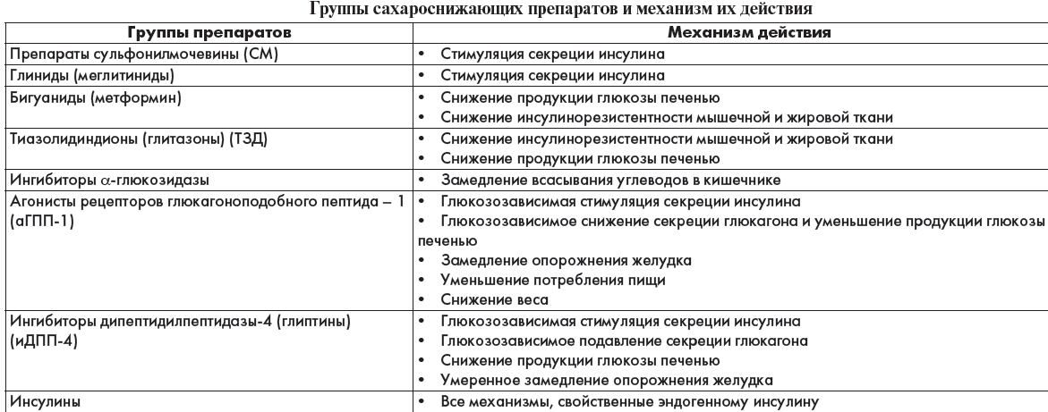

Slide 75
Type 1 diabetes treatment
Type 1 diabetes is best treated with a combination of background basal insulin and premeal short- or rapidacting insulin.
The basal insulin is preferably initiated as insulin glargine, although twice daily neutral protamine Hagedorn (NPH) insulin or insulin detemir are alternative approaches.
The rapid-acting insulin analogues are preferred for prandial coverage.
• Many patients with type 1 diabetes can benefit from continuous subcutaneous insulin infusion therapy delivere by commercially available insulin pumps.

Slide 76
Ultra-short/Rapid-acting insulin: Insulin lyspro (Humalog),Insulin asparte (Novorapid), Insulin Glulysin (Apidra)
Onset of action - 5-15 min
A maximal effect - 1- 2 hours
Duration of action - 4-5 hours
Short-acting insulin – soluble insulin (Actrapid, Humulyne Regular)
Onset of action - 30-60 min
A maximal effect - 2-4 hours
Duration of action - 6-8 hours
Intermediate-acting insulin – Ptotaphane, Humulyne NPH, Insuman Basal and others:
Onset of action - 1-2 hours
A maximal effect - 4-12 hours
Duration of action - 18-22 hours
Long-acting insulin – Glargine (Lantus), Detemir (Levemir):
Onset of action - 4-6 hours
Duration of action - 28-36 hours
Extra-long-acting insulin – Degludek (Tresiba) > 42 h

Slide 77
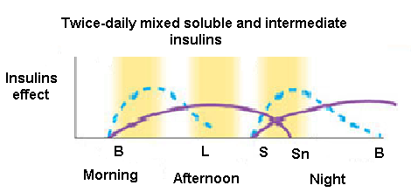
Principles of insulin treatment
Young people with type 1 diabetes can be started on injections
of an intermediate-acting insulin at a dose of 8-10 U twice-daily.
Insulin regimens.
Profiles of soluble insulins are shown as dashed lines, intermediate- or long-
acting insulin as solid lines and rapid-acting insulin analogues as dotted lines.
The arrows indicate when the injections are given.
B, breakfast; L, lunch; S, supper; Sn, snack (bedtime).
Target blood glucose values should normally be:
4-6 mmol/L before meals
< 8 mmol/L after meals
Hb Alc < 6,5%

Slide 78
Regimen 1 of insulin treatment
The total insulin requirement is estimated to be 0.5 to 0.6 units/kg; lower initial doses can be used in patients with low body weight or those demonstrating high sensitivity to insulin.
Approximately two-thirds of the total insulin is given 30 minutes before breakfast using a combination intermediate (NPH) and short-acting (regular) insulin in a ratio of 2:1.
One-sixth of the total dose is given 30 minutes before supper as regular insulin and one-sixth of the total insulin dose is given as NPH at bedtime.
Rapid-acting insulin can be substituted for regular and given immediately before the meal.
Adjust dosages according to glucose response; do not adjust NPH insulin more often than every 48 hours

Slide 79
Regimen 2 of insulin treatment
Half of the total dose is administered using a basal long-acting insulin (glargine) given at bedtime. Approximately one-sixth of the total dose is given as a rapid-acting insulin administered thrice daily before meals, adjusted to match the intake of dietary carbohydrate. Begin with an insulin-to-carbohydrate ratio of 1:15 (1 unit of insulin per 15 grams carbohydrate) and adjust the ratio according to glucose response.
A supplemental rapid-acting insulin dose (correction dose) can be added to correct for blood-glucose excursions before meals. The correction dose is calculated by dividing 1800 by the total daily insulin requirement to estimate the amount of blood glucose (mg/dL) lowered per 1 unit of insulin. (Experts disagree as to the denominator [1800 versus 1700], and 1500 is substituted if regular insulin is used).
Adjust glargine according to the FBG, increasing by 1 to 2 units for each 20 mg/dL of FBG over 100 mg/dL, and allowing 5 days between further increments.
When glucose control is stable, glargine can be shifted to any convenient consistent time each day, although, glargine injection in the morning reduces the frequency of overnight and early morning hypoglycemia.
Approximately one-third of type 1 patients experience a waning effect of glargine before the end of a 24-hour cycle, and require splitting the dose to twice daily.
Twice daily injection of detemir is an alternative to glargine.

Slide 80
Indications for insulin treatment
Type 1 diabetes
Severe decompensation of diabetes (hyperglycemic crisis) due to infection, trauma, surgical operation, stress, other diseases.
Acute complications: ketoacidosis, hyperosmolar state, lactic acidosis
Pregnancy, lactation.
Diabetic nephropathy with chronic renal failure 2-3
Hepatic failure
Diabetic gangrene.
Cachexia.
No effect from oral hypoglycaemic drugs.
Contraindications for the treatment with oral hypoglycaemic drugs.
Severe surgical operations.
Exacerbation of the chronic infection (pyelonephritis, tuberculosis).

Slide 81
Complications of insulin therapy
1. At the injection site:
Shallow injections result in intradermal insulin delivery and painful, reddened lesions or even scarring.
Injection site abscesses occur but are extremely rare.
Local allergic responses.
Generalized allergic responses are rare.
Fatty lumps (lipohypertrophy)

Slide 82
2. Insulin resistance
Obesity.
Acanthosis nigricans (antibodies directed against the insulin receptor)
3. Weight gain
4. Hypoglycaemia during insulin treatment
This is the most common complication of insulin therapy.
Symptoms develop when the blood glucose level falls below 3 mmol/L
typically develop over a few minutes
with 'adrenergic' features of sweating, tremor and a pounding heartbeat.
physical signs: pallor and a cold sweat.
patients with long-standing diabetes appear pale, drowsy or detached.
behaviour is clumsy or inappropriate, and some become irritable or even aggressive.
patients develop convulsions during hypoglycaemic coma
hemiparesis that resolves within a few minutes when glucose is administered.

Slide 83
Urgent treatment of hypoglycaemia
1. Mild hypoglycaemia
Any form of rapidly absorbed carbohydrate will relieve the early symptoms, and sufferers should always carry glucose or sweets.

Slide 84
2. Severe hypoglycaemia
Blood should be taken for glucose estimation before treatment is given.
intravenous glucose (25-50 mL of 50% dextrose solution) followed by a flush of normal saline to preserve the vein (since 50% dextrose scleroses veins),or
intramuscular glucagon (1 mg)
oral glucose is given to replenish glycogen reserves once the patient revives.

Slide 85
INITIATION AND ADJUSTMENT OF THERAPY FOR TYPE 2 PATIENTS
• Lifestyle intervention is the first step in treating new onset type 2 diabetes.
However, as lifestyle intervention alone fails to achieve metabolic goals in most individuals, some diabetologists recommend the concurrent initiation of metformin, in the absence of contraindications.
• If lifestyle intervention and metformin fail to achieve glycemic goals, another medication should be added within 2 to 3 months (a sulfonylurea, or a thiazolidinedione, or insulin

Slide 86
Tablet treatment for type 2 diabetes
Sulphonylureas
Their principal action is to promote insulin secretion in response to glucose and other secretagogues.

Slide 87
Sulfonylureas
Sulfonylureas work by stimulating the pancreas to release more insulin and are only effective when there is some pancreatic beta-cell activity still present. These oral agents have been available for decades and are available in less expensive generic forms. Non-obese patients with type 2 diabetes are usually started on sulfonylureas.
Sulfonylureas are typically used if metformin alone does not adequately lower blood sugar; however, their effectiveness can decrease over time.
Choice of sulfonylurea depends upon:
indications, DM complications, cost
A common side effect is hypoglycemia (low blood sugar); however, shorter-acting agents such as glipizide (Glucotrol) and glimepiride (Amaryl) may have less risk of hypoglycemia.This class may also cause weight gain and is therefore not suitable for obese patients.
Sulfonyureas should not be used in patients with severe kidney disease. (>3 stage)

Slide 88
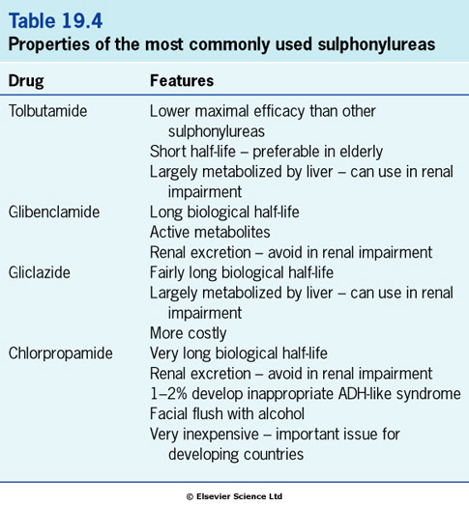

Slide 89
Meglitinides
Meglitinides are oral treatments that work by stimulating the pancreas to release insulin in response to a meal. They work similarly to sulfonylureas, but are safer to use in patients with kidney disease.
These agents are dosed 3 to 4 times a day, given before meals.
Hypoglycemia is a common side effect. Cough, runny or stuffy nose, sore throat are also more common side effects. If convulsions (seizures) or unconsciousness occur while taking repaglinide or nateglinide, hypoglycemia is likely

Slide 90
Biguanides
Metformin reduces gluconeogenesis and increases insulin sensitivity.
does not induce hypoglycaemia in normal volunteers.
may be given in combination with sulphonylureas or other oral drugs when a single agent has proved to be ineffective.

Slide 91
Metformin
Metformin is the only available biguanide; it is available in a cost-saving generic. In fact, metformin is the first drug of choice in most type 2 diabetic patients after a diagnosis.
It works by:
inhibiting the amount of glucose produced by the liver
increasing insulin-receptor binding
stimulating tissue uptake of glucose
Metformin does not stimulate the pancreas to make or release more insulin. It does not cause hypoglycemia or weight gain therefore obese patients with type 2 diabetes are usually started on biguanides.
Common side effects include abdominal discomfort, diarrhea, nausea or vomiting, loss of appetite, and metallic taste. Over time these side effects may lessen, and initial nausea may be relieved by taking metformin with food.

Slide 92
Thiazolidinediones
The thiazolidinediones ('glitazones') reduce insulin resistance by interaction with peroxisome proliferator-activated receptor-gamma (PPAR-gamma).
The glitazones lower circulating insulin relative to plasma glucose, but do not return glucose levels to normal.

Slide 93
Alpha-glucosidase inhibitors
Alpha-glucosidase inhibitors (acarbose, miglitole) slow the digestion of carbohydrates and delay glucose absorption. They work by inhibiting intestinal enzymes that digest carbohydrates, thereby reducing carbohydrate digestion after a meal, which lowers postprandial (after a meal) blood sugar elevation in diabetics.
They are not as effective as metformin or sulfonylureas at lowering blood glucose, but can be added to other treatments if needed.
Common side effects include:
abdominal pain
diarrhea
flatulence (gas)
which can worsen with higher doses. Start treatment with lower doses and titrate upwards to lessen adverse gastrointestinal side effects.

Slide 94
NOVEL DRUGS
GLP-1 receptor activators (Exenatide - bayetta , Liraglutide – victosa)
Increase insulin secretion
Decrease glucagon secretion
Decrease glucose production by liver
Dipeptidylpeptidase-4 inhibitors – glyptines
(Sitaglyptine - Yanuvia, Vildaglyptine- Galvus, Saxaglyptine - Ongliza)
Increase insulin secretion
Decrease glucagon secretion
Decrease glucose production by liver
Decrease food intake
Lower weight
Sodium glucose co-transporter 2 (SGLT2)-inhibitors – Gliflozins decrease glucose reabsorption in the kidney (Dapagliflozin, Empagliflozin, Canagliflozin). Enhance glycemic control, reduce BP, BW. Increase risk of DKA, UGT infections, hypoglycemia.

Slide 95
INCRETIN MIMETICS
The glucagon-like peptide 1 (GLP-1) agonists, or incretin mimetics (EXENATIDE, LIRAGLUTIDE) , are injectable agents that help the pancreas to produce insulin more efficiently. They bind to GLP-1 receptors and stimulate glucose dependent insulin release. These drugs inhibit glucagon secretion and slow gastric emptying. In turn, this prevents a steep rise in blood glucose levels after eating.
Clinically, they may be used:
as a third-line agent when oral medications are not fully successful in lowering blood sugar levels
in overweight type 2 diabetic patients who gain weight taking oral medication, as they can promote weight loss by suppressing appetite
Side effects include gastrointestinal problems like diarrhea, nausea, and rarely, pancreatitis. Patients with kidney impairment cannot use Byetta (EXENATIDE), Bydureon, or Adlyxin; the other agents should be used with caution. These drugs do not usually cause low blood sugar.

Slide 96
Dipeptidyl Peptidase 4 (DPP-4) Inhibitors
DPP-4 inhibitors (often called "gliptins“ : saxagliptine, sitagliptine, vildagliptine ) are oral medications that work by regulating the levels of insulin the body produces after a meal. These drugs inhibit the enzyme dipeptidyl peptidase 4 which results in increased activity of incretins, which inhibits glucagon release. Glucagon normally causes release of glucose into the blood.
The over effect of DPP-4 inhibitors is to:
increased insulin secretion from the pancreas in response to a meal
decrease gastric emptying
decrease blood sugar levels
This class of medication can be given with other oral agents when blood sugar levels are not at goal, as well in patients who cannot tolerate metformin or sulfonylureas; however, they are not usually used as first line treatments.

Slide 97
Selective Sodium-Glucose Transporter-2 (SGLT-2) Inhibitors
Sodium-glucose cotransporter-2 (SGLT-2) inhibitors are a class of oral antidiabetic drugs used in type 2 diabetes.
SGLT-2 inhibitors work by lowering the renal (kidney) glucose threshold, resulting in an increased amount of glucose being excreted in the urine. These agents are not used first line for type 2 diabetes treatment, but can be combined with other medications.
These agents will not lead to hypoglycemia (low blood sugar)
Common side effects may include:
vaginal yeast infections
urinary tract infections
increased urination
thirst
stomach pain
male genital yeast infections

Slide 98
Ингибиторы натрий-глюкозного котранспортера 2 типа (иНГЛТ-2) - глифлозины
Механизм действия
Снижают реабсорбцию глюкозы в почках
Снижают массу тела
Инсулиннезависимый механизм действия
Снижение HbA1c на 0,8-0,9%
Повышают риск ДКА!
Повышают риск уро-генитальных инфекций
Препараты:
-дапаглифлозин- форсига (5 мг, 10 мг)
-эмпаглифлозин – джардинс (10 мг, 25 мг)
- канаглифлозин – инвокана (100, 300 мг)
Кратность приема - 1 раз в сутки,
длительность действия 24 часа

Slide 99
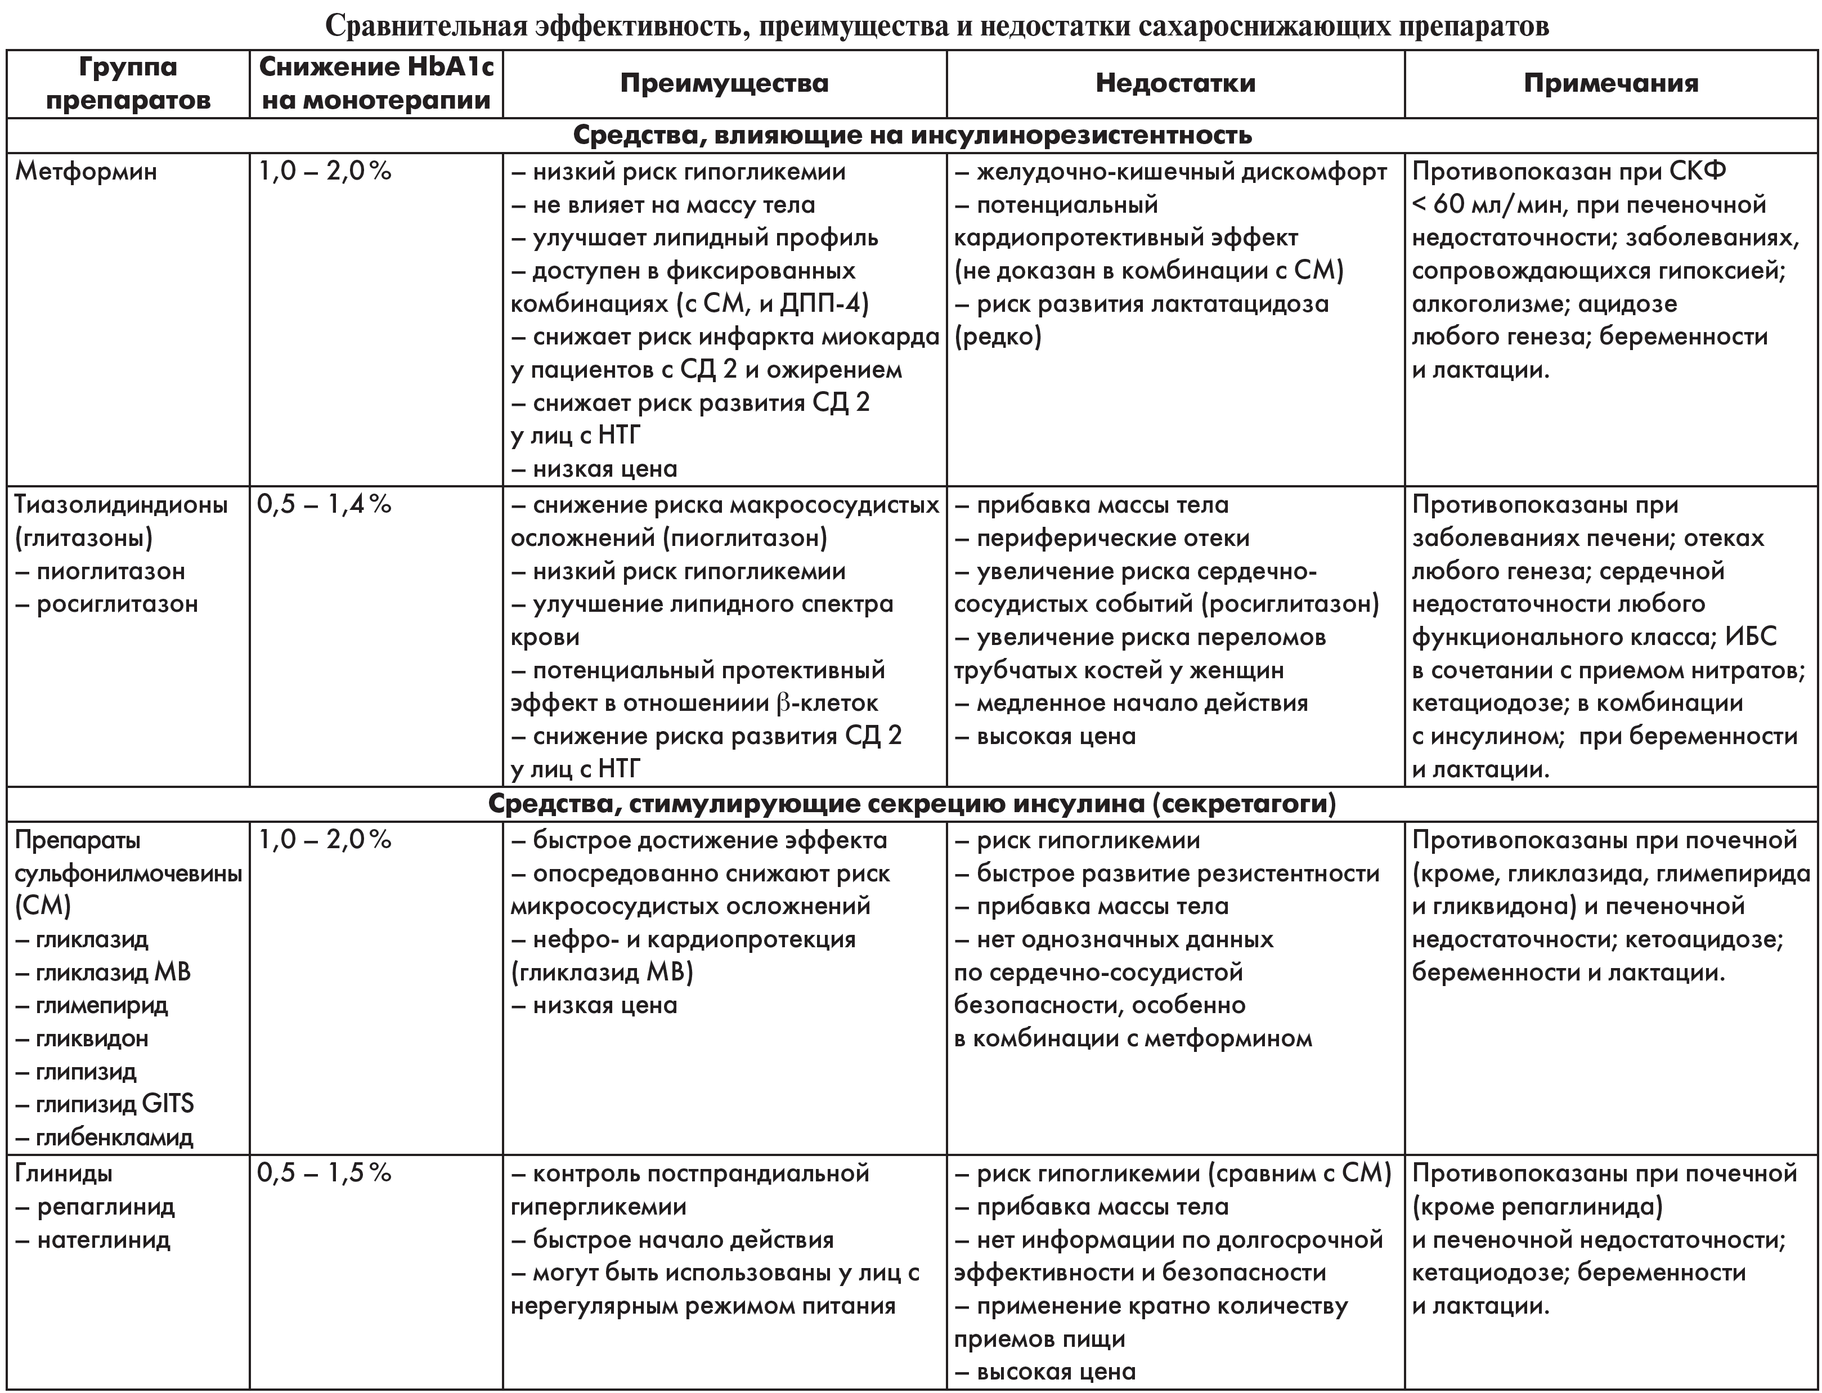

Slide 100
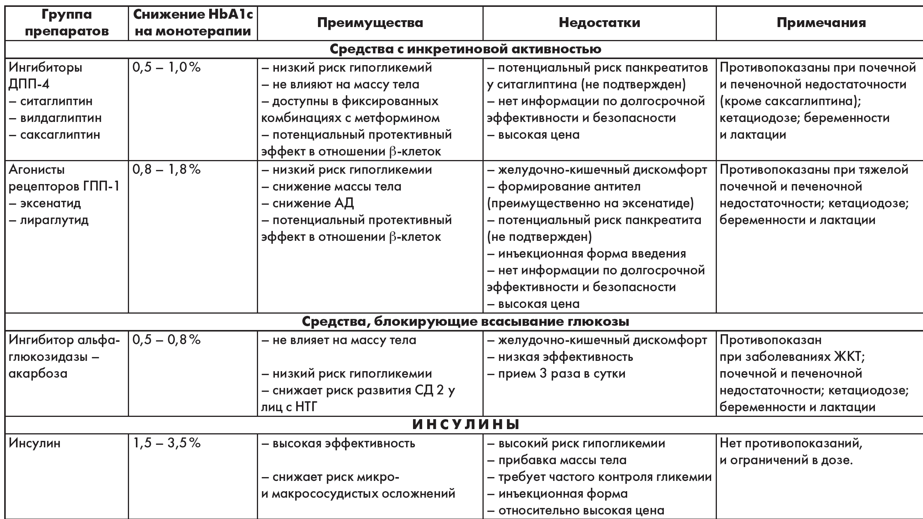

Slide 101
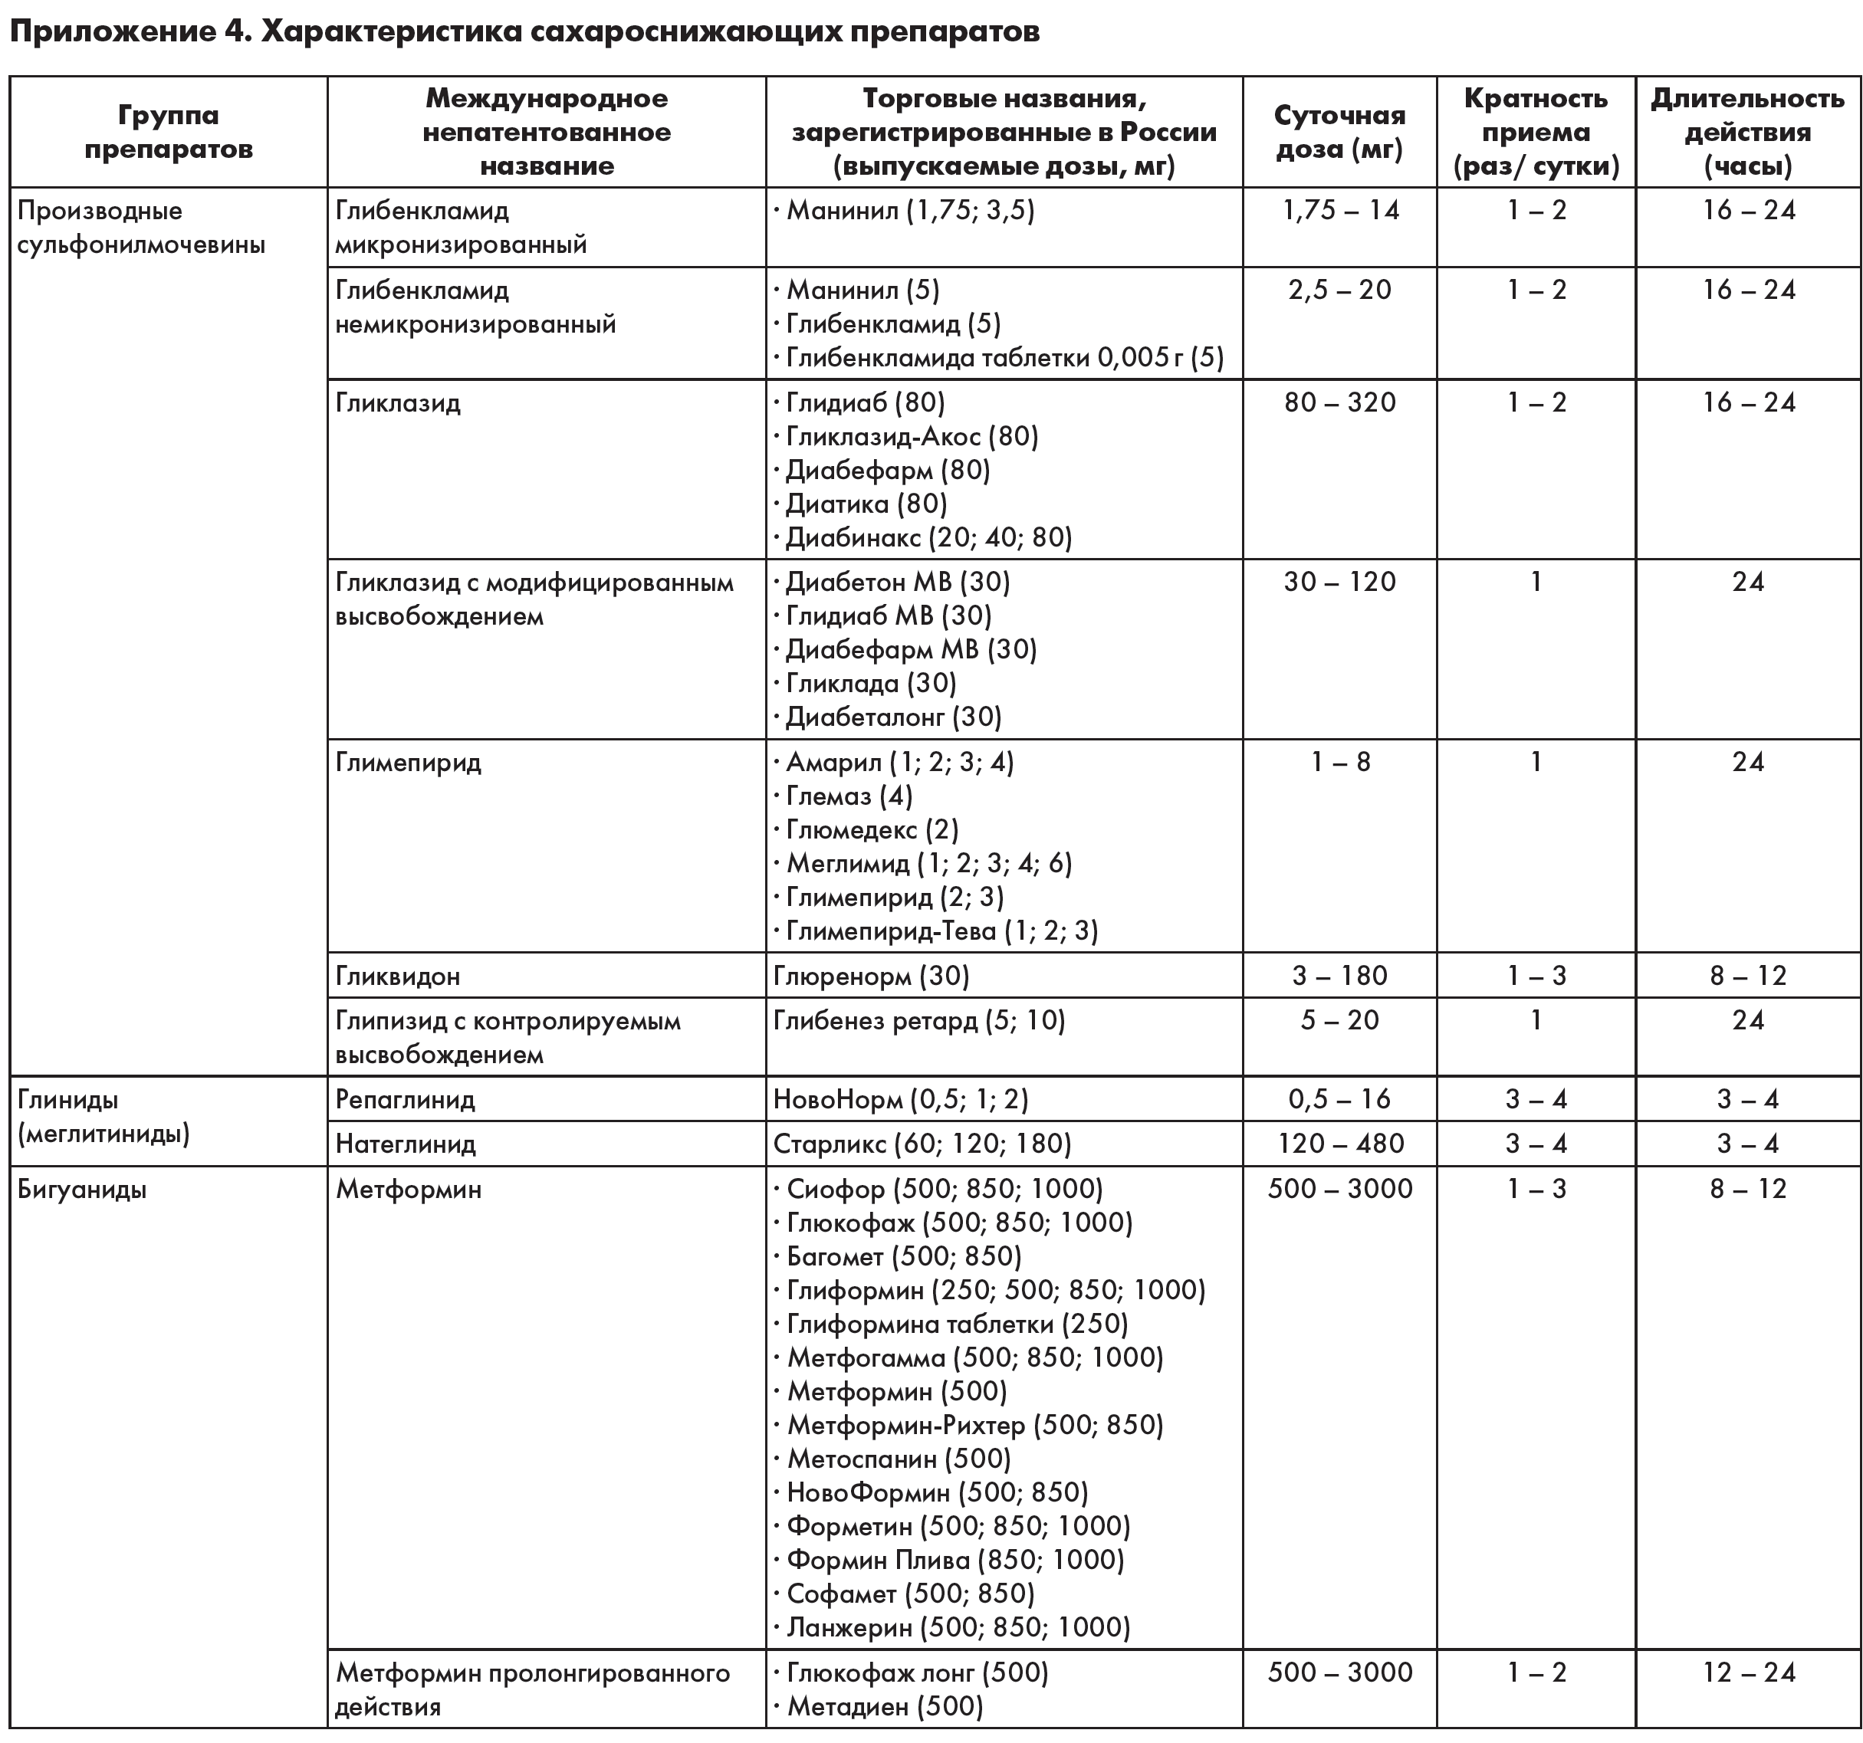

Slide 102
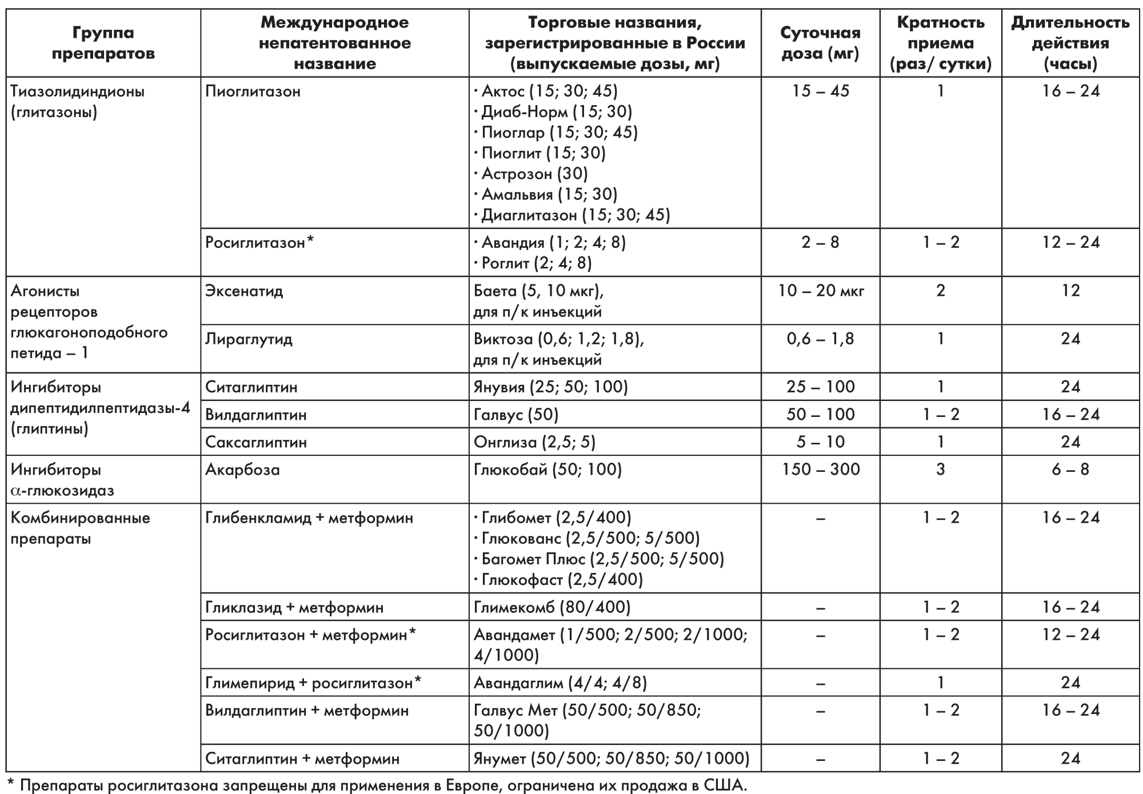

Slide 103
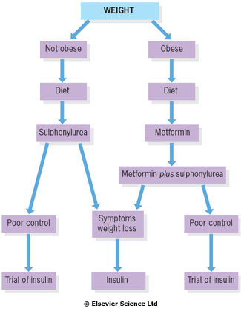
Type 2 diabetes
Conventional treatment pathway for type 2 diabetes.

Slide 104
Target HbAc1 levels depend on
Age
Life longevity expectation (<5 years)
Severity of DM complications
Easy hypoglycemia state
(from 6,5% to 8,5%)

Slide 105
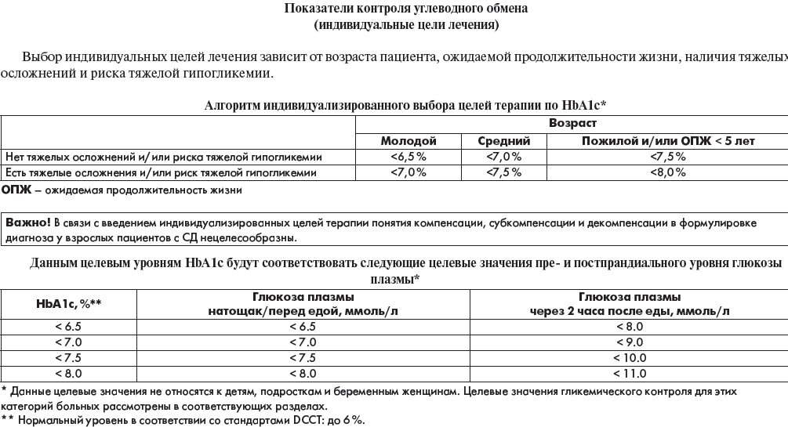

Slide 106
Diet is the first line of treatment, followed by metformin or DPPi for the overweight and a sulphonylurea for the lean.
Sulphonylureas and insulin should be used with caution in the obese since they predispose to weight gain.

Slide 110
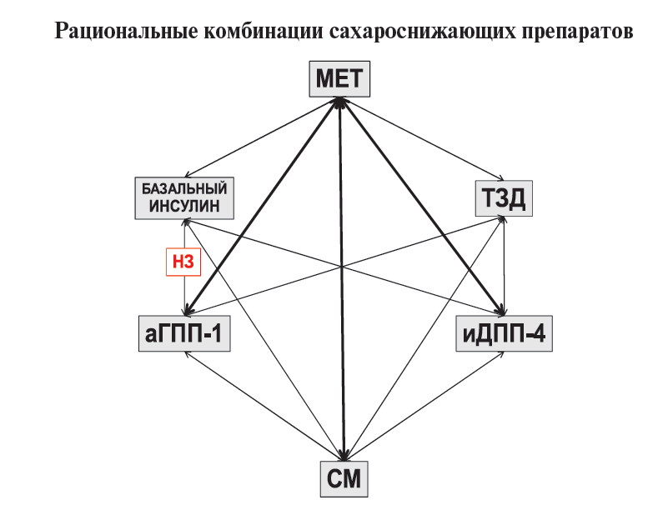

Slide 111
Criteria to assess the type 1 diabetes metabolic control
Fasting glucose level < 6 mmol/l (5-6 mmol/l)
After meal < 8 mmol/l (7,5-8mmol/l)
At bedtime < 7 mmol/l (6-7 mmol/l)
HbAlc 5-7% (<6.5-7.5%) depending on age, complications and history of hypoglycemia

Slide 112
Criteria to assess the type 2 diabetes metabolic control
Fasting glucose level < 5,5 mmol/l (5-5,5 mmol/l)
After meal <7,5 mmol/l
At bedtime 6-7 mmol/l (<7 mmol/l)
HbAlc < 6,5% (6,5%-7.5%) if there are no complications, hypoglycemia

Slide 113
Target levels of BP and cholesterol
BP should be controlled below 135/85 (in kidney damage < 130/80)
Total cholesterol < 4,5 mmol/l (better < 4,0 mmol/l)
LDL-Chol. <2,0- 1,8 mmol/l (<1.4 in CVD – very high risk)
HDL-Chol. > 1,0 (men) and > 1,2 in women
TG < 1,7 mmol/l

Slide 114
GLUCOSE MONITORING
• HbA1c is measured every 3 months during stabilization of therapy; once the targeted goal has been achieved, measurement can be limited to 6-month intervals.
• There is a correlation of HbA1c with long-term complications.
• The target HbA1c is <7.0% (American Diabetes Association [ADA] recommendation) or <6.5% (American Association of Clinical Endocrinologists [AACE] recommendation), eg, as close to the normal range (<6.0%) as possible without subjecting the patient to repetitive episodes of hypoglycemia.
• Self-monitoring of blood glucose (SMBG) is essential to properly adjust therapy, particularly insulin.

Slide 115
Regular checks for patients with diabetes
Checked each visit
Review of self-monitoring results and current treatment.
Talk about targets and change where necessary.
Talk about any general or specific problems.
Continued education.
Checked at least once a year
Biochemical assessment of metabolic control (e.g. glycated Hb test).
Measure bodyweight.
Measure blood pressure.
Measure plasma lipids (except in extreme old age).
Measure visual acuity.
Examine state of retina (ophthalmoscope or retinal photo).
Test urine for proteinuria.
Test blood for renal function (creatinine).
Check condition of feet, pulses and neurology.
Review cardiovascular risk factors.
Review self-monitoring and injection techniques.
Review eating habits.

Slide 116
Management of complications
1. Management of diabetic eye disease
Maculopathy and proliferative retinopathy - retinal laser photocoagulation.
In patients with disc new vessels - panretinal photocoagulation.
Surgery can be performed to try to salvage some vision after vitreous haemorrhage and to treat traction retinal detachment in advanced retinopatny.

Slide 117
2. Management of diabetic nephropathy.
Angiotensin-converting enzyme inhibitors (ACEI) or an angiotensin receptor II antagonist (ARA) are the drugs of choice.
They should also be used in normotensive patients with persistent microalbuminuria.
Oral hypoglycaemic agents partially excreted via the kidney (e.g. chlorpropamide) must be avoided.

Slide 118
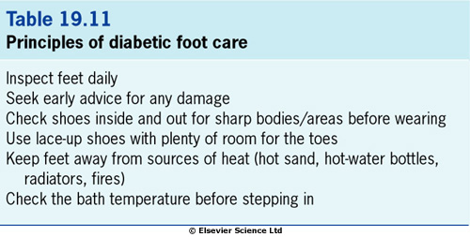
3. Management of diabetic foot.

Slide 119
Infection.
Early antibiotic treatment.
Ischaemia.
Doppler ultrasound stethoscope
Femoral arteriography
Abnormal pressure.
An ulcerated site must be kept non-weight-bearing.
special deep shoes
removable or non-removable casts of the leg.

Slide 120
Diabetic metabolic emergencies
Hyperglycemic crisis
Diabetic ketoacidosis (coma)
Hyperglycemic hyperosmolar state (coma)
Lactic acidosis (coma)
Hypoglycemic state (coma)

Slide 121
DIABETIC EMERGENCIES
• DKA and hyperglycemic hyperosmolar syndrome (HHS) are two of the most serious acute complications of diabetes.
• Hypoglycemia is another life-threatening acute complication requiring immediate treatment.

Slide 122
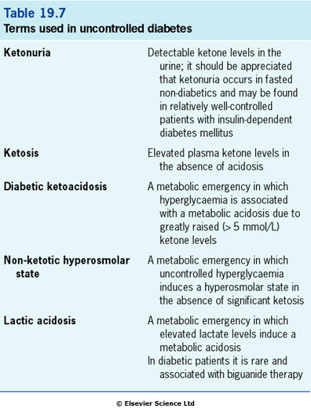

Slide 123
Diabetic metabolic emergencies
Diabetic ketoacidosis
Diabetic ketoacidosis is the hallmark of type 1 diabetes.
It is usually seen in the following circumstances:
-previously undiagnosed diabetes
-interruption of insulin therapy
-stress or intercurrent illness , common - infection

Slide 124
Diabetic ketoacidosis
Usually occurs in patients with type 1 diabetes;
can occur in patients with type 2 diabetes subjected to severe illness or stress
• Precipitating factors include:
- undiagnosed and untreated diabetes,
- omission of insulin or inadequate insulin treatment,
- trauma,
severe infection,
MI or cerebrovascular accident (CVA),
perioperative stress
severe physical or emotional stress.

Slide 125
Ketogenesis
Insulin deficiency
↓
Lipolysis
↓
Free fatty acids
↓
Ketone formation
(acetoacetate, acetone
and β-hydroxybutyrate)
↓
Acidosis

Slide 126
Pathogenesis
Hyperglycaemia Hyperketonaemia
↓ ↓
Osmotic diuresis Acidosis and vomiting
↓ ↓
Dehydration
↓
Renal hypoperfusion

Slide 127
Signs and symptoms
Typical of DKA include nausea, vomiting, abdominal pain, severe dehydration, hyperventilation (Kussmaul breathing),and lethargy or coma.
Symptoms and signs of DKA are produced by dehydration and acidosis
Manifestation of concomitant disease interfere to clinical picture

Slide 128
Clinical features
prostration
hyperventilation (Kussmaul respiration)
nausea
vomiting
abdominal pain
confusion and stupor are common
up to 5% present in coma
the eyeball is lax to pressure
the smell of ketones on the breath
the skin is dry
the body temperature is subnormal

Slide 129
Laboratory findings
Glucose usually above 250 mg/dL but occasionally lower.
Acidosis with low arterial pH (<7.3), low serum bicarbonate (<18 mEq/dL), and increased anion gap.
Positive serum and urine ketones.
Serum potassium usually initially high, but falls precipitously with insulin and fluid infusion, and correction of acidosis. Careful monitoring of the serum potassium concentration during treatment is essential.
Elevated serum blood urea nitrogen (BUN); elevation of creatinine may be a laboratory artifact because of ketone interference with the assay.
Hypophosphatemia may not be apparent until after therapy is initiated.
Elevated white blood cell (WBC) count can be caused by demargination of white blood cells in the absence of infection.

Slide 130
Anion gap
AG = [ Na + К] – ( [ Cl - ] + [HCO3 -] )
К = 4,0-5,6 mmol/l
Na = 135-155 mmol/l
Cl = 95-110 mmol/l
HCO3 = 21-25 mmol/l
рН = 7,35-7,45
Normal range 12 ± 4mmol/l

Slide 131
Diagnosis
Hyperglycaemia is demonstrated by dipstick, while a blood sample is sent to the laboratory for confirmation.
Ketonaemia is confirmed by centrifuging a blood sample and testing the plasma with a dipstick that measures ketones.
An arterial blood sample is taken for blood gas analysis.

Slide 132
Management
1. Replace the fluid losses with normal saline.
2. Replace the electrolyte losses.
Potassium is given as soon as insulin is started.
3. Restore the acid-base balance.
Bicarbonate is seldom necessary and is only considered if the pH is below 7.0 ([H+] > 100 nmol/L), and is best given as an isotonic (1.26%) solution.
4. Replace the deficient insulin.
Modest doses of insulin.
Soluble insulin is given as an intravenous infusion or as hourly intramuscular injections.
5. Monitor blood glucose closely.
Hourly measurement is needed in the initial phases of treatment.
6. Replace the energy losses.
When plasma glucose falls to near-normal values (12 mmol/L), saline infusion should be replaced with 5% dextrose containing 20 mmol/L of potassium chloride.

Slide 133
Guidelines for the diagnosis and management of diabetic ketoacidosis
Diagnosis
- Hyperglycaemia: measure blood glucose.
- Ketonaemia: test plasma with ketostix/Acetest.
- Acidosis: measure blood gases.
Investigations
- Blood glucose
- Urea and electrolytes
- Full blood count
- Blood gases
- Blood and urine culture
- Chest X-ray
- ECG
- Cardiac enzymes.
Phase 1 Management
Insulin: soluble insulin i.v. 6 units/hour by infusion, or 20 units i.m. stat. followed by 6 units i.m. hourly.
Fluid replacement: 0.9% sodium chloride with 20 mmol KCl per litre. An average regimen would be 1 L in 30 minutes,
then 1 L in 1 hour, then 1 L in 2 hours, then 1 L in 4 hours, then 1 L in 6 hours.
Adjust KCl concentration depending on results of 2 hours' blood K measurement.
IF:
Blood pressure below 80 mmHg, give plasma expander.
pH below 7.0 give 500 mL of sodium bicarbonate 1.26% plus 10 mmol KCl-. Repeat if necessary to bring pH up to 7.0.
Phase 2 Management
When blood glucose falls to 10-12 mmol/L swap infusion fluid to 1 litre 5% dextrose plus 20 mmol KCl- 6-hourly.
Continue insulin with dose adjusted according to hourly blood glucose test results.
Phase 3 Management
Once stable and able to eat and drink normally, transfer patient to four times daily subcutaneous insulin regimen
(based on previous 24 hours' insulin consumption, and trend in consumption).
Special measures
Broad-spectrum antibiotic if infection likely.
Bladder catheter if no urine passed in 2 hours.
Nasogastric tube if drowsy.
Consider CVP pressure monitoring if shocked or if previous cardiac or renal impairment.
Consider s.c. prophylactic heparin in comatose, elderly or obese patients.
Subsequent management
Monitor glucose hourly for 8 hours.
Monitor electrolytes 2-hourly for 8 hours.
Adjust K+ replacement according to results.

Slide 134
Problems of management
1. Hypotension.
This may lead to renal shutdown.
Treatment: plasma expanders (if the systolic blood pressure is below 80 mmHg
2. Coma.
Treatment: It is essential to pass a nasogastric tube to prevent aspiration.
3. Cerebral oedema.
Treatment: rehydration and use of hypertonic fluids such as 8.4% bicarbonate.
4. Hypothermia.

Slide 135
5. Late complications.
stasis pneumonia
deep-vein thrombosis
6. Complications of therapy.
hypoglycaemia
hypokalaemia (loss of K+ in the urine from osmotic diuresis)
pulmonary oedema
hyperchloraemic acidosis

Slide 136
Subsequent management
Intravenous dextrose and insulin are continued until the patient feels able to eat and keep food down.
The drip is then taken down and a similar amount of insulin is given as three injections of soluble insulin subcutaneously at meal times and a dose of intermediate-acting insulin at night.

Slide 137
Non-ketotic hyperosmolar state
Common precipitating factors include:
consumption of glucose-rich products and fluid depletion
concurrent medication such as thiazide diuretics or steroids,
intercurrent illness.
Age. Old people more readily become dehydrated.
The degree of insulin deficiency. This is less severe in non-ketotic coma.

Slide 138
HYPEROSMOLAR HYPERGLYCEMIC STATE (HHS)
Clinical features
Dehydration
Neurologic abnormalities confusing TIA or stroke
Stupor or coma.
• Laboratory findings
Blood glucose in excess of 600 mg/dL (>30 mmol/l),
mild acidosis caused by lactic acid (pH >7.3),
elevated serum osmolality (>320 mOsm/kg),
marked pre-renal azotemia
variable serum sodium concentration.

Slide 139
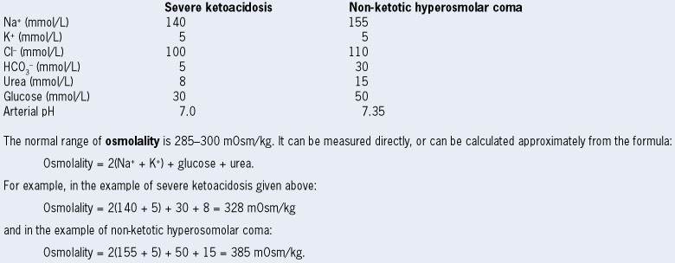
Clinical features
Electrolyte changes in diabetic ketoacidosis and
non-ketotichyperosmolar state

Slide 140
Examples of blood values
The normal anion gap is less than 17.
It is calculated as (Na+ + K+) - (Cl- + HCO3-).
In the example of ketoacidosis the anion gap is 40.
In the example of non-ketotic hyperosmolar coma the anion gap is 20.
Mild hyperchloraemic acidosis may develop in the course of therapy.

Slide 141
Investigations and treatment
The plasma osmolality is usually extremely high.
Patients are extremely sensitive to insulin and the glucose concentration may plummet.
The resultant change in osmolality may cause cerebral damage.
It is sometimes useful to infuse insulin at a rate of 3 U per hour for the first 2-3 h, increasing to 6 U/h if glucose is falling too slowly.
Normal saline is the standard fluid for replacement. Avoid half-normal saline (0.45%).
Prognosis
The reported mortality ranges as high as 20-30%.
Non-ketotic hyperglycaemia is not an absolute indication for subsequent insulin therapy, and survivors may do well on diet and oral agents.

Slide 142
Lactic acidosis
Lactic acidosis may occur in diabetic patients on biguanide therapy.
Patients present in severe metabolic acidosis with a large anion gap (calculated as (Na+ + K+) - (Cl- + HCO3-), normally less than 17 mmol/L), usually without significant hyperglycaemia or ketosis.
Treatment: rehydration and infusion of isotonic 1.26% bicarbonate.
The mortality is in excess of 50%.

Slide 143
Urgent treatment of hypoglycaemia
1. Mild hypoglycaemia
Any form of rapidly absorbed carbohydrate will relieve the early symptoms, and sufferers should always carry glucose or sweets.

Slide 144
2. Severe hypoglycaemia
Blood should be taken for glucose estimation before treatment is given.
intravenous glucose (25-50 mL of 50% dextrose solution) followed by a flush of normal saline to preserve the vein (since 50% dextrose scleroses veins),or
intramuscular glucagon (1 mg)
oral glucose is given to replenish glycogen reserves once the patient revives.

Slide 145
Recurrent severe hypoglycaemia
This affects 1-3% of insulin-dependent patients.
Most are adults who have had diabetes for more than 10 years.
The following factors may predispose to recurrent hypoglycaemia:
Overtreatment with insulin.
Excessive insulin doses.
Endocrine causes (pituitary insufficiency, adrenal insufficiency and premenstrual insulin sensitivity).
Alimentary causes (exocrine pancreatic failure and diabetic gastroparesis).
Renal failure.
Patient causes.

Slide 146
Recurrent ketoacidosis
This usually occurs in adolescents or young adults, particularly girls.
Metabolic decompensation may develop very rapidly.
It almost always occurs in the context of considerable psychosocial problems, particularly eating disorders.
Other causes include:
Iatrogenic. Inappropriate insulin combinations may be a cause of swinging glycaemic control.
Intercurrent illness. Unsuspected infections, including urinary tract infections and tuberculosis, may be present. Thyrotoxicosis can also manifest as unstable glycaemic control.

Slide 147
Brittle diabetes
There is no precise definition for this term, which is used to describe patients with recurrent ketoacidosis and/or recurrent hypoglycaemic coma.

Slide 148
Surgery
The procedure for insulin-treated patients is simple:
Long-acting and/or intermediate insulin should be stopped the day before surgery, with soluble insulin substituted.
Whenever possible, diabetic patients should be first on the morning theatre list.
An infusion of glucose, insulin and potassium is given during surgery. The insulin can be mixed into the glucose solution or administered separately by syringe pump. A standard combination is 16 U of soluble insulin with 10 mmol of KCl in 500 mL of 10% glucose, infused at 100 mL/h.
Postoperatively, the infusion is maintained until the patient is able to eat. Other fluids needed in the perioperative period must be given through a separate intravenous line and must not interrupt the glucose/insulin/potassium infusion. Glucose levels are checked every 2-4 hours and potassium levels are monitored. The amount of insulin and potassium in each infusion bag is adjusted either upwards or downwards according to the results of regular monitoring of the blood glucose and serum potassium concentrations.
The same approach is used in the emergency situation, with the exception that a separate variable-rate insulin infusion may be needed to bring blood glucose under control before surgery.
Non-insulin-treated patients should stop medication 2 days before the operation. Patients with mild hyperglycaemia (fasting blood glucose below 8 mmol/L) can be treated as non-diabetic. Those with higher levels are treated with soluble insulin prior to surgery, and with glucose, insulin and potassium during and after the procedure, as for insulin-treated patients.

Slide 149
Pregnancy and diabetes
Metabolic control of diabetes in pregnancy
The patient should perform daily home blood glucose profiles, recording blood tests before and 2 hours after meals.
Insulin requirements rise progressively, and intensified insulin regimens are generally used.
The aim is to maintain blood glucose and HbA1c levels as close to the normal range as can be tolerated.
General management
The patient is seen at intervals of 2 weeks or less at a clinic managed jointly by physician and obstetrician.
Retinopathy and nephropathy may deteriorate during pregnancy.

Slide 150
Obstetric problems associated with diabetes
stillbirth,
mechanical problems in the birth canal (fetal macrosomia, hydramnios and pre-eclampsia).
Ketoacidosis in pregnancy carries a 50% fetal mortality.
Neonatal problems
fetal macrosomia
hyaline membrane disease
neonatal hypoglycaemia
Gestational diabetes
This term refers to glucose intolerance that develops in the course of pregnancy and usually remits following delivery.
The condition is typically asymptomatic
Treatment: diet in the first instance, but most patients require insulin cover during the pregnancy. Insulin does not cross the placenta.

