Slide 1
Pituitary gland disease
Acromegaly
Hypopituitarism

Slide 2
Growth hormone excess: gigantism and acromegaly
GH stimulates skeletal and soft-tissue growth.
GH excess therefore produces gigantism in children
(if acquired before epiphyseal fusion)
and acromegaly in adults.

Slide 3
Tall stature
The most common causes are hereditary (two tall parents!), idiopathic (constitutional) or early development.
It can occasionally be due to hyperthyroidism.
Other causes include chromosomal abnormalities (e.g. Klinefelter's syndrome, Marfan's syndrome) or metabolic abnormalities.
GH excess is a very rare cause and is usually clinically apparent.

Slide 4
Acromegaly
This is due to a pituitary tumour in almost all cases.
Hyperplasia due to GHRH excess is very rare.
Incidence of acromegaly is approximately 3-4/million per year
Prevalence is about 50-80/million.

Slide 5
Clinical features
Symptoms and signs of acromegaly are shown in next figure.
One-third of patients present with changes in appearance,
one-quarter with visual field defects or headaches;
in the remainder the diagnosis is made by an alert observer in another clinic, e.g. GP, diabetic, hypertension, dental, dermatology.

Slide 7
Investigations
GH levels may exclude acromegaly if undetectable but a detectable value is non-diagnostic. Normal adult levels are < 1 mU/L for most of the day except during stress or a 'GH pulse'.
The glucose tolerance test is diagnostic. Acromegalics fail to suppress GH below 1 mU/L and some show a paradoxical rise; about 25% of acromegalics have a diabetic glucose tolerance test.

Slide 8
Investigations
IGF-1 levels are almost always raised in acromegaly - a single plasma level of IGF-1 reflects mean 24-hour GH levels and is useful in diagnosis.
Visual field defects are common.
MRI scan of pituitary - will almost always reveal the pituitary adenoma.

Slide 9
Investigations
Pituitary function - partial or complete anterior hypopituitarism is common.
Prolactin - mild to moderate hyperprolactinaemia occurs in 30% of patients. In some, the adenoma secretes both GH and prolactin.

Slide 10
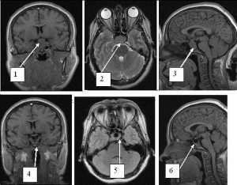
Pituitary visualisation

Slide 11
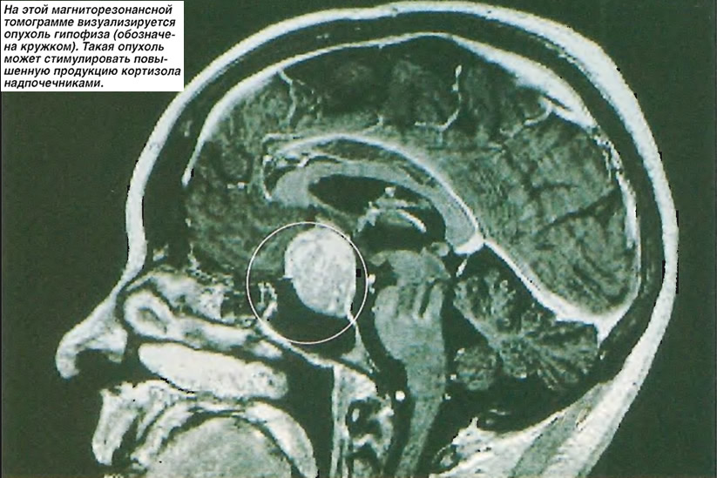

Slide 12
Management
Untreated acromegaly results in markedly reduced survival with most deaths from:
heart failure,
coronary artery disease
hypertension-related causes.
In addition, there is an increase in deaths due to neoplasia, particularly large-bowel tumours.

Slide 13
Treatment
Treatment is therefore indicated in all except the elderly or those with minimal abnormalities.
There is now consensus agreement that the aim of therapy should be to achieve a mean growth hormone level below 5 mU/L, which has been shown to reduce mortality to normal levels.

Slide 14
Management and treatment
The choice lies between:
trans-sphenoidal surgery (first-line therapy - minimally invasive technologies),
transfrontal surgery (for massive macroadenomas),
external radiotherapy (is combined with medium-term treatment with a somatostatin analogue or a dopamine agonist)

Slide 15
Drug treatment
Somatostatin analogues - octreotide, lanreotide (the treatment of choice in resistant cases),
dopamine agonists (are most effective in mixed growth-hormone-producing (somatotroph) and prolactin-producing (mammotroph) tumours) - bromocriptine 10-60 mg daily or cabergoline 0.5 mg daily (higher than for prolactinomas).

Slide 16
Surgery
Trans-sphenoidal surgery is generally agreed as the appropriate first-line therapy. The surgical access is throw sinus sphenoidalis. It will result in clinical remission in a majority of cases (60-80%) with pituitary microadenoma, but in only 50% of those with macroadenoma. Transfrontal surgery is rarely required except for massive macroadenomas.

Slide 17
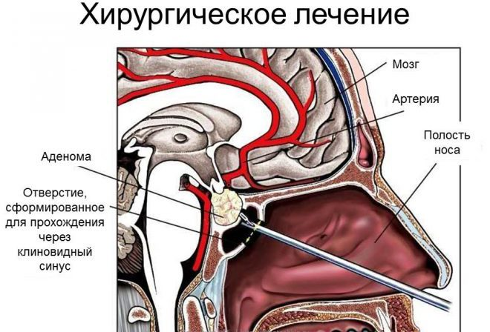

Slide 18
External radiotherapy
External radiotherapy is normally used after pituitary surgery fails to normalize GH levels rather than as primary therapy.
It is often combined with medium-term treatment with a somatostatin analogue or a dopamine agonist because of the slow biochemical response to radiotherapy, which may take 10 years or more.

Slide 19
Somatostatin analogues
Octreotide and lanreotide are synthetic analogues of somatostatin (GHRIH) which are the treatment of choice in resistant cases, and employed as a short-term treatment while other modalities become effective.
Long-acting preparations (monthly for octreotide, every 10-14 days for lanreotide) are now replacing older subcutaneous regimens. Both are generally well tolerated but are associated with an increased incidence of gallstones and are expensive.

Slide 20
Dopamine agonists
Dopamine agonists now play a lesser role. They can be given to shrink tumours prior to definitive therapy or to control symptoms and persisting GH secretion; they are probably most effective in mixed growth-hormone-producing (somatotroph) and prolactin-producing (mammotroph) tumours. The doses are bromocriptine 10-60 mg daily or cabergoline 0.5 mg daily (higher than for prolactinomas) but should be started slowly. Given alone they rarely reduce GH to 'safe' levels - but may be useful for mild residual disease or in combination with somatostatin analogues.

Slide 21
Growth hormone antagonists
Pegvisomant is a GH receptor antagonist which has its effect by binding to and preventing dimerization of the GH receptor.
It has shown considerable promise in clinical trials and has recently been licensed for use.
Its main role is likely to be in treatment of patients in whom GH cannot be reduced to safe levels with somatostatin analogues alone.

Slide 22
Outcomes
Complete cure is often slow, if possible at all. The choice lies between trans-sphenoidal surgery, transfrontal surgery, external radiotherapy, octreotide, and dopamine agonists.
Progress can be assessed by mean GH levels and by serial IGF-1 measurements.
When present, hypopituitarism should be corrected and concurrent diabetes and/or hypertension should be treated conventionally; both usually improve with treatment of the acromegaly

Slide 23
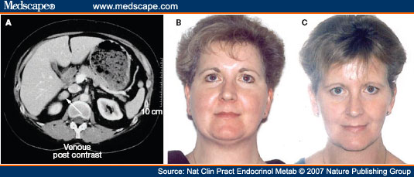
Treatment results in Cushing disease

Slide 24
Hypopituitarism
Pathophysiology:
Deficiency of hypothalamic releasing hormones or of pituitary trophic hormones is either selective or multiple.
There are, for example, rare isolated deficiencies of LH/FSH and ACTH, some of which may be:
congenital,
autoimmune or
idiopathic in nature

Slide 25
Multiple deficiencies - . Panhypopituitarism
Multiple deficiencies usually result from tumour growth or other destructive lesions.
GH and gonadotrophins are usually first affected.
Hyperprolactinaemia, rather than prolactin deficiency, occurs relatively early because of loss of tonic inhibitory control by dopamine.
TSH and ACTH are usually last to be affected.
Panhypopituitarism refers to deficiency of all anterior pituitary hormones; it is most commonly caused by pituitary tumours, surgery or radiotherapy.
Multiple deficiencies can also rarely result from congenital defects, e.g. mutation of the gene for the pituitary-specific transcription factor 'Pit-1' causes deficiency in GH, prolactin and TSH.

Slide 26
Posterior pituitary deficiency (hypothalamic cause)
Vasopressin and oxytocin secretion will be significantly affected only if the hypothalamus is involved, either by a hypothalamic tumour or by major suprasellar extension of a pituitary lesion.
Posterior pituitary deficiency is rare in an uncomplicated pituitary adenoma

Slide 27
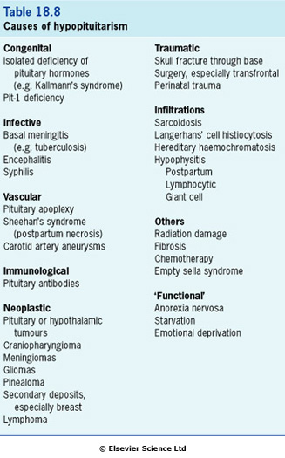

Slide 28
Clinical features
Symptoms of deficiency of a pituitary-stimulating hormone are the same as primary deficiency of the peripheral endocrine gland (e.g. TSH deficiency and primary hypothyroidism cause similar symptoms due to lack of thyroid hormone secretion).

Slide 29
Clinical features
tiredness and general malaise
slowness of thought and action, dry skin and cold intolerance (hypothyroidism)
mild hypotension, hyponatraemia and ultimately cardiovascular collapse (hypoadrenalism)
loss of libido, loss of secondary sexual hair, amenorrhoea and impotence (gonadotrophin and sex hormones deficiencies)
galactorrhoea and hypogonadism (hyperprolactinaemia)
weight gain (due to hypothyroidism) or weight loss (pituitary cachexia).
long-standing panhypopituitarism may give the classic picture of pallor with hairlessness ('alabaster skin').

Slide 30
Particular syndromes related to hypopituitarism are:
1. Kallmann's syndrome
This syndrome is isolated gonadotrophin (GnRH) deficiency.
anosmia or hyposmia (due to olfactory bulb agenesis or hypoplasia).
color blindness,
optic atrophy,
nerve deafness,
cleft palate,
renal abnormalities,
cryptorchidism,
neurologic abnormalities (mirror movements).

Slide 31
2. Sheehan's syndrome
This situation, now rare, is pituitary infarction following postpartum haemorrhage.
3. Pituitary apoplexy
A pituitary tumour may occasionally infarct or haemorrhage into itself. This may produce severe headache sometimes followed by acute life-threatening hypopituitarism.

Slide 32
4. The 'empty sella' syndrome
An 'empty sella' is sometimes reported on pituitary imaging.
This is due to:
defect in the diaphragma and extension of the subarachnoid space (cisternal herniation)
spontaneous infarction of a tumour.

Slide 33
Investigations
Each axis of the hypothalamic-pituitary system requires separate investigation. However, the presence of normal gonadal function (ovulatory/menstruation or normal libido/erections) suggests that multiple defects of anterior pituitary function are unlikely.
Tests range from the simple basal levels (e.g. T₄ or free T₄ for the thyroid axis), to stimulatory tests for the pituitary, and tests of feedback for the hypothalamus.

Slide 34
Tests for hypothalamic-pituitary (HP) function
All hormone levels are measured in plasma illness otherwise stated Tests shown in bold are those normally measured on a single basal 0900h sample in the initial assessment of pituitary function
Basal investigations
Axis | Pituitary hormone | End-organ product/function | Common dynamic tests | Other tests
Anterior pituitary HP-ovarian | LH FSH | Oestradiol Progesterone (day 21 of cycle) |  | Ovarian ultresound LHRH test
HP-testicular | LH FSH | Testosterone |  | Sperm count LHRH test
Growth | GH | IGF-1 IGF-8P3 | Insulin tolerance test | GH response to sleep, exercise or arginine infection GHRH test
Prolactin | Prolactin
HP-thyroid | TSH | Free T4, T3 |  | TRH test
HP-adrenal | ACTH | Cortisol | Insulin tolerance test Short synacthen (tetracosactide) test | Glucagon test CRH test Metyrapone test
Posterior pituitary Thirst and osmoregulation |  | Plasma / urine osmolality | Water deprivation test | Hypertonic saline infusion

Slide 35
Assessment of the hypothalamo-pituitary-adrenal
Assessment of the hypothalamo-pituitary-adrenal axis remains critical but controversial: basal 0900h cortisol levels above 500 nmol/L, and probably above 400 nmol/L, indicate an adequate reserve, while levels below 100 nmol/L predict an inadequate stress response. In many cases basal levels are equivocal and a dynamic test is essential: the insulin tolerance test is widely regarded as the 'gold standard' but the synacthen test, though an indirect measure, is used by many as a routine test of hypothalamic-pituitary-adrenal status. Overall the assessment of adrenal reserve is best left in the hands of a specialist endocrinologist

Slide 36
Insulin tolerance test
Indication
Diagnosis or exclusion of ACTH and growth hormone deficiency
Procedure
Should only be performed in experienced, specialist units
Exclude cardiovascular disease (ECG), epilepsy or unexplained blackouts; exclude severe untreated hypopituitarism (basal cortisol must be > 100 nmol/L; normal free T4)
Intravenous hydrocortisone and glucose available for emergency
Overnight fast, begin at 0800-0900h
Soluble insulin, 0.15 Units/kg, i.v. at time 0
Glucose, cortisol and GH at 0, 30, 45, 60, 90, 120 min

Slide 37
Normal response
Cortisol rises above 550 nmol/L* * Precise cortisol normal ranges are variable between laboratories and assays - appropriate local reference ranges must be used
GH rises above 20 mU/L (severe deficiency = < 9 mU/L (3 ng/L))
Glucose must be < 2.2 mmol/L to achieve adequate stress response

Slide 38
Replacement therapy for hypopituiterism
Adrenal | Hydrocortisone 15-40 mg daily (starting dose 10 mg on rising / 5 mg evening) (Normally no need for mineralocorticoid replacement)
Thyroid | Thyroxine 100-150 µg daily
Gonactal Male Female Fertility | Testosterone intramuscularly, orally, as patch or implant Cyclical oestrogen/progestogen orally or as patch HCG plus FSH (purified or recombinant) or pulsatile GnRH to produce testicular development, spermatogenesis or ovulation
Growth | Recombinant human GH used routinely to achieve normal growth in children Also advocated for replacement therapy in adults where GH has effects on muscle mass and well-being
Thirst | Desmopressin (DDAVP) 10-20 mg one the three times daily by nasal spray or orally 100-200 mg three times daily Carbamazepine and thiazides are rarely used in mild diabetes insipidus
Breast (Prolactin inhibition) | Dopamine agonist as replacement inhibition (e.g. bromocriptine 2.5-15 mg daily)

Slide 39
Replacement therapy
Steroid and thyroid hormones are essential for life. Both are given as oral replacement drugs, as in primary thyroid and adrenal deficiency, aiming to restore the patient to clinical and biochemical normality and levels may be monitored by routine hormone assays.

Slide 40
Replacement therapy
Sex hormone production is replaced with androgens and oestrogens, both for symptomatic control and to prevent long-term problems related to deficiency (e.g. osteoporosis). When fertility is desired, gonadal function may be stimulated directly by human chorionic gonadotrophin (HCG, mainly acting as LH), purified or biosynthetic gonadotrophins, or indirectly by pulsatile gonadotrophin-releasing hormone (GnRH - also known as luteinizing hormone-releasing hormone, LHRH); all are expensive and time-consuming and should be restricted to specialist units.

Slide 41
Replacement therapy
GH therapy is given in the growing child, under the care of a paediatric endocrinologist.
In adult GH deficiency, GH therapy also produces improvements in body composition, work capacity and psychological well-being, together with reversal of lipid abnormalities associated with with a high cardiovascular risk, and this may result in significant symptomatic benefit in some cases.

Slide 42
Two points should be noted:
Thyroid replacement should not commence until normal glucocorticoid function has been demonstrated or replacement steroid therapy initiated, as an adrenal 'crisis' may otherwise be precipitated.
Glucocorticoid deficiency may mask impaired urine concentrating ability, diabetes insipidus only becoming apparent after steroid replacement.

