Slide 1
The thyroid gland disease
Volgograd State Medical University
The Internal Disease Department
PhD, MD, Prof. AR Babaeva

Slide 2
The thyroid axis. Hypothyrodism.
The metabolic rate of many tissues is controlled by the thyroid hormones, and overactivity and underactivity of the gland pose the most common of all endocrine problems.

Slide 3
Synthesis and metabolism of the thyroid hormones.
More T4 than T3 is produced, but T4 is converted in some peripheral tissues (liver, kidney and muscle) to the more active T3 by 5'-monodeiodination; an alternative 3'-monodeiodination yields the inactive reverse T3 (rT3). The latter step occurs particularly in severe non-thyroidal illness

Slide 4
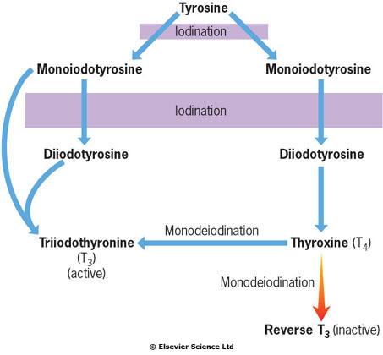
Synthesis and metabolism of the thyroid hormones

Slide 5
Biochemistry: T4 and T3 binding
In plasma, more than 99% of all T4 and T3 is bound to hormone-binding proteins (thyroxine-binding globulin, TBG; thyroid-binding prealbumin, TBPA; and albumin). Only free hormone is available for tissue action, where T3 binds to specific nuclear receptors within the cell.

Slide 6
Factors affecting thyroxine-binding globulin (TBG) levels
Increased TBG Hereditary Pregnancy Oestrogen therapy Oral contraceptive use Hypothyroidism Phenothiazines Acute viral hepatitis | Decreased TBG Hereditary Androgens Corticosteroid excess Thyrotoxicosis Nephrotic syndrome Major illness Malnutrition Chronic liver disease
Drug causing altered binding Non-steroidal anti-inflammatory drugs Phenytoin

Slide 7
Iodine deficiency
Globally, dietary iodine deficiency is a major cause of thyroid disease as iodine is an essential requirement for thyroid hormone synthesis. The recommended daily intake of iodine should be at least 140 μg, and dietary supplementation of salt and bread has reduced the number of areas where 'endemic goitre' still occurs

Slide 8
Physiology of the hypothalamic-pituitary- thyroid axis
TRH is released in the hypothalamus and stimulates release of TSH from the pituitary.
TSH stimulates the TSH receptor in the thyroid to increase synthesis of both T₄ and T₃ and also to release stored hormone, producing increased plasma levels of T₄ and T₃.
T₃ feeds back on the pituitary and perhaps hypothalamus to reduce TRH and TSH secretion.

Slide 9
Characteristics of thyroid function tests in common thyroid disorders
(the clinically most informative tests in each situation are shown in bold)
 | TSH (0,3-3,5 mU/L) | Total T4 (50-150 mmol/L) | Free T4 (10-25 pmol/L) | T3 (1,2-3,1 nmol/L)
Thyrotoxicosis | Suppressed (<0,05 mU/L) | Increased | Increased | Increased
Primary hypothyroidism | Increased (>10 mU/L) | Low/low-normal | Low/low-normal | Normal or low
TSH deficiency | Low-normal or subnormal | Low-low-normal | Low/low-normal | Normal or low
T3 toxicosis | Suppressed (<0,05 mU/L) | Normal | Normal | Increased
Compensated euthyroidism | Slightly increased (5-10 mU/L) | Normal | Normal | Normal

Slide 10
Thyroid function tests
1) TSH measurement
As a single test of thyroid function it is the most sensitive in most circumstances, but many laboratories prefer to perform at least two tests:
TSH + free T4
TSH + free T3 (where hyperthyroidism is suspected)
TSH + serum free T4 (where hypothyroidism is likely).

Slide 11
2) 'Free' T4 tests
These attempt to measure only the unbound active hormone
TBG is sometimes measured directly
3) TRH test
This has been rendered almost obsolete except for investigation of hypothalamic-pituitary dysfunction

Slide 12
Problems in interpretation of thyroid function tests.
There are three major areas of difficulty:
1. Serious acute or chronic illness
ill patients can have low total and free T4 and T3 with a normal or low basal TSH (the 'sick euthyroid' syndrome)
levels are only mildly below normal and are mediated by IL-1 and IL-6
the tests should be repeated after resolution of the underlying illness

Slide 13
2. Pregnancy and oral contraceptives
greatly increased TBG levels
high or high-normal total T4
normal free T4
TSH is often slightly suppressed in the first trimester.
3. Drugs
Many drugs affect thyroid function tests by interfering with protein binding. Basal TSH should be measured.

Slide 14
Antithyroid antibodies
They may be either destructive or stimulating; both occasionally coexist in the same patient.
Destructive antibodies may be directed:
against the microsomes (the antigen is the thyroid peroxidase (TPO) enzyme)
against thyroglobulin

Slide 15
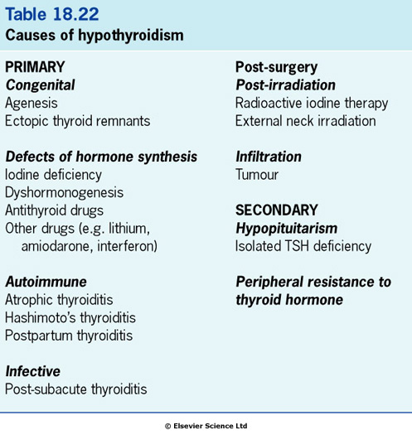

Slide 16
Causes of primary hypothyroidism
1. Atrophic (autoimmune) hypothyroidism
Antithyroid autoantibodies leads to lymphoid infiltration of the gland and eventual atrophy and fibrosis.
It is six times more common in females and the incidence increases with age.
The condition is associated with other autoimmune disease (pernicious anaemia, vitiligo) and other endocrine deficiencies.

Slide 17
2. Hashimoto's thyroiditis
It is a form of autoimmune thyroiditis.
more common in women and most common in late middle age
atrophic changes with regeneration ⇒ goitre formation.
very high titres (> 1000 IU/L) of TPO antibodies
patients may be hypothyroid or euthyroid
patients may go through an initial toxic phase, 'Hashi-toxicity'.
3. Postpartum thyroiditis
this is usually a transient phenomenon observed following pregnancy
may involve hyperthyroidism, hypothyroidism or the two sequentially
histologically is a lymphocytic thyroiditis.

Slide 18
4. Iodine deficiency
in mountainous areas dietary iodine deficiency still exists in some areas as 'endemic goitre' where goitre, occasionally massive, is common.
borderline hypothyroidism ⇒TSH stimulation ⇒ thyroid enlargement.
5. Dyshormonogenesis
genetic defects in the synthesis of thyroid hormones ⇒ hypothyroidism with a goitre.
one particular familial form is associated with sensorineural deafness (Pendred's syndrome).

Slide 19
Clinical features
Hypothyroidism may produce many symptoms. The alternative term 'myxoedema' refers to the accumulation of mucopolysaccharide in subcutaneous tissues. The classic picture of the slow, dry-haired, thick-skinned, deep-voiced patient with weight gain, cold intolerance, bradycardia and constipation makes the diagnosis easy.

Slide 20
Clinical features
Milder symptoms are, however, more common and hard to distinguish from other causes of non-specific tiredness. Many cases are detected on biochemical screening.

Slide 21
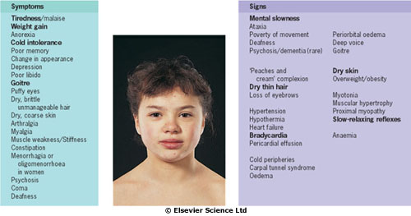
The symptoms and signs of hypothyroidism.
Bold type indicates signs of greater discriminant value. A history from a relative is often revealing. Symptoms of other autoimmune disease may be present.

Slide 22
Diagnosis
Special difficulties in diagnosis may arise in certain circumstances:
Children with hypothyroidism may not show classic features but often have a slow growth velocity, poor school performance and sometimes arrest of pubertal development.

Slide 23
Diagnosis
Young women with hypothyroidism may not show obvious signs. Hypothyroidism should be excluded in all patients with oligomenorrhoea/amenorrhoea, menorrhagia, infertility or hyperprolactinaemia.
The elderly show many clinical features that are difficult to differentiate from normal ageing.

Slide 24
Investigation of primary hypothyroidism
Serum TSH is the investigation of choice.
A high TSH level confirms primary hypothyroidism.
A low total or free serum T4 level confirms the hypothyroid state and is necessary as, if there is hypothalamic and pituitary disease the TSH may be low or normal.
Thyroid and other organ-specific antibodies may be present.

Slide 25
Other abnormalities include the following:
anaemia, which is usually normochromic and normocytic in type but may be macrocytic (sometimes this is due to associated pernicious anaemia) or microcytic (in women, due to menorrhagia)
increased serum aspartate transferase levels, from muscle and/or liver
increased serum creatine kinase levels, with associated myopathy
hypercholesterolaemia
hyponatraemia due to an increase in ADH and impaired free water clearance.

Slide 26
Treatment
Replacement therapy with thyroxine (i.e. T4) is given for life.
The starting dose will depend upon the severity of the deficiency and on the age and fitness of the patient, especially cardiac performance.
In the young and fit, 100 μg daily is suitable, while 50 μg daily (increased to 100 μg after 2-4 weeks) is more appropriate for the small, old or frail.
Patients with ischaemic heart disease require even lower initial doses, especially if the hypothyroidism is severe and long-standing.
over-replacement may increase the risk of atrial fibrillation in those aged over 60.

Slide 27
Borderline hypothyroidism or
'compensated euthyroidism'
Low-normal serum T4 levels + slightly raised TSH levels.
Sometimes this follows surgery or radioactive iodine therapy when it can reasonably be seen as 'compensatory'.
Treatment: thyroxine (if TSH is above 10 mU/L, or when possible symptoms, high-titre thyroid antibodies or lipid abnormalities are present).

Slide 28
Myxoedema coma
hypothermia
severe cardiac failure
hypoventilation
hypoglycaemia
hyponatraemia
Treatment: T3 orally or intravenously in doses of 2.5-5 μg every 8 hours, then increasing as above. Large intravenous doses should not be used.

Slide 29
Additional measures, though unproven, should include:
oxygen (by ventilation if necessary)
monitoring of cardiac output and pressures via a Swan-Ganz catheter
gradual rewarming
hydrocortisone 100 mg i.v. 8-hourly
glucose infusion to prevent hypoglycaemia.

Slide 30
'Myxoedema madness'
Depression is common in hypothyroidism.
With severe hypothyroidism in the elderly the patient may become frankly demented or psychotic, sometimes with striking delusions.
This may occur shortly after starting T4 replacement.

Slide 31
Screening for hypothyroidism
Untreated, severe hypothyroidism produces permanent neurological and intellectual damage ('cretinism').
Routine screening of the newborn using a blood-spot, as in the Guthrie test, to detect a high TSH level as an indicator of primary hypothyroidism is efficient and cost-effective; cretinism is prevented if T4 is started within the first few months of life.
Screening of elderly patients for thyroid dysfunction has a low pick-up rate, is controversial and not currently recommended.
However, patients who have undergone thyroid surgery or received radioiodine should have regular thyroid function tests, as should those receiving lithium or amiodarone therapy.

Slide 32
HYPERTHYRODISM
CAUSES
CLINICAL PICTURE
DIAGNOSIS
TREATMENT

Slide 33
Hyperthyroidism
Hyperthyroidism (thyroid overactivity, thyrotoxicosis) is common, affecting perhaps 2-5% of all females at some time and with a sex ratio of 5 : 1, most often between ages 20 and 40 years. Nearly all cases (> 99%) are caused by intrinsic thyroid disease; a pituitary cause is extremely rare

Slide 34
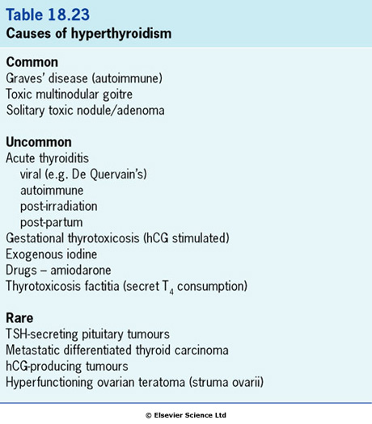

Slide 35
Grave’s disease
This is the most common cause of hyperthyroidism and is due to an autoimmune process
Thyrotoxicosis is the main presentation

Slide 36
Graves' disease
Serum IgG antibodies bind to the thyroid TSH receptor stimulating thyroid hormone production, behaving like TSH.
There is an association with HLA-B8, DR3 and DR2.
Some infections (Yersinia enterocolitica, Escherichia coli and other Gram-negative organisms) may be the initiating factor.
Thyroid eye disease is common.
Graves' dermopathy, lymphadenopathy and splenomegaly are rare .
Association with other autoimmune disorders (pernicious anaemia, vitiligo and myasthenia gravis).

Slide 37
Other causes of hyperthyroidism/thyrotoxicosis
1. Toxic solitary adenoma/nodule (Plummer's disease)
It does not usually remit after a course of antithyroid drugs.
2. Toxic multinodular goitre
This commonly occurs in older women.
Antithyroid drugs are rarely successful, although they can control the hyperthyroidism.

Slide 38
3. de Quervain's thyroiditis
This is transient hyperthyroidism from an acute inflammatory process, probably viral in origin.
fever
malaise
pain in the neck
tachycardia
local thyroid tenderness
ESR and plasma viscosity are raised
transient hypothyroidism
Treatment: aspirin, prednisolone (in severely symptomatic cases).

Slide 39
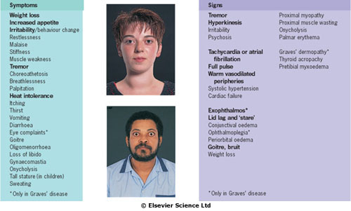
The symptoms and signs of hyperthyroidism.
Bold type indicates signs of greater discriminant value.

Slide 40
Clinical presentation
The eye signs, pretibial myxoedema and thyroid acropachy occur only in Graves' disease. Pretibial myxoedema is an infiltration on the shin, essentially occurring only with eye disease (see below). Thyroid acropachy is very rare and consists of clubbing, swollen fingers and periosteal new bone formation.

Slide 41
Clinical presentation
In the elderly, a frequent presentation is with atrial fibrillation, other tachycardias and/or heart failure, often with few other signs. Thyroid function tests are mandatory in any patient with atrial fibrillation.

Slide 42
Clinical features of hyperthyroidism
eye signs
pretibial myxoedema
thyroid acropachy (clubbing, swollen fingers and periosteal new bone formation)
pretibial myxoedema

Slide 43
Presentation
In the elderly:
atrial fibrillation, other tachycardias
heart failure
'apathetic thyrotoxicosis' (like hypothyroidism)
Children:
excessive height or excessive growth rate
behavioural problems (hyperactivity)
weight gain rather than loss.

Slide 44
Differential diagnosis
Differentiation of the mild case from anxiety states:
eye signs
diffuse goiter
proximal myopathy
wasting

Slide 45
Investigations
↓ serum TSH (< 0.05 mU/L)
↑ serum T4, free T4 or T3
TPO and thyroglobulin antibodies (Graves' disease)
TSH receptor antibodies: thyroid stimulating immunoglobin (TSI) 80% positive, TSH-binding inhibitory immunoglobin (TBII) 60-90% in Graves' disease.

Slide 46
Treatment
Drugs used in the treatment of hyperthyroidism
Drug | Usual starting dose | Side-effects | Remarks
Antithyroid drugs Carbimazole Propylthiouracil | 20-40 mg 8-hourly, or in single dose 100-200 mg 8-hourly | Rash, nausea, vomiting, arthralgia, agranulocytosis (0.1%), jaundice Rash, nausea, vomiting, agranulocytosis | Active metabolite is methimazole Mild immunosuppressive activity Additionally blocks conversion T4 to T3
Beta-blocker for symptomatic control Propranolol | May need higher doses than normal in hyperthyroidism as metabolism is increased 40-80 mg every 6-8 hours | Avoid in asthma Use with care in heart failure | Use agents without intrinsic sympathomimetic activity as receptors highly sensitive

Slide 47
Antithyroid drugs
They inhibit the formation of thyroid hormones.
Although thyroid hormone synthesis is reduced very quickly, the long half-life of T4 (7 days) means that clinical benefit is not apparent for 10-20 days.
Beta-blockers.
They provide rapid partial symptomatic control and decrease peripheral conversion of T4 to T3.
They should not be used alone for hyperthyroidism except when the condition is self-limiting, as in subacute thyroiditis.

Slide 48
Gradual dose titration
Propylthiouracil is used in similar fashion.
Review after 4-6 weeks and reduce dose of carbimazole depending on clinical state and T4/T3 levels.
When clinically and biochemically euthyroid, stop beta-blockers.
Review after 2-3 months and, if controlled, reduce carbimazole (gradually reduce dose to 5 mg daily over 6-24 months if hyperthyroidism remains controlled).
When the patient is euthyroid on 5 mg daily carbimazole, discontinue

Slide 49
'Block and replace' regimen
Carbimazole 40 mg daily+100 μg of thyroxine daily (usually for 18 months)
Is contraindicated in pregnancy.
Radioactive iodine
Iodine-131 in an empirical dose (usually 200-500 MBq), accumulates in the thyroid and destroys the gland by local radiation - though it takes several months to be fully effective.

Slide 50
Surgery: subtotal thyroidectomy
Thyroidectomy should be performed only in patients who have previously been rendered euthyroid.
Conventional practice is to stop the antithyroid drug 10-14 days before operation and to give potassium iodide (60 mg three times daily), which reduces the vascularity of the gland.

Slide 51
Choice of therapy
Indications for either surgery or radioiodine are:
patient choice
persistent drug side-effects
poor compliance with drug therapy
recurrent hyperthyroidism after drugs.
Particular indications for surgery include:
a large goitre, which is unlikely to remit after antithyroid medication

Slide 52
Special situations in hyperthyroidism
1. Thyroid crisis or 'thyroid storm'
hyperpyrexia
severe tachycardia
extreme restlessness.
It is usually precipitated by:
stress
infection
surgery in an unprepared patient
radioiodine therapy
Treatment: propranolol + potassium
iodide + antithyroid drugs + corticosteroids

Slide 53
2. Thyroid hormone resistance
Mutations to the receptor⇒ necessity for higher levels of thyroid hormones⇒ high blood levels of thyroxine with a normal TSH.
This has two consequences:
thyroid function tests appear abnormal even when the patient is euthyroid and requires no treatment.
different tissues contain different thyroid hormone receptors. Heart and bone may exhibit 'thyrotoxic' effects in spite of a normal serum TSH.

Slide 54
Long-term consequences of hyperthyroidism
an increased risk of osteoporosis
increase in overall mortality

Slide 55
Thyroid eye disease
Pathophysiology
It is due to a specific immune response that causes retro-orbital inflammation.
Swelling and oedema of the extraocular muscles ⇒ ⇒ limitation of movement and to proptosis.
Ultimately increased pressure on the optic nerve ⇒ ⇒ optic atrophy.
Histology: focal oedema and glycosaminoglycan deposition followed by fibrosis.
Ophthalmopathy is more common in smokers.

Slide 56
Clinical features
soreness
painful watering
prominence of the eyes
'stare' of lid retraction
proptosis
limitation and discomfort of eye movement
visual impairment
corneal damage
There is periorbital oedema and conjunctural oedema and inflammation

Slide 57
Investigations
TSH, T3 and free T4
The exophthalmos should be measured
MRI of the orbits (will exclude other causes and show enlarged muscles and oedema).

Slide 58
Treatment
Smokers should be advised to stop.
Methylcellulose or hypromellose eyedrops are given to aid lubrication and improve comfort.
Some patients gain relief by sleeping upright. The eyelids can be taped to ensure closure at night.
Systemic steroids (prednisolone 30-120 mg daily). Pulse intravenous methylprednisolone may be more rapidly effective in severe cases.
Irradiation of the orbits (20 Gy in divided doses) is used in severe instances. This improves inflammation and occular motility but has little effect on proptosis.
Lid surgery will protect the cornea if lids cannot be closed.
Surgical decompression of the orbit(s) is occasionally needed.
Corrective eye muscle surgery may improve diplopia due to muscle changes.

Slide 59
Goitre (thyroid enlargement)
Clinical features
commonly a goitre is noticed as a cosmetic defect
the majority are painless, but pain or discomfort can occur in acute varieties
large goitres can produce dysphagia and difficulty in breathing
a small goitre may be more easily visible (on swallowing) than palpable.

Slide 60
Clinical examination:
Size
Shape
Consistency
Mobility of the gland
Lower margin (retrosternal extension)
A bruit may be present
Associated lymph nodes
Tracheal position

Slide 61
Particular points of note are:
Puberty and pregnancy may produce a diffuse increase in size of the thyroid.
Pain in a goitre may be caused by thyroiditis, bleeding into a cyst or (rarely) a thyroid tumour.
Excessive doses of carbimazole or propylthiouracil will induce goitre.
Iodine deficiency and dyshormonogenesis can also cause goitre.

Slide 62
Goitre-causes and types
Diffuse Simple Physiological (puberty, pregnancy) Autoimmune Graves’ disease Hashimoto’s disease Thyroiditis Acute (de Quervain’s thyroiditis) Iodine deficiency (endemic goiter) Dyshormonogenesis Goitrogens (e.g. sulphonylureas) | Nodular Multinodular goiter Solitary nodular Fibrotic (Reidel’s thyroiditis) Cysts Tumours Adenomas Carcinomas Lymphomas Miscellaneous Sarcoidosis tuberculosis

Slide 63
Treatment
Indications for surgical intervention are:
The possibility of malignancy (rapid growth, pain, cervical lymphadenopathy, change in voice or previous irradiation to the neck, a positive or suspicious FNA)
Pressure symptoms on the trachea or, more rarely, oesophagus. The possibility of retrosternal extension should be excluded.
Cosmetic reasons. A large goitre is often a considerable anxiety to the patient even though functionally and anatomically benign.

