Slide 1
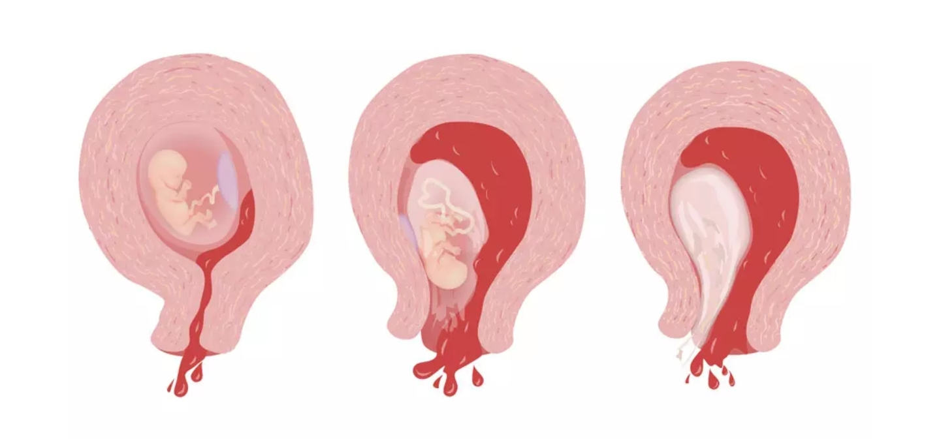
Ethical problems of medicine of [ Abortion ]

Slide 2
Created by: Maryam Bakhshaei
Dentistry student of volgmu university of russia
Course 2 semester 4
Group 24
This article include creator openion and Dr. Ehsan hossein zade
From iran . And Women, childbirth and midwifery book written by Dr. Hojjat Elah Akbarzadeh Pasha and Dr. Ali Akbarzadeh Pasha

Slide 3
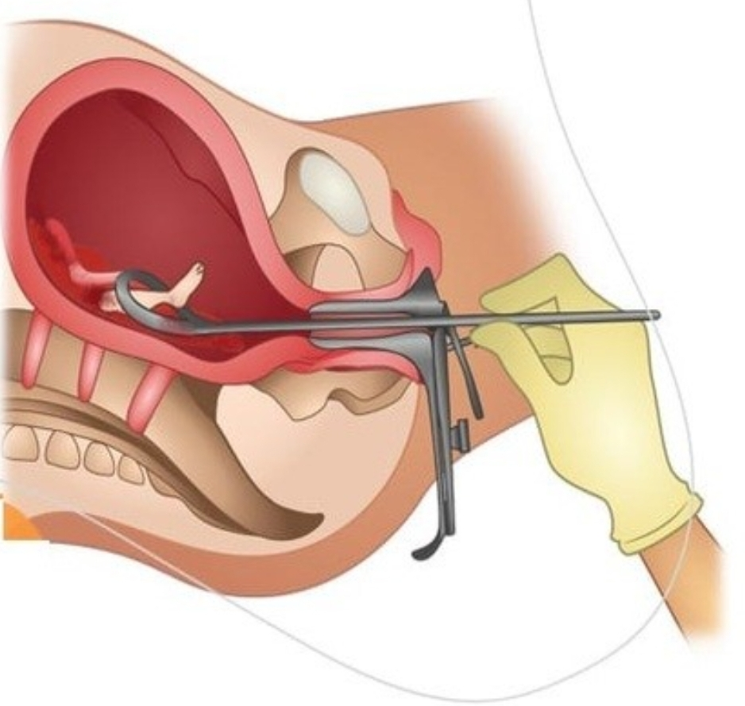
Types of abortion: Abortions are divided into two main categories: - Spontaneous abortion; - Induction abortion (intentional).
Types of abortion: Abortions are divided into two main categories: - Spontaneous abortion; - Induction abortion (intentional). Spontaneous abortion: An abortion that happens unintentionally is called a spontaneous abortion. Spontaneous abortion includes different types, which include: 1- complete abortion; 2- incomplete abortion; 3- Inevitable abortion; 4- threatening abortion; 5- Repeated abortion; 6- Forgotten or silent abortion; It should be noted that there is a possibility of spontaneous abortion up to the twelfth week,
and from the thirteenth week onwards, the possibility of spontaneous abortion is very low.

Slide 4
Intentional abortion: Termination of pregnancy by a person’s will, by medication or surgery, such as curettage, is called induced abortion or intentional abortion. Intentional abortion includes two types: 1_ Abortion according to doctor’s diagnosis Sometimes according to the doctor’s diagnosis and for reasons such as a threat to the mother’s life or serious harm to her health in case of continued pregnancy, pregnancy caused by sexual assault or illicit relationship, or the possibility of a baby being born with severe physical defects or mental retardation, preserving the pregnancy for the fetus or the mother is high-risk, in which case the doctor orders the termination of the pregnancy;

Slide 5
2- Intentional abortion or illegal abortion Termination of pregnancy on demand and the mother uses pills for abortion is considered illegal. An abortion performed in the first 2 months of pregnancy has very few consequences and does not change a person’s fertility, but the possibility of pelvic infection increases slightly. It is dangerous to use pills for abortion arbitrarily and it may cause problems for the mother and the next pregnancy.

Slide 6
Abortion in Iranian laws In Iranian law, which originates from Islamic rules, abortion is considered illegal in principle and the law does not prescribe it. In Iranian law, the right to life of the fetus is fully recognized. Therefore, if someone other than the mother commits a crime on the fetus, the retribution or retribution will include her(14). This person can be a doctor, a midwife or a lay person. However, in the case of abortion by the mother, the situation is different, and if a mother aborts her own fetus, she will not be retaliated against, nor will she be imprisoned or other punishments, but she is forced to pay dowry to the father of the fetus, that is, her husband, which is a private right. (not criminal punishment) can be forgiven by the spouse(15). In Iranian law, abortion is legally possible in only two ways. According to the abortion law, if the fetus is retarded or malformed, or if the continuation of carrying the fetus is dangerous for the health of the mother, legal abortion is possible before four months with the opinion of three doctors and without payment of dowry.(16)

Slide 7
Among the symptoms of miscarriage, the following can be mentioned. - spotting; - Bleeding in pregnancy; - Discharge of tissue or fluids from the vagina; - Abdominal contractions; - severe abdominal pain; - back ache.

Slide 8
(14) https://rc.majlis.ir/fa/law/show/92683 (15) https://rc.majlis.ir/fa/law/show/845048 (16) https://rc.majlis.ir/fa/law/show/97756

