Slide 1
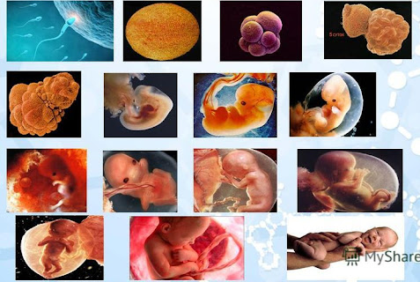
Lecture 4
ONTOGENESIS
(embryonic period)

Slide 2
Ontogenesis
is an individual development of the organism from the formation of a zygote (fertilization) to the death.

Slide 3
Fertilization
is the fusion of gametes to initiate the development of a new individual organism.
In animals, the process involves the fusion of an ovum with a sperm, which first creates a zygote and then leads to the development of an embryo.

Slide 4
Stages of Fertilization
Hundreds of millions of sperm cells are deposited in the vagina during sexual intercourse.
A sperm cell can survive in the woman’s body for up to six days, but the oocyte can only be fertilized in the 12 to 24 hours after ovulation.
Fertilization occus in 4 stages:
Capacitation
Acrosomal reactions
Cortical reaction
Formation of synkaryon

Slide 5
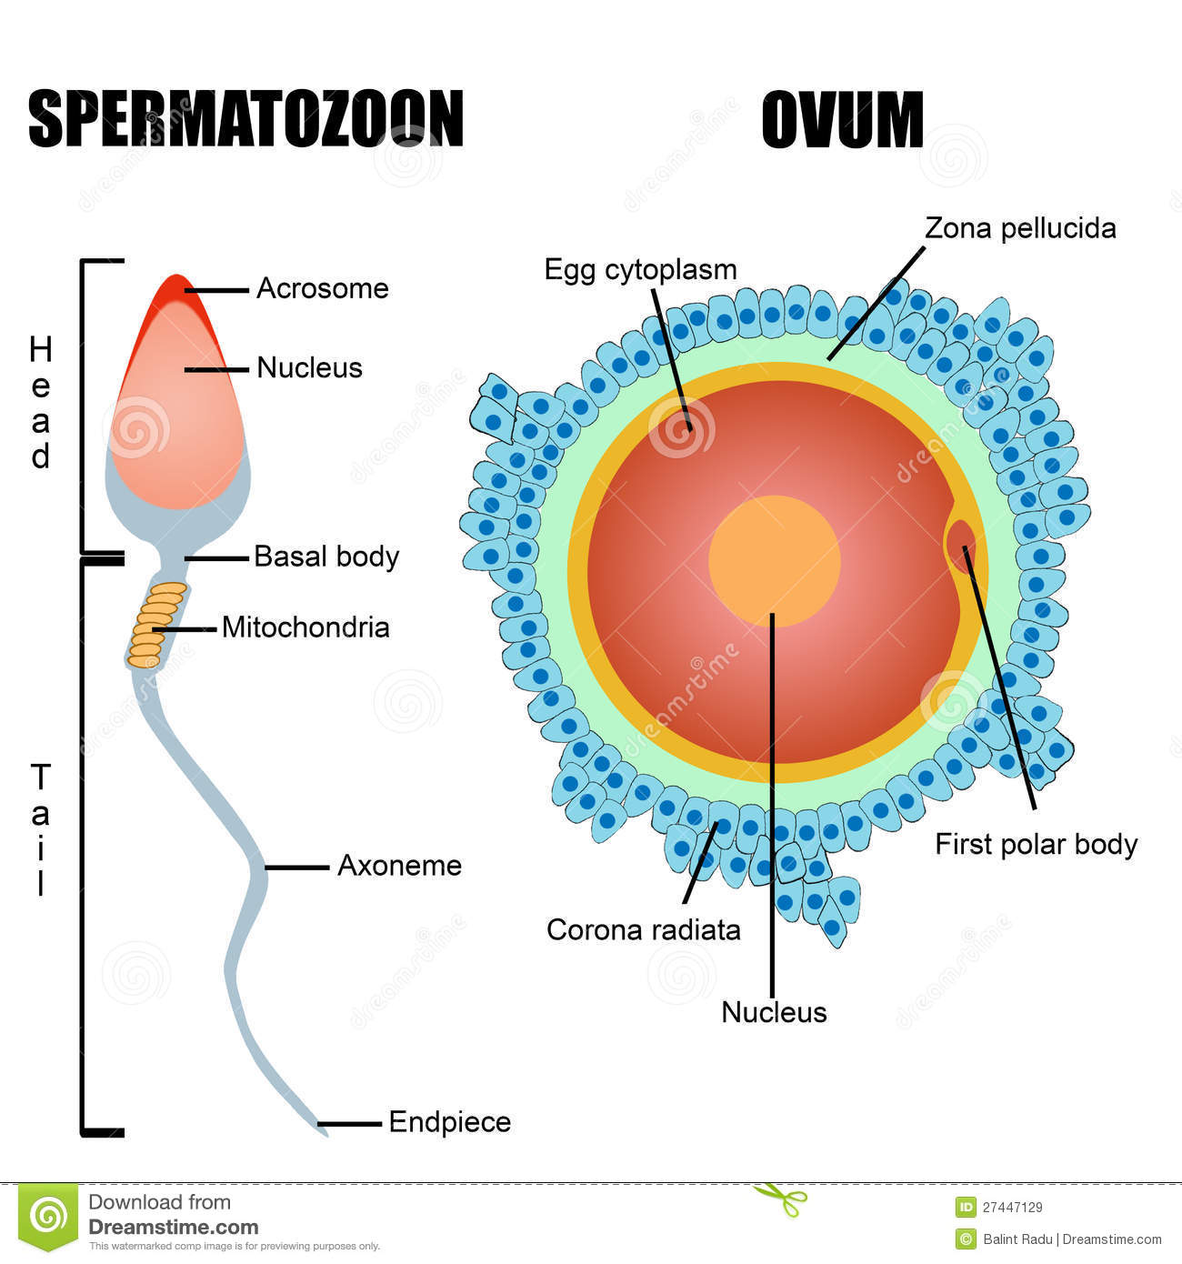

Slide 6
Capasitation
At the beginning of the process, the sperm undergoes a series of changes, as freshly ejaculated sperm is unable or poorly able to fertilize. The sperm must undergo capacitation in the female's reproductive tract over several hours, which increases its motility and destabilizes its membrane, preparing it for the acrosome reaction.
Acrosomal reactions
After binding to the corona radiata the sperm reaches the zona pellucida, which is an extra-cellular matrix of glycoproteins. A special complementary molecule on the surface of the sperm head binds to a glycoprotein in the zona pellucida. This binding triggers the acrosome to burst releasing enzymes that help the sperm get through the zona pellucida.

Slide 7
Cortical reaction
After the sperm enters the cytoplasm cortical granules inside the secondary oocyte fuse with the plasma membrane to make it hard and impermeable to sperm. This prevents fertilization of an egg by more than one sperm.
Fusion (Formation of synkaryon)
The oocyte completes its second meiotic division. This results in a mature ovum. The nucleus of the oocyte is called a pronucleus.
The sperm's tail and mitochondria degenerate with the formation of the male pronucleus.
The pronuclei migrate toward the center of the oocyte, rapidly replicating their DNA as they do so to prepare the zygote for its first mitotic division.

Slide 8
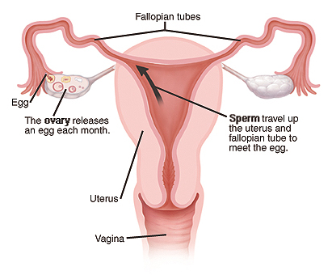

Slide 10
Cleavage
is the division of cells in the early embryo.
It depends from type of ovum.

Slide 11
Type of ovum (eggs)
Eggs classified according to
the amount of yolk
distribution of yolk

Slide 12
According to the amount of yolk
Alecithal
Oligolecithal
Mesolecithal
Polylecithal

Slide 13
According to the distribution of yolk
Homolecithal
Centrolecithal
Telolecithal
Isolecithal

Slide 14
Type of ovum |  | Characteristic | Example
According to the amount of yolk
Alecithal | Without yolk |  | Mammals
Oligolecithal | Small amount |  | Amphioxus
Mesolecithal | Moderate amount |  | Amphibians
Polylecithal | Large amount |  | Birds
According to distribution of yolk
Homolecithal | The yolk equally distributed throughout the cytoplasm |  | Amphioxus
Centrolecithal | The yolk in the center of the cytoplasm |  | Arthropodes
Telolecithal | The unequel distribution of yolk in the cytoplasm. The yolk is concentrated at one pole of the egg separate from the developing embryo. |  | Birds, Reptiles, Fish
Isolecithal | The small amounts of yolk evenly distributed throughout the cytoplasm. |  | Mammals

Slide 15
Cleavage
Cleavage is the division of cell in the early embryo.
The zygote of many species undergo rapid divisions, producing a cells called blastomeres.
Cleavage as way of division differs from other forms of cell divisions. During cleavage the number of cells increases without increasing the mass of cells.

Slide 16
Cleavage
Depending on the kind of egg, the cleavage may be:
holoblastic (total or complete), the cleavage furrows divide the entire egg.
meroblastic (partial or incomplete), segmentation takes place only in a small portion of the egg

Slide 17
Holoblastic cleavage
The egg is separated completely.
There are:
complete equal cleavage, in which the blastomeres do not differ in size (it is typical for homolecital and alecital eggs),
complete unequal cleavage, in which the blastomeres can differ significantly in size (it is typical for moderately telolecital eggs.

Slide 18
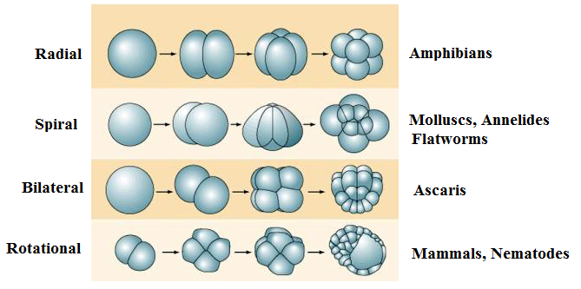
Complete equal cleavage may be:
radially symmetrical - Radial
spirally symmetrical - Spiral
bilaterally symmetrical - Bilateral
Irregular - Rotational
Complete unequal cleavage
may be:

Slide 19
Meroblastic cleavage:
The egg is separated incompletely. It is typical for polylecithal and telolecithal eggs, rich in yolk.
There are:
Discoidal - limited to a relatively small area at the animal pole, cleavage farrow do not pass through the entire egg and do not capture the yolk.
Superficial - only the surface layer is divided.

Slide 20
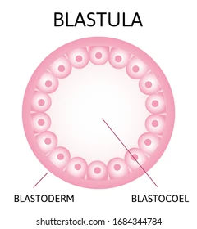
Blastula
Cleavage ends with the formation of a sphere called a blastula.
A blastula is a sphere of cells surrounding a blastocoel. The blastocoel is a fluid filled cavity which contains amino acids, proteins, growth factors, sugars, ions and other components which are necessary for cellular differentiation.

Slide 21
Kinds of blastula
Coeloblastula (Typical blastula). It forms as result of holoblastic cleavage. It a single layered bubble with a large blastocoel (Amphioxus).
Periblastula. It is formed as a result of superficial cleavage. The blastocoel is absent. (Insects).
Discoblastula. It is formed as a result of discoidal cleavage. The blastocoel is small. (Boney fishes, reptile, birds).
Amphiblastula. It is formed of two types of structurally different blastomeres: micromeres and macromeres. (Amphibians).
Blastocyst. It is formed in mammals as a result of holoblastic cleavage. Outer cells are called trophoblast, inner cells are called as inner cell mass and they form the embryo. (Human).

Slide 23
Gastrulation is formation of three-layered structure known as the gastrula.
Gastrulation is a phase of the embryonic development of most animals, during which the single-layered ,blastula is reorganized into a three-layered structure known as the gastrula.
These three germ layers are known as the
Ectoderm
Mesoderm
Endoderm

Slide 24
Ways of gastrulation:
Immigration - migration of individual cells of the blastula wall into the blastocele. (a)
Invagination -it occurs by embedding the wall of the blastula in the blastocele; it is characteristic of most animal groups. (b)
Epiboly - fouling of some cells with rapidly dividing other cells or fouling with cells of the internal mass of the yolk (with incomplete crushing). (c)
Delamination - the cells located outside are transformed into the ectoderm, and the remaining cells into the endoderm. (d)

Slide 25
Derivates of embryonic layers
Ectoderm gives:
epidermis,
nervous system
Endoderm gives:
epithelium of the digestive system
epithelium of respiratory system
organs associated with the digestive system (liver and pancreas)
Mesoderm gives:
muscles
cartilage of the ribs and vertebrae
the dermis
blood and blood vessels
bones
connective tissue

