Slide 1
Lecture 10
MEDICAL HELMINTHOLOGY
PHYLUM PLATHELMINTHES
CLASS TREMATODA (Flukes)

Slide 2
MEDICAL HELMINTHOLOGY
Medical helminthology studies of worms and especially parasitic worms. Worms-parasites of man belong to the types of Plathelminthes (Flat worms) and Nemathelminthes (Round worms).

Slide 3
PHYLUM PLATHELMINTHES
General characteristics
Platyhelminthes are bilaterally symmetricalanimals
Body is formed from three main cell layers (endoderm, mesoderm, and ectoderm)
Body is flattened dorsoventrally
Plathelminthes have no internal body cavity, so are described as acoelomates
There is no specialized circulatory and respiratory systems
Representatives of the two classes (Class Trematoda and Class Cestoda) of phylum Plathelminthes may be parasites of human.

Slide 4
CLASS TREMATODA (Flukes)
General characteristics
Flattened dorsoventrally;
Leaf-like shaped body;
Bilaterally symmetrical;
Unsegmented;
Has no body cavity;

Slide 5
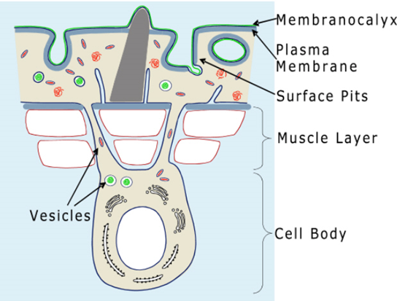
Outer coating is tegument

Slide 6
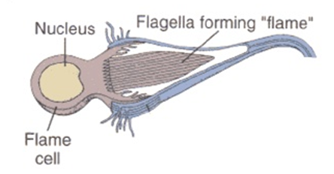
Organs of fixation in the form of suckers: oral and ventral;
Nervous system: brain consists of a pair of ganglia in the head region, from which two or three pairs of nerve cords run down the length of the body.
Digestive system: mouth, pharynx, esophagus, two blind-ending;
Excretory system: some protonephridia - flame cells

Slide 7
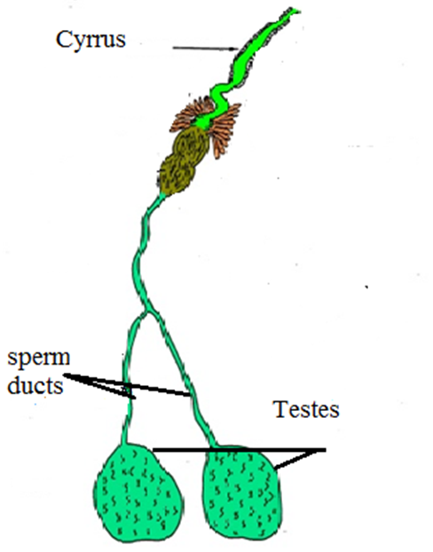
10. Reproductive system: Most trematodes are hermaphrodites, having both male and female organs (except blood flukes);
✓ The male system: two testes, with sperm ducts, the copulatory organ, a cirrus

Slide 8
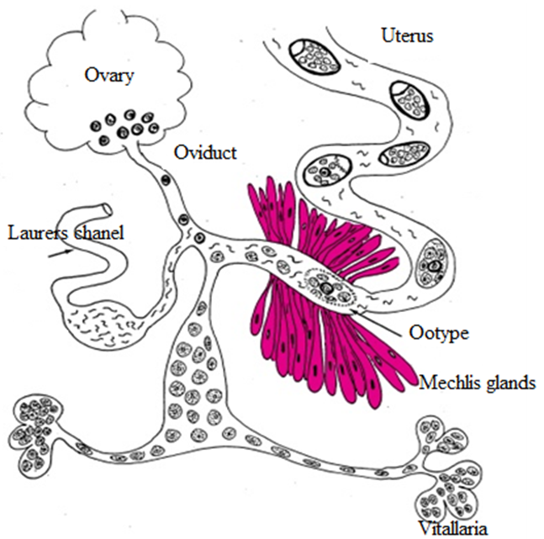
The female system:
a single ovary,
an oviduct,
an ootype (where fertilization occurs),
vitelline glands (produce yolk cells),
Mehlis' gland (shell gland),
a copulatory duct termed Laurer's canal, an elongated uterus,
genital pore

Slide 9
Life cycle
All Trematodes have similar life cycle
First intermediate host – snail allways
Second intermediate host may be fish, ant, crab or may be abcent
developmental stages which are
miracidium
sporocyst
redia
cercaria
metacercaria

Slide 10
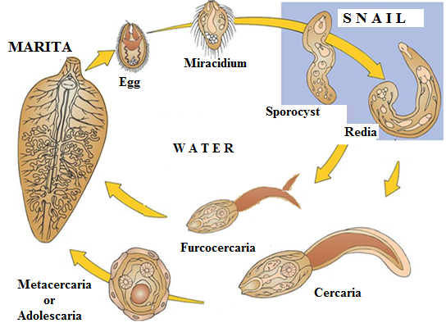
General Life Cycle

Slide 11
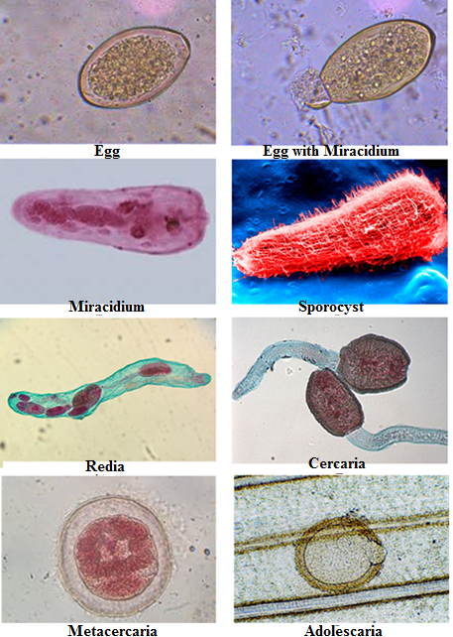

Slide 12
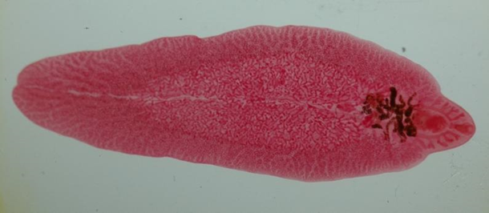
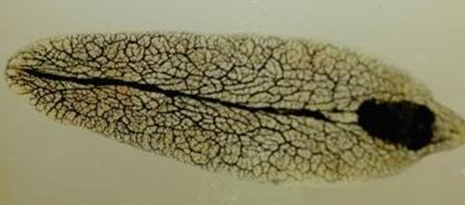
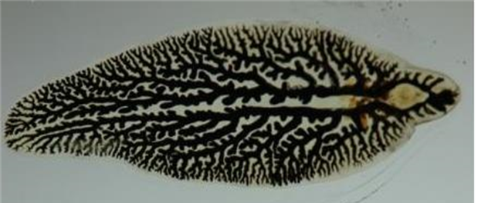
Fasciola hepatica
Disease: Fascioliasis.
Geographic distribution: worldwide.
Localization in human body: biliary ducts
Morphology: adults are about 3 cm long and 1 cm wide,

Slide 13
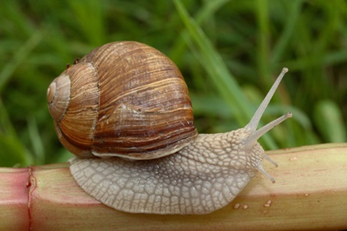
Mode of transmission: ingestion of water, some non-water plants and vegetables, which contain metacercariae
Life Cycle:
Definitive host– humans, cattle.
Intermediate host - the snail Galba genus.

Slide 14
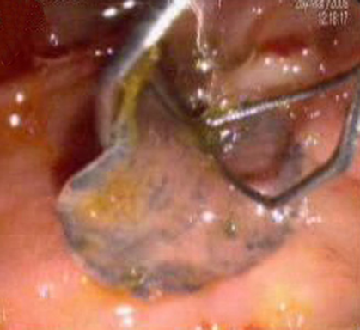
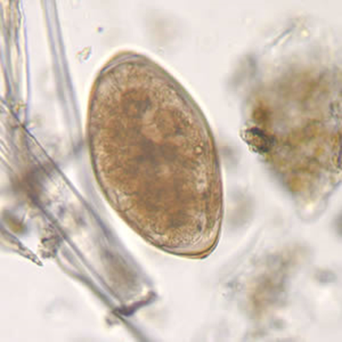
Pathogenesis: abdominal pain, hepatomegaly, fever, vomiting, diarrhea.
Diagnosis: microscopic identification of eggs in the stools
Prevention and control:
do not drink fresh water
proper washing or cooking of water plants before consumption

Slide 15
OPISTHORCHIS FELINEUS
Disease: opisthorchiasis
Geographic distribution: Europe, Asia
Localization in human body: bile ducts, gallbladder, liver.
Morphology: length 4-13 mm. In the middle part of the body there is a branched uterus. Behind it there is a round ovary. There is a rosella-like testis in the back of the uterus - a diagnostic sign of the Opisthochis felineus

Slide 16
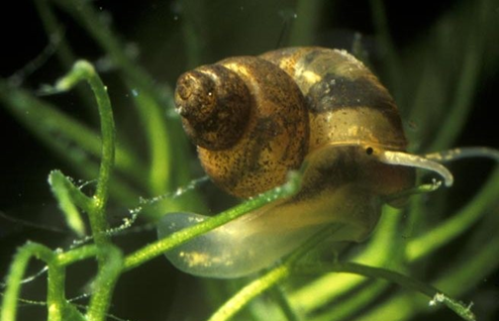
Mode of transmission: raw, frozen, dried, pickled, and salted fish, which contains metacercariae.
Life Cycle:
Definitive host - carnivorous mammals and humans
First intermediate host - the snail Bithynia leachi genus
Second intermediate host – fish
Pathogenesis: abdominal pain, diarrhea or constipation. Diagnosis: microscopic identification of immature eggs in feces, in fluid from biliary drainage, or duodenal aspirate

Slide 17
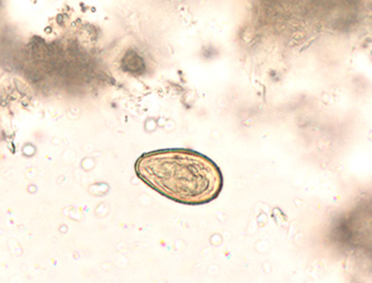
Diagnosis: microscopic identification of eggs in the stools
Prevention and control:
not eating undercooked or contaminated raw, frozen, dried, pickled, and salted fish;

Slide 18
DICROCELIUM LANCEATUM
Disease: dicrocoeliasis.
Geographic distribution: Europe, northern Asia, America and northern Africa.
Localization in human body: bile ducts, gallbladder and liver Very rare in humans.
Morphology: worm is 1 centimeter long with lanceolate form of the body; Two round testis are situated in the front of the body - the diagnostic sign of the Dicrocoelium lanceatum.

Slide 19
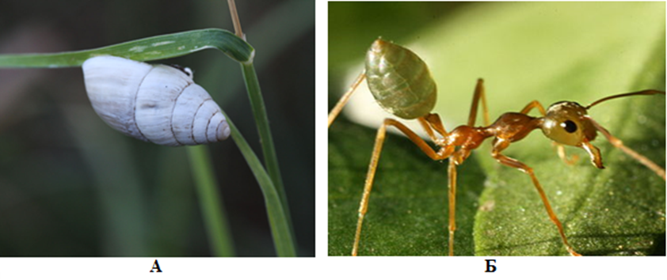
Mode of transmission: ingestion of plants with the ants, which contain metacercariae
Life Cycle:
Definitive host - herbivorous mammals (cattle, horses)
First intermediate host - he snail of Zebrina and Helicela genus
Second intermediate host – ants Fornica genus

Slide 20
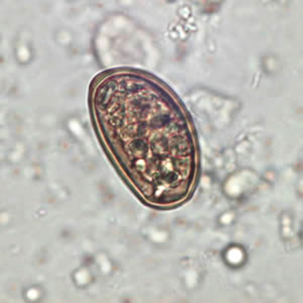
Pathogenesis: most infections are light and asymptomatic. In heavier infections, symptoms may include cholecystitis, liver abscesses and upper abdominal pain.
Diagnosis: microscopic identification of eggs in the stool or duodenal fluid.
Prevention and control:
eradication of the snails, ants when possible; dehelmithization of cattle.

Slide 21
SCHISTOSOMA - BLOOD FLUKES
Schistosoma mansoni
Schistosoma haematobium
Schistosoma japonicum

Slide 22
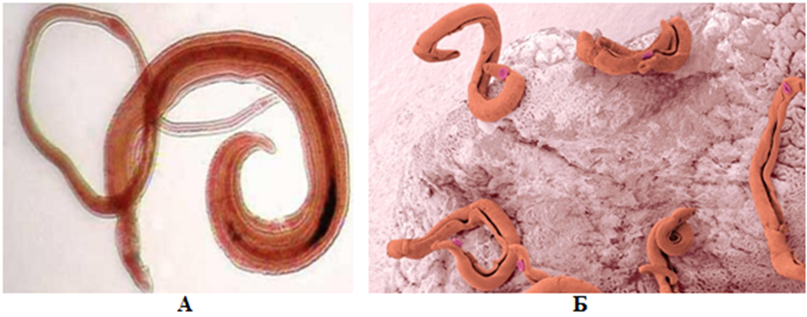
Disease: schistosomiasis
Geographic distribution: Asia, Africa, Latin America, and the Middle East
Localization in human body: each species has a preferred location:
Morphology: adult worms 10–20 mm long;, the sexes are separate. the male is considerably larger than the female. The male surrounds the female and encloses her within his gynacophoric canal

Slide 23
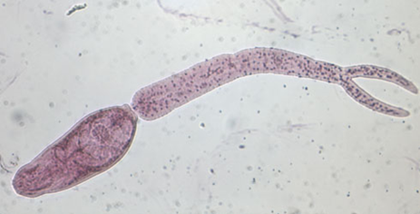
Mode of transmission: penetration of skin by furcocercarie.
Life Cycle:
Definitive host - human
Intermediate host - snail
Lass larval form - furcocercaria

Slide 24
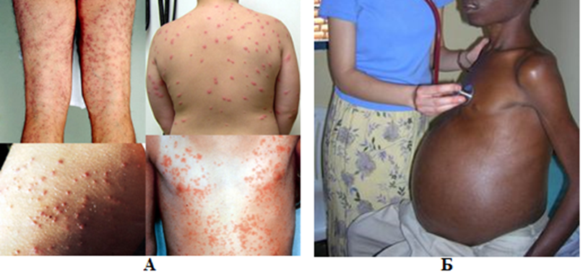
Pathogenesis:
the first symptoms are a rash or itch
in two months chills, cough, diarrhea, fatigue, fever and muscle aches can occur
after years of infection eggs inflame organs such as the liver, bladder and lungs.

Slide 25
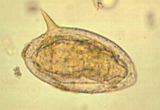
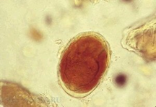
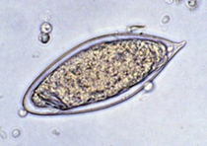
Diagnosis: microscopic identification of eggs in stool or urine.
Stool examination should be performed when infection with S. mansoni or S. japonicum is suspected,
urine examination should be performed if S. haematobium is suspected.
Prevention and control:
swimming in endemic areas should be avoided.

