Slide 1
LOCAL AND REGIONAL ANESTHESIA IN DENTISTRY

Slide 2
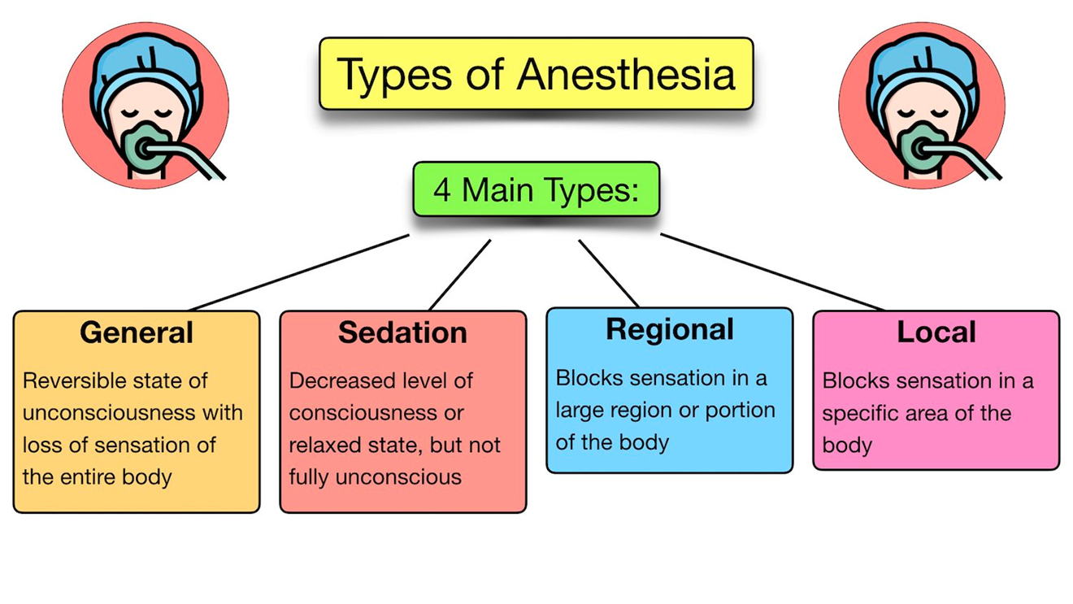

Slide 3
We expect to feel no pain during surgery or at least to have no memory of the procedure. But it wasn’t always so.
Until the discovery of general anaesthesia in the middle of the 19th century, surgery was performed only as a last and desperate resort. Conscious and without pain relief, it was beset with unimaginable terror, unspeakable agony and considerable risk.

Slide 4
It was against this background that general anaesthesia was discovered.
A young US dentist named William Morton, spurred on by the business opportunities afforded by technical advances in artificial teeth, doggedly searched for a surefire way to relieve pain and boost dental profits.

Slide 5
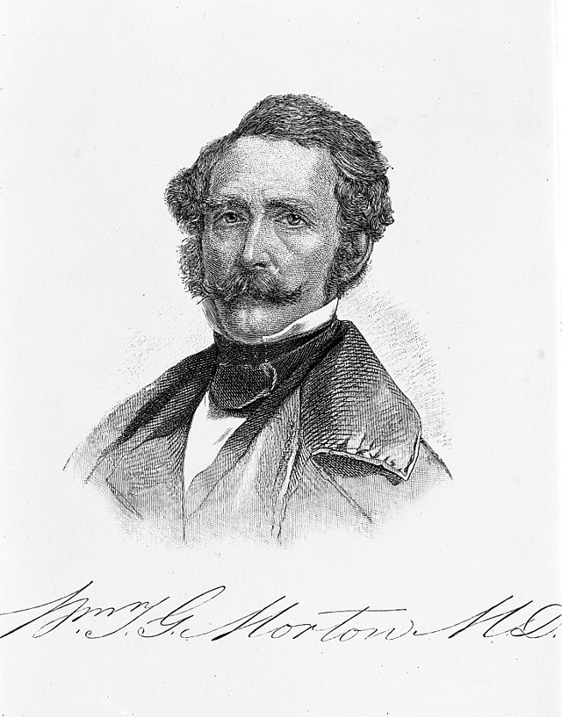
William Thomas Green Morton (August 9, 1819 – July 15, 1868) was an American dentist and physician

Slide 6
His efforts were soon rewarded. He discovered when he or small animals inhaled sulfuric ether (now known as ethyl ether or simply ether) they passed out and became unresponsive.
A few months after this discovery, on October 16, 1846 and with much showmanship, Morton anaesthetised a young male patient in a public demonstration at Massachusetts General Hospital. So began the story of general anaesthesia, which for good reason is now widely regarded as one of the greatest discoveries of all time.

Slide 7
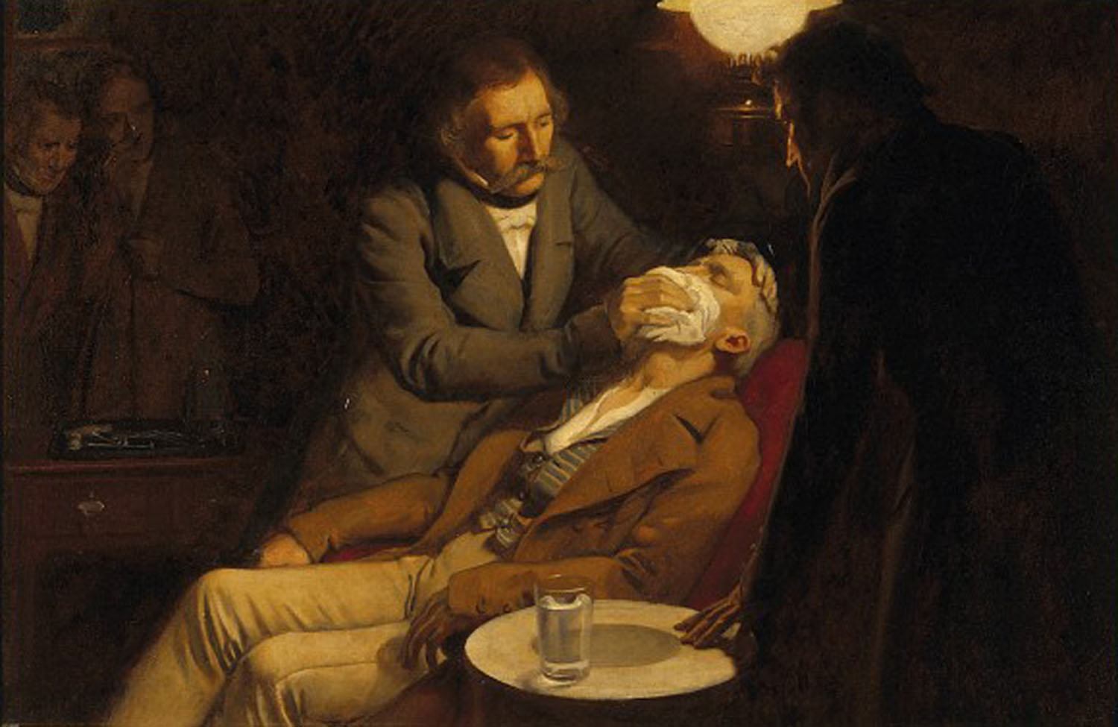
Ernest Board; the first use of ether as an anaesthetic in 1846 by the dental surgeon W.T.G. Morton

Slide 8
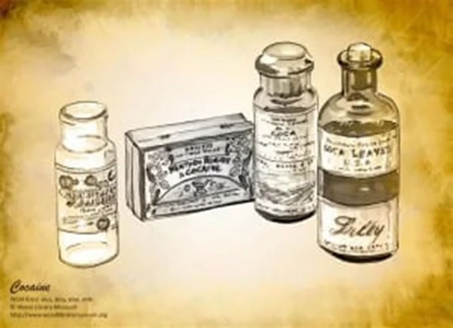
1884
Dr. Karl Koller (1857-1944)-Viennese ophthalmologist and colleague of Sigmund Freud, introduces cocaine as an anesthetic for eye surgery.
Dr. William S. Halsted uses cocaine (1852-1922) for the first regional (mandibular or jaw) nerve block with cocaine.

Slide 9
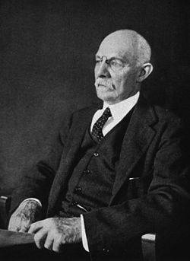
William Stewart Halsted in 1922
William Stewart Halsted, M.D. (September 23, 1852 – September 7, 1922) was an American surgeon who emphasized strict aseptic technique during surgical procedures, was an early champion of newly discovered anesthetics, and introduced several new operations, including the radical mastectomy for breast cancer.

Slide 10
In 1923, Dr. Gaston Labat and his colleagues founded the original American Society of Regional Anesthesia shortly after publishing his landmark textbook on regional anesthesia techniques.
Dr. Gaston Labat (1876-1934) was born on the island of Mahe, in the Seychelles, and was educated in Durban, South Africa and in Mauritius, where he worked in his brother-in-law's chemist shop (a pharmacy). He then went to France to complete his education, earning a degree in medicine in 1920.

Slide 11
While still a medical student, he became an assistant to the surgeon Dr. Victor Pauchet (1869-1936), and was a co-author of the third edition of Pauchet's textbook on regional anesthesia. Dr. Labat immigrated to the U.S. in 1920, and worked for the Mayo Clinic for one year before practicing in New York City.
He published his own classic textbook, Regional Anesthesia, Its Technic and Clinical Application, in 1922.

Slide 12
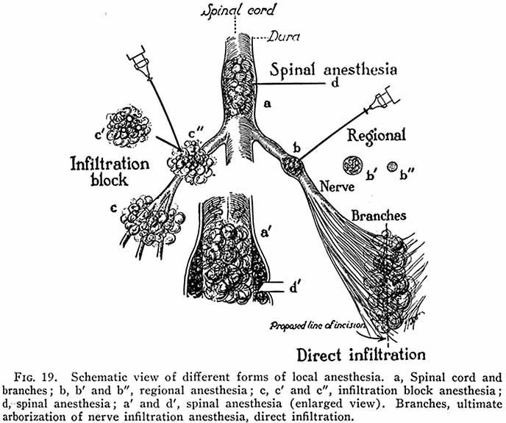

Slide 13
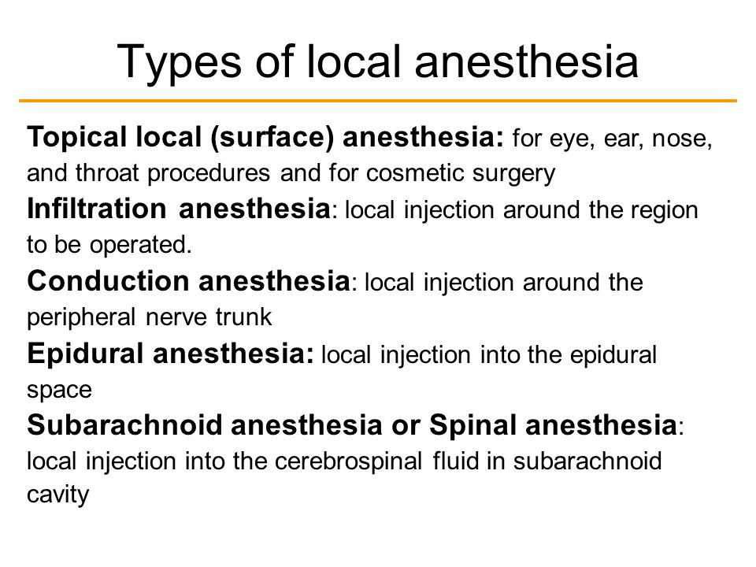

Slide 14
METHODS OF INDUCING LOCAL ANESTHESIA:
Low temperature
Mechanical trauma
Anoxia
Neurolytic agents such as alcohol & phenol
Chemical agents such as local anesthetics

Slide 15
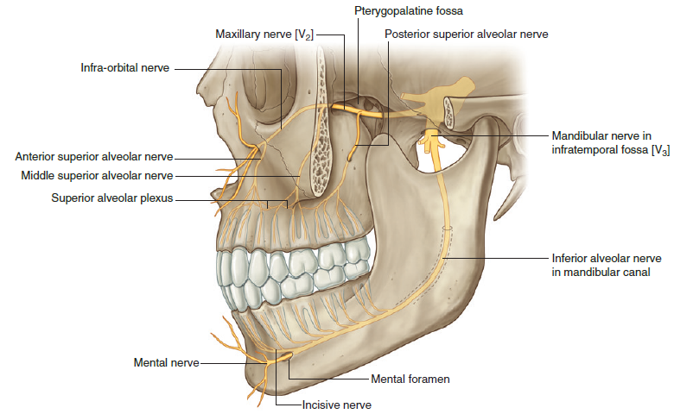

Slide 16
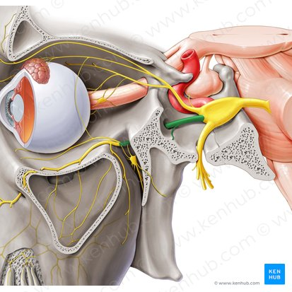
Nerves
Maxillary nerve
Nervus maxillaris

Slide 17
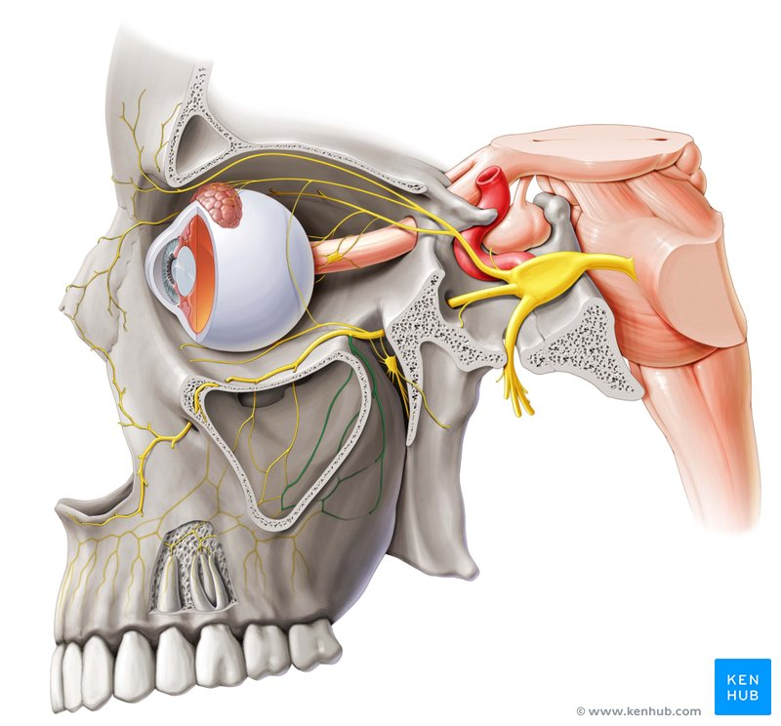
Nerves
Posterior superior alveolar nerve (lateral-left view)

Slide 18
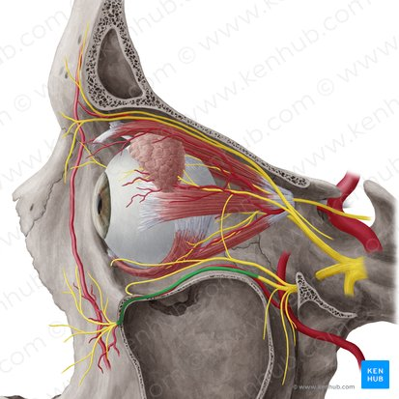
Nerves
Infraorbital nerve
Nervus infraorbitalis

Slide 19
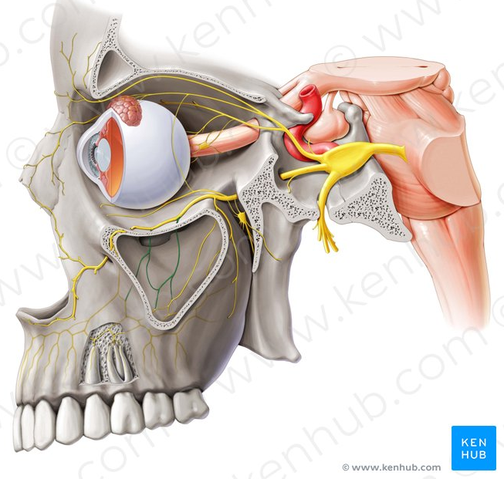
Nerves
Middle superior alveolar nerve
Nervus alveolaris superior medius

Slide 20
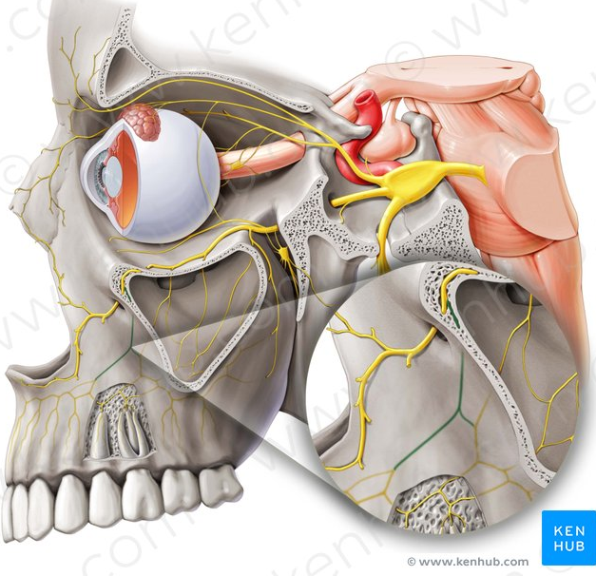
Nerves
Anterior superior alveolar nerve
Nervus alveolaris superior anterior

Slide 21
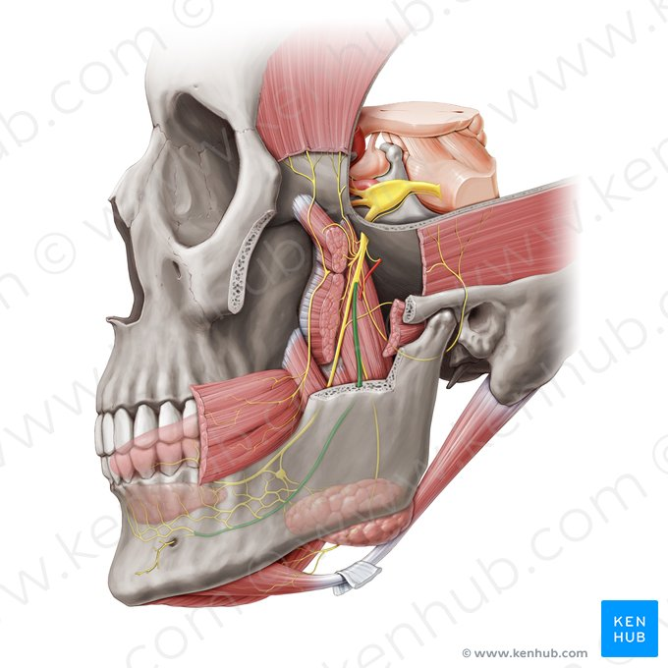
Nerves
Inferior alveolar nerve
Nervus alveolaris inferior

Slide 22
MAXILLARY :
–Posterior superior alveolar (PSA) nerve block -several molar teeth in one quadrant
–Middle superior alveolar (MSA) nerve block -premolars in one quadrant
–Anterior superior alveolar (ASA) nerve block-anterior teeth in one quadrant
–Maxillary (V2, second division) nerve block -extensive buccal, palatal, and pulpalmanagement in one quadrant
Greater (anterior) palatine nerve block -palatal soft and osseous tissue treatment distal to the canine in one quadrant
–Nasopalatinenerve block-palatal soft and osseous tissue management from canine to canine bilaterally
–Anterior middle superior alveolar (AMSA) nerve block -anterior teeth, palatal and buccalsoft and hard tissues
–Palatal approach-anterior superior alveolar (P-ASA) nerve block-anterior teeth and their palatal and facial soft and hard tissues

Slide 23
Maxillary Anesthesia: Acessory
Supraperiosteal (infiltration)
Periodontal ligament (PDL, intraligamentary) injection
Intraseptal injection
Intracrestal injection,
Intraosseous (IO) injection

Slide 24
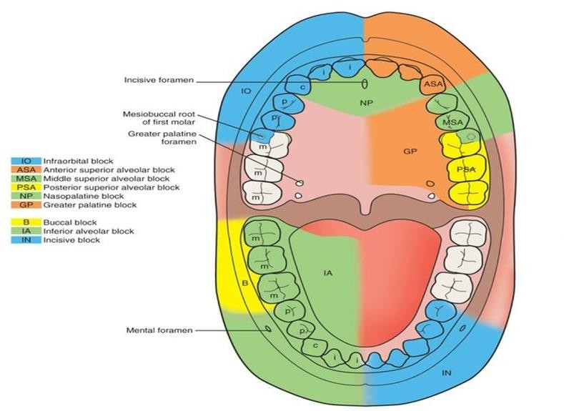

Slide 25
POSTERIOR SUPERIOR ALVEOLAR NERVE BLOCK
Commonly used dental nerve block
Highly successful technique (>95%)
•Other Common Names –Tuberosity block, zygomatic block.
•Areas Anesthetized
–Pulps of the maxillary third, second, and first molars (entire tooth = 72%;
mesiobuccal root of the maxillary first molar not anesthetized = 28%)
–Buccal periodontium and bone overlying these teeth

Slide 26
Nerve
Posterior superior alveolar nerve (lateral-left view)

Slide 27
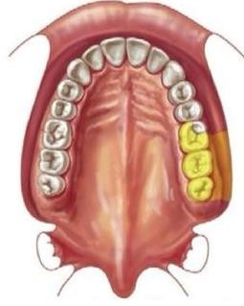
POSTERIOR SUPERIOR ALVEOLAR NERVE BLOCK
Indications
When treatment involves two or more
maxillary molars
When supraperiosteal injection is contraindicated (e.g., with infection or acute inflammation)
When supraperiosteal injection has proved ineffective
Contraindication
When the risk of hemorrhage is too great. Ex:
hemophiliac patient

Slide 28
POSTERIOR SUPERIOR ALVEOLAR NERVE BLOCK
Advantages
Atraumatic: relatively large area of soft tissue into which the local anesthetic is deposited and the fact that bone is not contacted
High success rate (>95%)
Minimum number of necessary injections (Minimizes the total volume of local anesthetic solution administered)
Disadvantages
Risk of hematoma,
Technique somewhat arbitrary: no bony
landmarks during insertion
Second injection necessary for treatment of the
first molar (mesiobuccal root) in 28% of patients

Slide 29
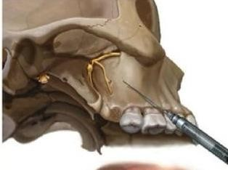
POSTERIOR SUPERIOR ALVEOLAR NERVE BLOCK
Positive Aspiration: Approximately
3.1%.
Alternatives
Supraperiosteal or PDL injections for pulpal and root anesthesia
Infiltrations for the buccal periodontium and hard tissues
Maxillary nerve block

Slide 30
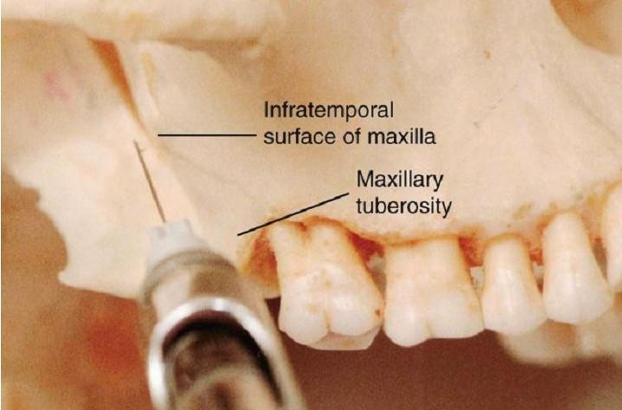
POSTERIOR SUPERIOR ALVEOLAR NERVE BLOCK
Technique
A 27-gauge short needle
recommended
Area of insertion: height of the mucobuccal fold above the maxillary second molar
Target area: PSA nerve—posterior, superior, and medial to the posterior border of the maxilla

Slide 31
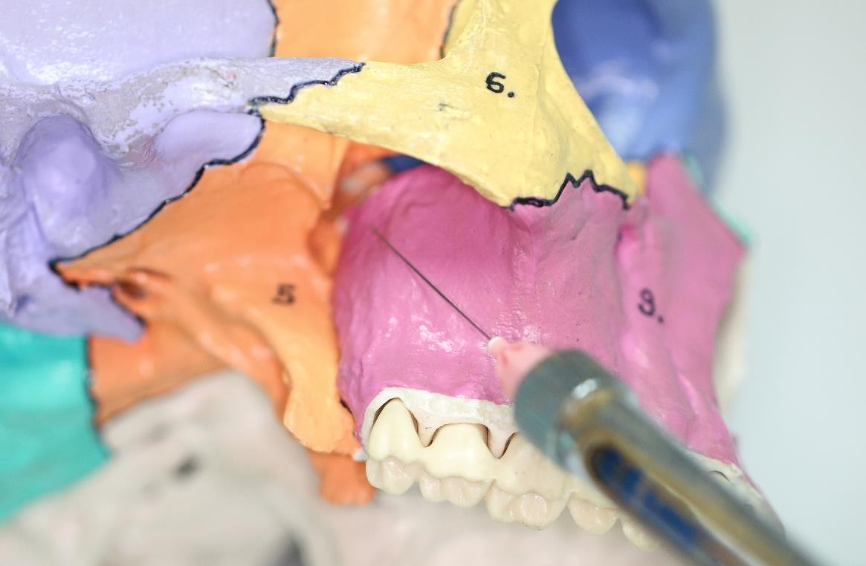
POSTERIOR SUPERIOR ALVEOLAR NERVE BLOCK TECHNIQUE
Landmarks
Mucobuccal fold
Maxillary tuberosity
Zygomatic process of the maxilla
Orientation of the bevel: toward bone during the injection. If bone is accidentally touched, the sensation is less unpleasant.

Slide 32
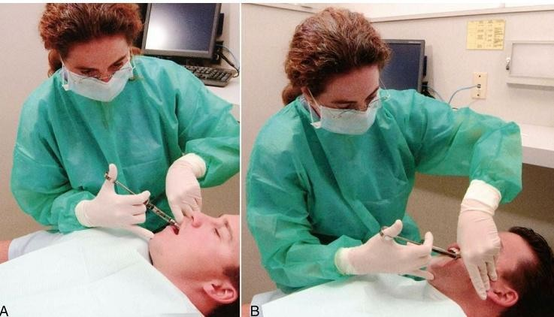
PROCEDURE
Operator position
–Left PSA nerve block, a right-handed administrator -10 o'clock position facing the patient.
–Right PSA block, a right-handed administrator -8 o'clock position facing the
patient

Slide 33
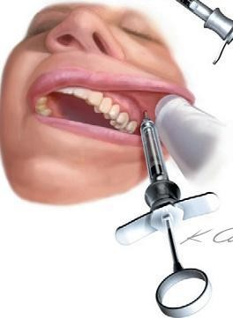
PROCEDURE
Apply a topical antiseptic (optional).
Orient the bevel of the needle toward bone.
Partially open the patient's mouth, pulling the mandible to the side of injection.
Retract the patient's cheek with your finger
(for visibility).
Pull the tissues at the injection site taut.
Insert the needle into the height of the
mucobuccal fold over the second molar

Slide 34
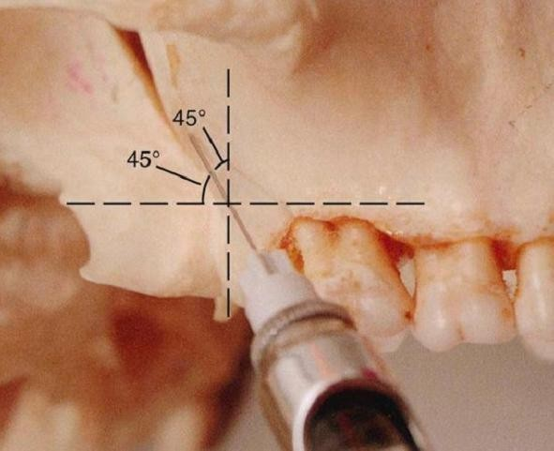
PROCEDURE
Advance the needle slowly in an upward, inward, and backward direction in one movement (not three)
  Upward: superiorly at a 45-degree angle to the occlusal plane
  Inward: medially toward the midline at a 45-degree angle to the occlusal plane
  Backward: posteriorly at a 45-degree angle to the long axis of the second molar

Slide 35
PROCEDURE
Slowly advance the needle through soft tissue.
Ideally there should be no resistance and therefore no discomfort to the patient.
If resistance (bone) is felt, the angle of the needle in toward the midline is too great.
Withdraw the needle slightly (but do not remove it entirely from the tissues) and
bring the syringe barrel closer to the occlusal plane.
Readvance the needle.

Slide 36
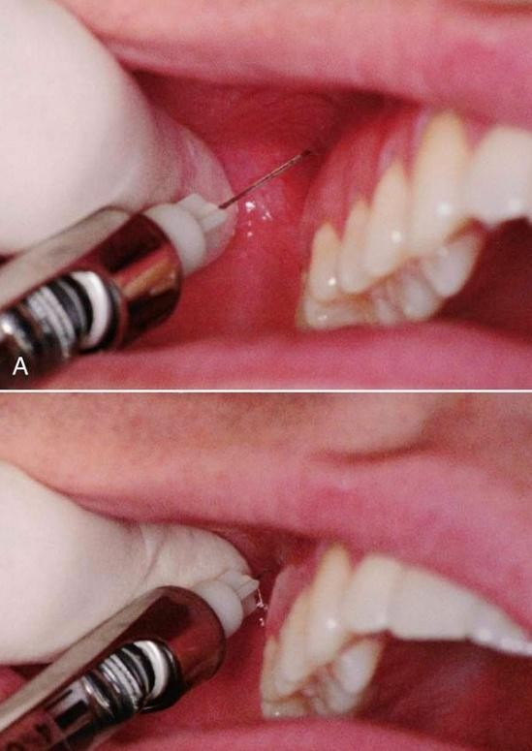
PROCEDURE
Advance the needle to the desired depth
Adult of normal size: depth of 16 mm places the needle tip in the immediate vicinity of target area
Aspirate in two planes.
If both aspirations are negative: Slowly, over 30 to 60 seconds, deposit 0.9 to 1.8 mL of anesthetic solution.
Slowly withdraw the syringe.
Wait minimally 3 to 5 minutes before
commencing the dental procedure.

Slide 37
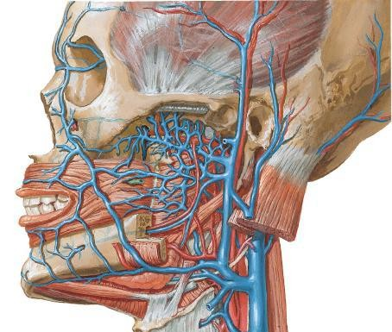
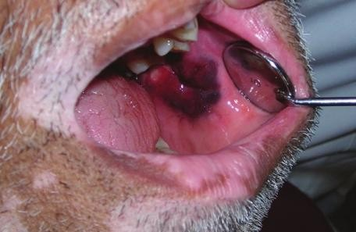
COMPLICATIONS
Hematoma: inserting the needle too far posteriorly into the pterygoid plexus of veins and in addition, the maxillary artery may be perforated.
–Use of a short needle minimizes the risk of
pterygoid plexus puncture.
Mandibular anesthesia: V3 is located lateral to the PSA nerves. Deposition of local anesthetic lateral to the desired location may produce varying degrees of mandibular anesthesia.

Slide 38
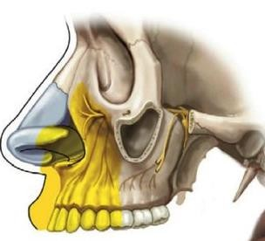
ANTERIOR SUPERIOR ALVEOLAR NERVE BLOCK
Also known as Infraorbital Nerve Block.
Not so popular –general lack of experience with this highly successful and extremely safe technique.
Infraorbital nerve provides anesthesia to the soft tissues of the anterior portion of the face, not to the teeth or intraoral soft and hard tissues.
Therefore it is inaccurate to call the ASA nerve block the infraorbital nerve block

Slide 39
Nerves
Anterior superior alveolar nerve
Nervus alveolaris superior anterior

Slide 40
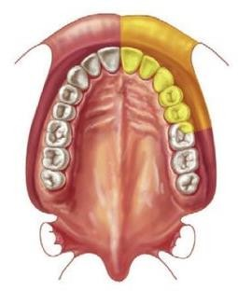
ANTERIOR SUPERIOR ALVEOLAR NERVE BLOCK
Nerves Anesthetized
Anterior superior alveolar
Middle superior alveolar
Infraorbital nerve
  Inferior palpebral
  Lateral nasal
  Superior labial
Areas Anesthetized
Pulps of the maxillary central incisor through the canine on the injected side
In about 72% of patients, pulps of the maxillary premolars and mesiobuccal root of the first
molar
Buccal (labial) periodontium and bone of these same teeth
Lower eyelid, lateral aspect of the nose, upper lip

Slide 41
ANTERIOR SUPERIOR ALVEOLAR NERVE BLOCK
Indications
Dental procedures involving more than two maxillary teeth and their overlying buccal tissues
Inflammation or infection (which contraindicates supraperiosteal injection)
When supraperiosteal injections have been ineffective because of dense cortical bone.
Contraindications
–Discrete treatment areas (one or two teeth only; supraperiosteal preferred)
–Hemostasis of localized areas

Slide 42
ANTERIOR SUPERIOR ALVEOLAR NERVE BLOCK
Advantages
Comparatively simple technique
Comparatively safe; minimizes the volume of solution used and the number of needle
punctures necessary to achieve anesthesia.
Disadvantages
Psychological
  Administrator: There may be an initial fear of injury to the patient's eye
  Patient: An extraoral approach to the infraorbital nerve may prove disturbing; however,
intraoral techniques are rarely a problem.
Anatomic: difficulty defining landmarks (rare)

Slide 43
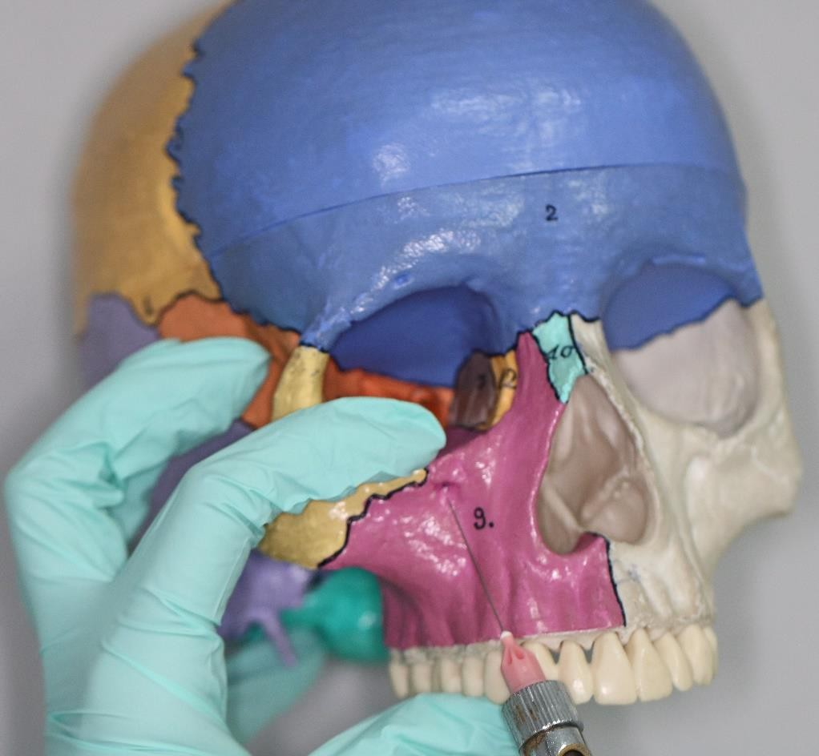
ANTERIOR SUPERIOR ALVEOLAR NERVE BLOCK
Technique
Positive Aspiration: 0.7%.
Alternatives
  Supraperiosteal, PDL, or IO injection for each tooth
  Infiltration for the periodontium and hard tissues
  Maxillary nerve block

Slide 44
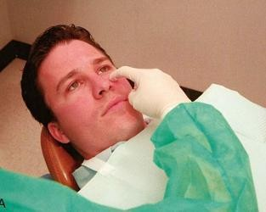
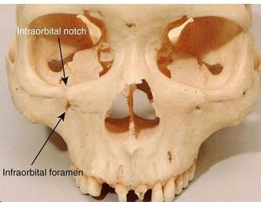
ANTERIOR SUPERIOR ALVEOLAR NERVE BLOCK
Technique
25-or 27-gauge long needle is recommended
Area of insertion: height of the mucobuccalfold directly over the first premolar.
Target area: infraorbital foramen
Landmarks
  Mucobuccal fold
  Infraorbital notch
  Infraorbital foramen
•Orientation of the bevel: toward bone

Slide 45
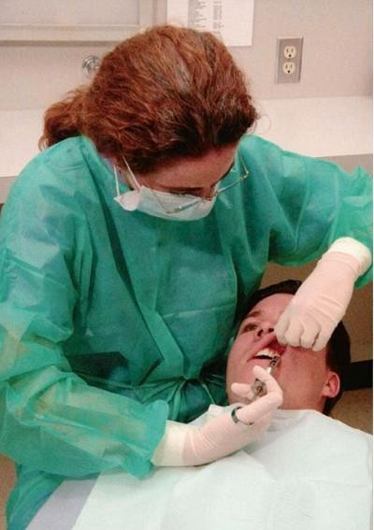
ANTERIOR SUPERIOR ALVEOLAR NERVE BLOCK
Procedure
Assume the correct position
For a right or left infraorbital nerve block (right-handed) -10 o'clock position directly facing the patient.

Slide 46
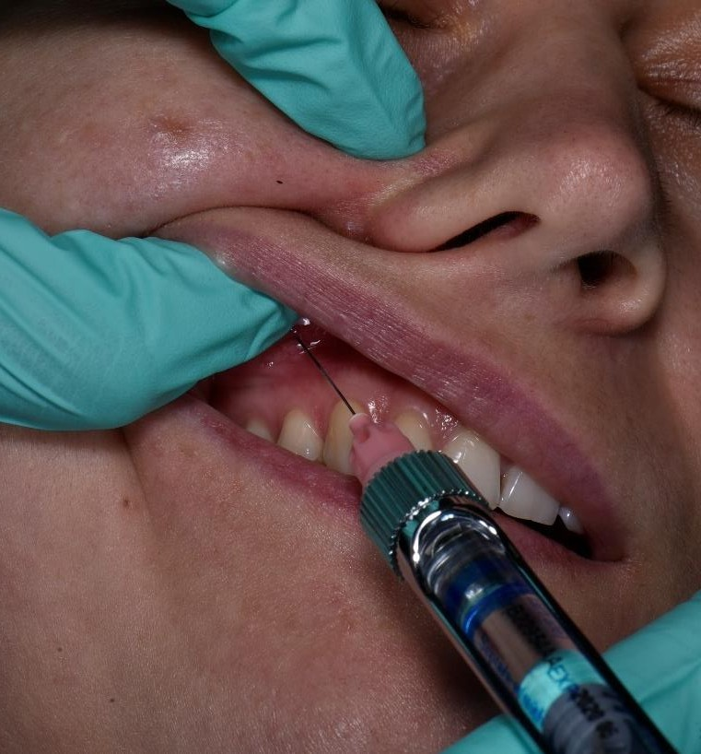
ANTERIOR SUPERIOR ALVEOLAR NERVE BLOCK
Procedure
Prepare the tissues at the injection site.
Locate the infraorbital foramen
Feel the infraorbital notch.
  Move your finger downward from the notch,
applying gentle pressure to the tissues.
  The bone immediately inferior to the notch is convex (felt as an outward bulge). This represents the lower border of the orbit and the roof of the infraorbital foramen
  As your finger continues inferiorly, a concavity
is felt; this is the infraorbital foramen.
  The patient senses a mild soreness when the foramen is palpated as the infraorbital nerve is pressed against bone.

Slide 47
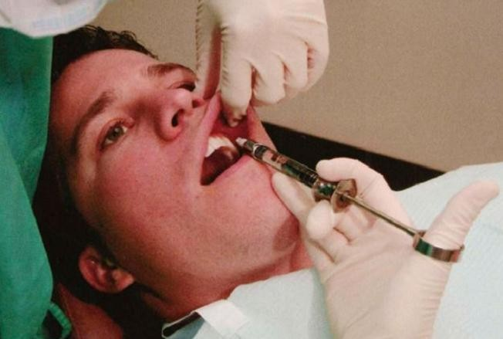
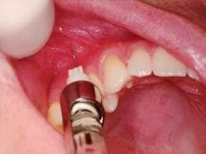
ANTERIOR SUPERIOR ALVEOLAR NERVE BLOCK
Procedure
Maintain your finger on the foramen or mark the skin at the site.
Retract the lip, pulling the tissues in the mucobuccal fold taut and increasing visibility.
Insert the needle into the height of the mucobuccal fold over the first premolar with the bevel facing bone
Orient the syringe toward the infraorbital
foramen.

Slide 48
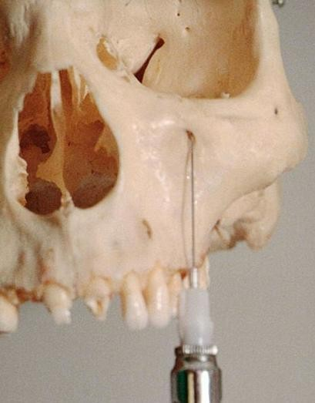
ANTERIOR SUPERIOR ALVEOLAR NERVE BLOCK
Procedure
The needle should be held parallel with the long axis of the
tooth as it is advanced, to avoid premature contact with bone
Advance the needle slowly until bone is gently contacted.
  The point of contact should be the upper rim of the infraorbital
foramen.
  The general depth of needle penetration is 16 mm for an adult of
average height
  The depth of penetration varies
    In a patient with a high (deep) mucobuccal fold
    a low infraorbital foramen
  A preinjection approximation of the depth of penetration can be made by placing one finger

Slide 49
ANTERIOR SUPERIOR ALVEOLAR NERVE BLOCK
Procedure
Before injecting the anesthetic solution, check for the following:
  Depth of needle penetration (adequate to reach the foramen)
  Any lateral deviation of the needle from the infraorbital foramen;
  Orientation of the bevel (facing bone)
  Position the needle tip during injection with the bevel facing into the infraorbital foramen
and the needle tip touching the roof of the foramen
Aspirate in two planes.

Slide 50
ANTERIOR SUPERIOR ALVEOLAR NERVE BLOCK
Procedure
Slowly deposit 0.9 to 1.2 mL(over 30 to 40 seconds).
Little or no swelling should be visible as the solution is deposited.
If the needle tip is properly inserted at the opening of the foramen, solution is directed toward the foramen.
  The administrator is able to “feel” the anesthetic solution as it is deposited beneath the finger on the foramen if the needle tip is in the correct position.
  At the conclusion of the injection, the foramen should no longer be palpable (because of
the volume of anesthetic in this position).
  At this point, the infraorbital nerve block (providing anesthesia to the soft tissues on the
anterior portion of the face and the lateral aspect of the nose) is complete.

Slide 51
ANTERIOR SUPERIOR ALVEOLAR NERVE BLOCK
Procedure
To transform it into the anterior superior alveolar nerve block do the
following:
  Maintain firm pressure with your finger over the injection site both during and for at least 1 minute after the injection
  Withdraw the syringe slowly and immediately make the needle safe.
  Maintain direct finger pressure over the injection site for a minimum of 1 minute, preferably 2 minutes, after injection.
  Wait a minimum of 3 to 5 minutes after completion of the injection before commencing the dental procedure.

Slide 52
ANTERIOR SUPERIOR ALVEOLAR NERVE BLOCK
Signs and Symptoms
Subjective: Tingling and numbness of the lower eyelid, side of the nose, and upper lip
Subjective and objective: numbness in the teeth and soft tissues along the distribution of the ASA and MSA nerves
Objective
  electrical pulp testing -no response
  Absence of pain during treatment

Slide 53
ANTERIOR SUPERIOR ALVEOLAR NERVE BLOCK
Safety Features
Needle contact with bone at the roof of the infraorbital foramen prevents inadvertent over-insertion and possible puncture of the orbit.
A finger positioned over the infraorbital foramen helps direct the needle toward the foramen.
  The needle should not be palpable. If it is felt, then its path is too superficial (away from the bone).
  In most patients, it is not possible to palpate the needle through soft tissues over the foramen unless it is too superficial.

Slide 54
ANTERIOR SUPERIOR ALVEOLAR NERVE BLOCK
Precautions
For pain on insertion of the needle and tearing of the periosteum, reinsert the needle in a more lateral (away from bone) position, or deposit solution as the needle advances through soft tissue.
To prevent overinsertion of the needle, estimate the depth of penetration before injection (review procedure), and exert finger pressure over the infraorbital foramen.
Overinsertionis unlikely because of the rim of bone that forms the superior rim
of the infraorbital foramen. The needle tip contacts this rim.

Slide 55
ANTERIOR SUPERIOR ALVEOLAR NERVE BLOCK
Failures of Anesthesia
Needle contacting bone below (inferior to) the infraorbital foramen. To correct:
  Keep the needle in line with the infraorbital foramen during penetration. Do not direct the needle toward bone.
  Estimate the depth of penetration before injecting.
Needle deviation medial or lateral to the infraorbital foramen. To correct:
  Direct the needle toward the foramen immediately after inserting and before advancing through the tissue.
  Recheck needle placement before aspirating and depositing the anesthetic solution

Slide 56
ANTERIOR SUPERIOR ALVEOLAR NERVE BLOCK
Complications
Hematoma(rare) may develop
–across the lower eyelid and the tissues between it and the infraorbital foramen.
Management: apply pressure on the soft tissue over the foramen for 2 to 3 minutes.
Its extremely rare because pressure is routinely applied to the injection site both during and after administration of the ASA nerve block.

Slide 57
GREATER PALATINE NERVE BLOCK
Also known as Anterior palatine nerve block.
Although potentially traumatic, its less than the nasopalatine nerve block
–tissues surrounding the greater palatine foramen are not as firmly adherent to bone
–therefore are better able to accommodate the volume of solution deposited.
Nerve Anesthetized: Greater palatine

Slide 58
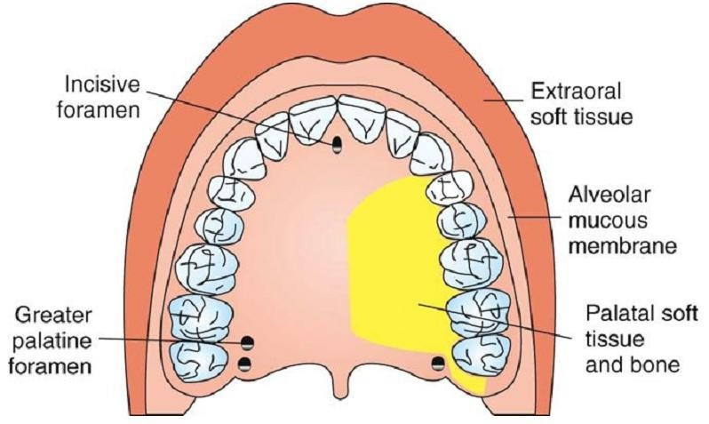
GREATER PALATINE NERVE BLOCK
Areas Anesthetized
The posterior portion of the hard palate and its overlying soft tissues, anteriorly as far as the first premolar and medially to the midline

Slide 59
GREATER PALATINE NERVE BLOCK
Indications
When palatal soft tissue anesthesia is necessary for restorative therapy on more than two teeth
–Ex: subgingival restorations -insertion of matrix bands subgingivally
For pain control during periodontal or oral surgical procedures involving the palatal soft and hard tissues
Contraindications
Inflammation or infection at the injection site
Smaller areas of therapy (one or two teeth)

Slide 60
GREATER PALATINE NERVE BLOCK
Advantages
Minimizes needle penetrations and volume of solution
Minimizes patient discomfort
Disadvantages
No hemostasisexcept in the immediate area of injection
Potentially traumatic
Positive Aspiration: Less than 1%.
Alternatives
Local infiltration into specific regions
Maxillary nerve block

Slide 61
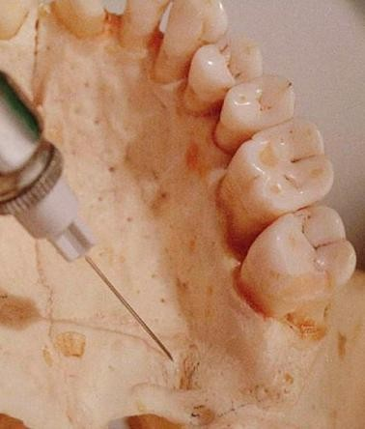
GREATER PALATINE NERVE BLOCK
Technique
A 27-gauge short needle is recommended.
Area of insertion: soft tissue slightly anterior to
the greater palatine foramen
Target area: greater (anterior) palatine nerve as it passes anteriorly between soft tissues and bone of the hard palate
Landmarks: greater palatine foramen and junction of the maxillary alveolar process and palatine bone
Path of insertion: advance the syringe from the opposite side of the mouth at a right angle to the target area
Orientation of the bevel: toward the palatal soft
tissues

Slide 62
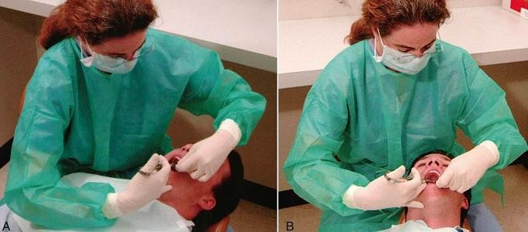
GREATER PALATINE NERVE BLOCK
Procedure
Assume the correct position
  Right GPN block (right-handed administrator): 7 or 8 o'clock position.
  Left GPN block: 11 o'clock position.
Patient: a supine position with mouth opened wide and extended neck.

Slide 63
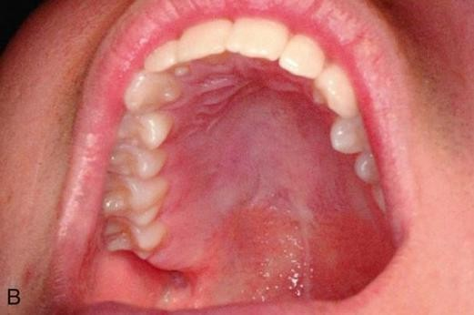
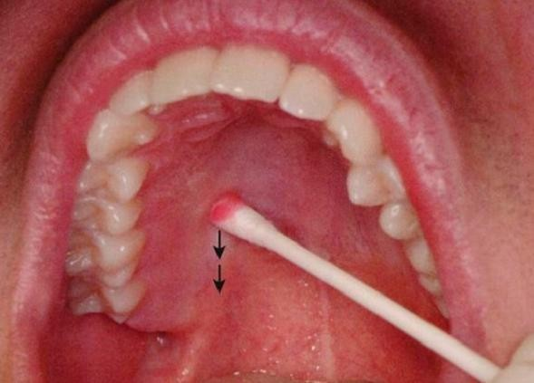
GREATER PALATINE NERVE BLOCK
Procedure
Turn the head to the left or right (for improved visibility).
Locate the greater palatine foramen
  –Place a cotton swab at the junction of the maxillary alveolar process and the hard palate.
  –Start in the region of the maxillary first molar and palpate posteriorly by pressing firmly into the tissues with the swab.
  –The swab “falls” into the depression created by the greater palatine foramen

Slide 64
GREATER PALATINE NERVE BLOCK
Procedure
The foramen is most frequently located distal to the maxillary second molar, but it may be located anterior or posterior to its usual position
Prepare the tissue at the injection site, just 1 to 2 mm anterior to the greater palatine foramen.
  Clean and dry with sterile gauze.
  Apply topical antiseptic (optional).
  Apply topical anesthetic for 2 minutes.
Move the swab posteriorlyso it is directly over the greater palatine foramen.
  Apply considerable pressure at the area of the foramen with the swab
  Note the ischemia (whitening of the soft tissues) at the injection site.

Slide 65
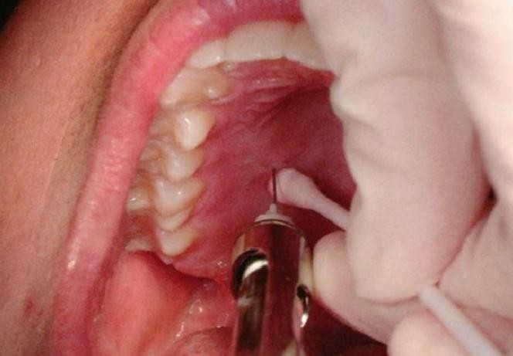
GREATER PALATINE NERVE BLOCK
Procedure
Direct the syringe into the mouth from the opposite side with the needle
approaching the injection site at a right angle

Slide 66
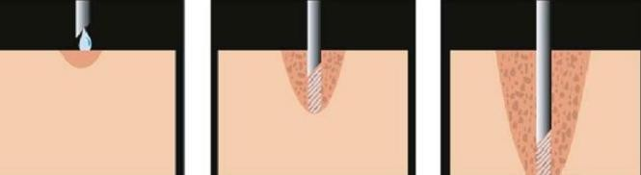
GREATER PALATINE NERVE BLOCK
Procedure
Place the bevel (not the point) of the needle gently against the previously blanched (ischemic) soft tissue at the injection site.
It must be well stabilized to prevent accidental penetration of the tissues.

Slide 67
GREATER PALATINE NERVE BLOCK
Procedure
With the bevel lying against the tissue
  Angle the needle a little and deposit a small volume of anesthetic -forced against the
mucous membrane
  Straighten the needle and permit the bevel to penetrate mucosa.
Continue to deposit small volumes of anesthetic throughout the procedure.
Ischemia spreads into adjacent tissues as the anesthetic

Slide 68
GREATER PALATINE NERVE BLOCK
Procedure
Continue to apply pressure anesthesia throughout the deposition of the
anesthetic solution
Slowly advance the needle until palatine bone is gently contacted.
  The depth of penetration is usually about 5 mm.
Aspirate in two planes
slowly deposit (30 second minimum): 0.45 to 0.6 ml
Withdraw the syringe.
Make the needle safe.
Wait 2 to 3 minutes before commencing the procedure.

Slide 69
GREATER PALATINE NERVE BLOCK
Signs and Symptoms
Subjective: numbness in the posterior portion of the palate
Objective: no pain during dental therapy
Safety Features: Contact with bone
Precautions :Do not enter the greater palatine canal.
  Not hazardous: no reason to enter the canal for this technique to be successful

Slide 70
GREATER PALATINE NERVE BLOCK
Failures of Anesthesia
Not a technically difficult injection to administer - success is well above 95%.
If LA is deposited too far anterior to the foramen, inadequate soft tissue anesthesia posterior to the site of injection (partial success).
Inadequate anesthesia in the area of the maxillary first premolar:
overlapping fibers from the nasopalatine nerve (partial success).
  To correct: Local infiltration may be necessary as a supplement in the area of inadequate anesthesia.

Slide 71
GREATER PALATINE NERVE BLOCK
Complications
Few of significance
Ischemia and necrosis of soft tissues when highly concentrated vasoconstricting solution used for hemostasis over a prolonged period
Hematoma is possible but rare because of the density and firm adherence of
palatal tissues to underlying bone.
Some patients may be uncomfortable if their soft palate becomes anesthetized

Slide 72
NASOPALATINE NERVE BLOCK
Also known as Incisive nerve block, sphenopalatine nerve block
Administration of a minimum volume of anesthetic solution.
Wide area of palatal soft tissue anesthesia is achieved
Thereby minimizing the need for multiple palatal injections.
Nerves Anesthetized: Nasopalatine nerves bilaterally.

Slide 73
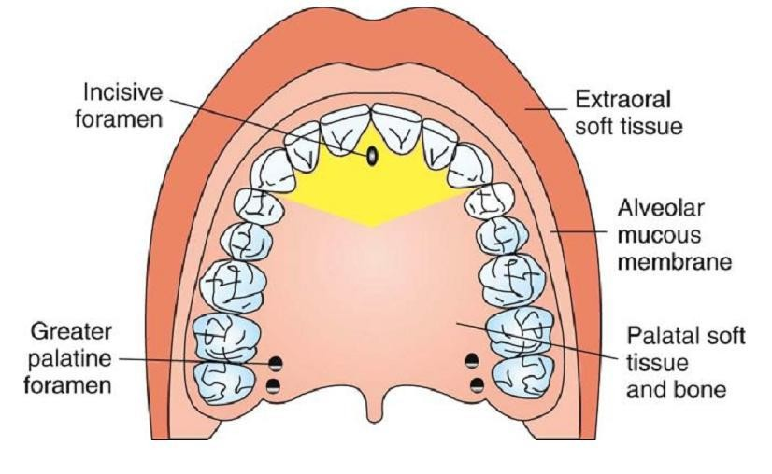
NASOPALATINE NERVE BLOCK
Areas Anesthetized
Anterior portion of the hard palate (soft and hard tissues) bilaterally from the
mesialof the right first premolar to the mesialof the left first premolar

Slide 74
NASOPALATINE NERVE BLOCK
Indications
When palatal soft tissue anesthesia is necessary for restorative treatment on more than two teeth (e.g., subgingival restorations, insertion of matrix bands subgingivally)
For pain control during periodontal or oral surgical procedures involving palatal soft and hard tissues
Contraindications
Inflammation or infection at the injection site
Smaller area of therapy (one or two teeth)

Slide 75
NASOPALATINE NERVE BLOCK
Advantages
•Minimizes needle penetrations and volume of solution
•Minimal patient discomfort from multiple needle penetrations
Disadvantages
No hemostasis except in the immediate area of injection
Potentially the most traumatic intraoral injection; however
  the protocol for an atraumatic injection
  or use of a C-CLAD system
  or a buffered local anesthetic solution can minimize or entirely eliminate discomfort

Slide 76
NASOPALATINE NERVE BLOCK
Positive Aspiration: Less than 1%.
Alternatives
  Local infiltration into specific regions
  Maxillary nerve block (unilateral only)
  Anterior middle superior alveolar (AMSA) nerve block (unilateral only)

Slide 77
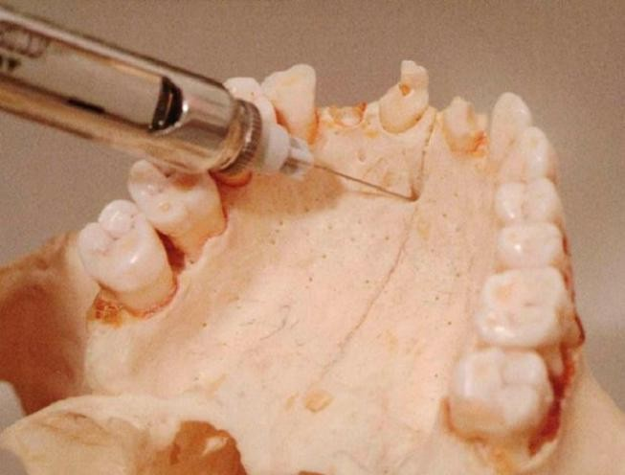
NASOPALATINE NERVE BLOCK
Technique: Single-Needle Penetration
27-gauge short needle is recommended.
Area of insertion: palatal mucosa just lateral to the incisive papilla - more sensitive than other palatal mucosa
Target area: incisive foramen, beneath the incisive papilla
Landmarks: central incisors and incisive papilla
Path of insertion: Approach the injection site at a 45-degree angle toward the
incisive papilla.
Orientation of the bevel: toward the palatal soft tissue

Slide 78
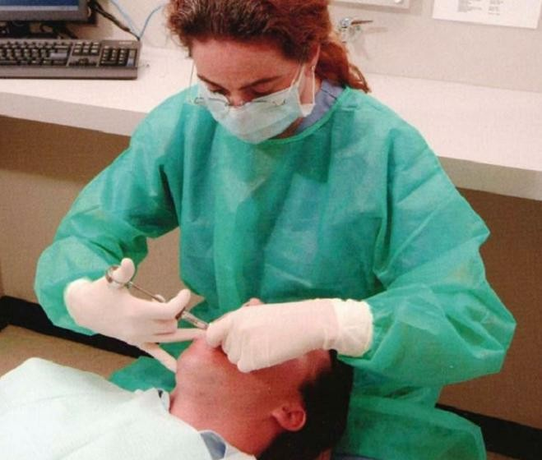
NASOPALATINE NERVE BLOCK
Procedure
Sit at the 9 or 10 o'clock position
Request the patient to: open wide and
extend the neck.
Turn the head to the left or right for improved visibility

Slide 79
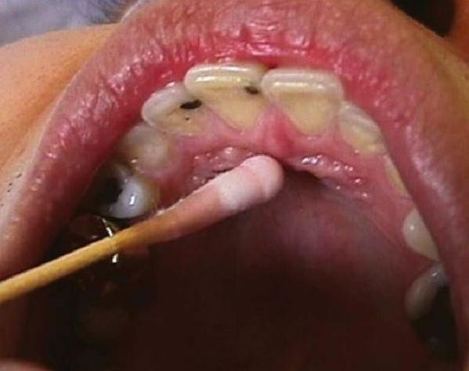
NASOPALATINE NERVE BLOCK
Prepare the tissue just lateral to the incisive papilla
Clean and dry with sterile gauze.
Apply topical antiseptic (optional) for 2 minutes.
After 2 minutes of topical anesthetic application, move the swab directly onto the incisive papilla

Slide 80
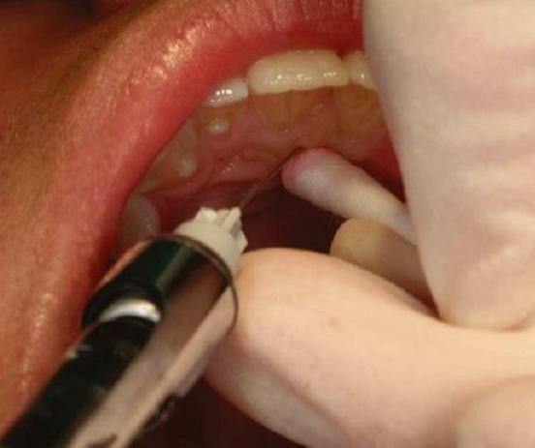
NASOPALATINE NERVE BLOCK
Procedure
With the swab in your left hand, apply
pressure to the area of the papilla.
Note ischemia at the injection site.
Place the bevel against the ischemic
soft tissues at the injection site.
The needle must be well stabilized to prevent accidental penetration of tissues.

Slide 81
NASOPALATINE NERVE BLOCK
Procedure
With the bevel lying against the tissue
Apply enough pressure to bow the needle slightly.
Deposit a small volume of anesthetic.
The solution will be forced against the mucous membrane.
Straighten the needle and permit the bevel to penetrate the mucosa.
Continue to deposit small volumes of anesthetic throughout the procedure.
Observe ischemia spreading into adjacent tissues as solution is deposited

Slide 82
NASOPALATINE NERVE BLOCK
Procedure
Continue to apply pressure with the cotton applicator stick while injecting the anesthetic.
Slowly advance the needle toward the incisive foramen until bone is gently
contacted
The depth of penetration normally is not greater than 5 mm.
Deposit small volumes of anesthetic while advancing the needle.
As the tissue is entered, resistance to the deposition of solution is significantly
increased; this is normal with this block

Slide 83
NASOPALATINE NERVE BLOCK
Procedure
Withdraw the needle 1 mm (to prevent subperiostealinjection).
The bevel now lies over the center of the incisive foramen.
Aspirate in two planes.
If negative, slowly deposit (15-to 30-second minimum) not more than 0.45 mL
In some patients, it is difficult to deposit 0.45 mLof anesthetic solution in this injection.
Slowly withdraw the syringe.
Make the needle safe.
Wait 2 to 3 minutes before commencing the dental procedure.

Slide 84
NASOPALATINE NERVE BLOCK
Signs and Symptoms
Subjective: numbness in the anterior portion of the palate
Objective: no pain during dental therapy
Safety Features: Contact with bone
Precautions
  Against pain
    Do not insert directly into the incisive papilla (quite painful).
    Do not deposit solution too rapidly.
    Do not deposit too much solution.
  Against infection
    If the needle is advanced more than 5 mm into the incisive canal and the floor of the nose is entered accidentally, infection may result.
    There is no reason for the needle to enter the incisive canal during a nasopalatine nerve block.

Slide 85
NASOPALATINE NERVE BLOCK
Failures of Anesthesia
Highly successful injection (>95% incidence of success)
Unilateral anesthesia: If solution is deposited to one side of the incisive canal
  To correct: Reinsert the needle into the already anesthetized tissue and reinject solution into the unanesthetized area.
Inadequate palatal soft tissue anesthesia in the area of the maxillary canine and first premolar
  fibers from the GPN overlap those of the nasopalatine nerve,
  To correct: Local infiltration may be necessary as a supplement in the area inadequately anesthetized

Slide 86
NASOPALATINE NERVE BLOCK
Complications
Few of significance
Hematoma is possible but extremely rare because of the density and firm adherence of palatal soft tissues to bone.
Necrosis of soft tissues is possible when highly concentrated vasoconstricting
solution (e.g., norepinephrine) is used for hemostasis over a prolonged period
Because of the density of soft tissues, anesthetic solution may “squirt” back out the needle puncture site during administration or after needle withdrawal.

Slide 87
MANDIBULAR BLOCKS
Deposit local anesthetic solution to within 1 mm of the target nerve
Significantly higher failure rate.
  Thicker cortical plate
  Anatomical variation of location of mandibular foramen.
Nerve blocks have been described
Inferior alveolar,
Incisive,
Gow-Gates mandibular,
Vazirani-Akinosi (closed-mouth)
Mental block
Buccal nerves block

Slide 88
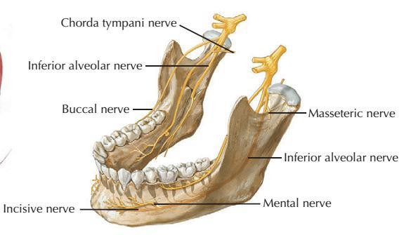
INFERIOR ALVEOLAR NERVE BLOCK (IANB)
Mostly reffered as mandibular nerve block.
Second most frequently used (after infiltration)
highest percentage of clinical failures even when properly administered.
Supplemental block with IANB
  Buccal Block –soft tissue on buccal aspect
  Supra-periosteal–overlap of contralateral nerve mostly anterior
  Periodontal ligament (PDL) injection -isolated portions of mandibular teeth sensitive even after successful IANB
  Intraosseous anesthesia (IO)–ineffective IANB, primarily when the tooth is pulpally involved.

Slide 89
Nerves
Inferior alveolar nerve
Nervus alveolaris inferior

Slide 90
INFERIOR ALVEOLAR NERVE BLOCK (IANB)
Bilateral IANBs is rarely indicated other than bilateral mandibular surgeries
  considerable discomfort
  feels unable to swallow
  likely to self-injure the anesthetized soft tissues.
Multiple anterior tooth (canine to canine)
  IANB on most affected teeth
  Incisive on the other side.

Slide 91
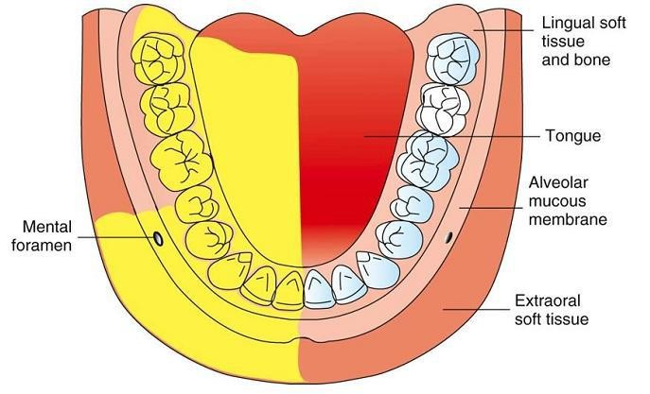
INFERIOR ALVEOLAR NERVE BLOCK (IANB)
Nerves Anesthetized
Inferior alveolar,
Incisive
Mental
Lingual (commonly)
Areas Anesthetized
Mandibular teeth to the midline
Body of the mandible, inferior portion of the ramus
Buccal mucoperiosteum, mucous membrane anterior to the mental foramen (mental
nerve)
Anterior two thirds of the tongue and floor of the oral cavity (lingual nerve)
Lingual soft tissues and periosteum (lingual nerve)

Slide 92
INFERIOR ALVEOLAR NERVE BLOCK (IANB)
Indications
Procedures on multiple mandibularteeth in one quadrant
When buccalsoft tissue anesthesia (anterior to the mental foramen) is necessary
When lingual soft tissue anesthesia is necessary
Contraindications
Infection or acute inflammation in the area of injection (rare)
Patients who are more likely to bite their lip or tongue, for ex.: physically challenged pt. and children

Slide 93
INFERIOR ALVEOLAR NERVE BLOCK (IANB)
Advantages: One injection provides a wide area of anesthesia
Disadvantages
Wide area of anesthesia (not indicated for localized procedures)
Rate of inadequate anesthesia (31% to 81%)
Intraoral landmarks not consistently reliable
Positive aspiration (10% to 15%, highest of all intraoral injection techniques)
Lingual and lower lip anesthesia, discomfiting to many patients and possibly
dangerous (self-inflicted soft tissue trauma) for certain individuals
Partial anesthesia possible where a bifid inferior alveolar nerve and bifid mandibular canals are present;
cross-innervation in lower anterior region

Slide 94
INFERIOR ALVEOLAR NERVE BLOCK (IANB)
Positive Aspiration: 10% to 15%. Alternatives
  Mental nerve block: buccal soft tissue anesthesia anterior to the first molar
  Incisive nerve block: pulpal and buccal soft tissue anesthesia of teeth anterior to the mental foramen (usually second premolar to central incisor)
  Supraperiosteal injection, for pulpal anesthesia of the central and lateral incisors, and sometimes premolars and molars
  Gow-Gates mandibular nerve block
  Vazirani-Akinosi mandibular nerve block
  PDL injection for pulpal anesthesia of any mandibular tooth
  IO injection for pulpal and soft tissue anesthesia of any mandibular tooth, but especially molars

Slide 95
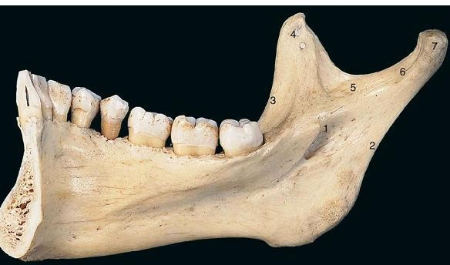
INFERIOR ALVEOLAR NERVE BLOCK (IANB)
Technique
A long dental needle is recommended for
the adult patient.
  A 25-gauge long needle is preferred
  A 27-gauge long is acceptable
Area of insertion: Mucous membrane on the medial (lingual) side of the mandibular ramus, at the intersection of two lines
Target area: Inferior alveolar nerve as it passes downward toward the mandibular foramen but before it enters into the foramen.

Slide 96

INFERIOR ALVEOLAR NERVE BLOCK (IANB)
Landmarks
Coronoid notch (greatest concavity on the anterior border of the ramus)
Pterygomandibular raphe(vertical portion)
Occlusal plane of the mandibular posterior teeth
Orientation of the needle bevel: bevel should
face the bone, but less critical

Slide 97
INFERIOR ALVEOLAR NERVE BLOCK (IANB)
Three parameters must be considered during administration of IANB:
the height of the injection,
the anteroposterior placement of the needle (which helps to locate a precise
needle entry point)
the depth of penetration (which determines the location of the inferior alveolar nerve)

Slide 98


INFERIOR ALVEOLAR NERVE BLOCK (IANB)
Procedure
Assume the correct position.
  right IANB (right-handed) -sit at the 8
o'clock position facing the patient
  left IANB (right-handed) -sit at the 10
o'clock position
Position the patient supine (recommended) or semisupine (if necessary).
Locate the needle penetration (injection) site.

Slide 99

INFERIOR ALVEOLAR NERVE BLOCK (IANB)
Needle penetration (injection) site
  –Height of injection: a line parallel to occlusal plane bisecting the thumb placed on coronoid notch.
  –Point of injection: deepest part of the pterygomandibular raphe
Tissue preparation
  –Dry with sterile gauze.
  –Apply topical antiseptic (optional) for 1 to 2 minutes.
6. Place the barrel of the syringe in the corner of
the mouth on the contralateral side

Slide 100

INFERIOR ALVEOLAR NERVE BLOCK (IANB)
Penetration depth: bone should be contacted ideally 20 to 25 mm (2/3 to 3/4 of a long needle).
  If bone is contacted too soon
    needle tip is usually located too far
anteriorly(laterally) on the ramus
    Redirect the needle until a more appropriate depth of insertion is obtained
  If bone is not contacted
    the needle tip usually is located too far posterior
(medial)
    To correct: Withdraw it slightly from the tissues and reposition the syringe barrel over the premolars and reinsert.

Slide 101
INFERIOR ALVEOLAR NERVE BLOCK (IANB)
When bone is contacted,
  withdraw approximately 1 mm to prevent subperiosteal injection
  Aspirate in two planes
  If negative, slowly deposit 1.5 mLof anesthetic over a minimum of 60 sec.
Slowly withdraw the syringe, and when approximately half its length
remains within tissues, reaspirate.
  If negative, deposit a portion of the remaining solution (0.2 mL) to anesthetize the lingual nerve

Slide 102
INFERIOR ALVEOLAR NERVE BLOCK (IANB)
Signs and Symptoms
Subjective
  Tingling or numbness of the lower lip
  Tingling or numbness of the tongue
Objective
  Using an electrical pulp tester (EPT)
  No pain is felt during dental therapy
Precautions
  Do not deposit local anesthetic if bone is not contacted
  needle tip may be resting within the parotid gland near the facial nerve (cranial nerve VII)
  transient blockade (paralysis) of the facial nerve may develop if local anesthetic solution is
deposited.
  Avoid pain by not contacting bone too forcefully

Slide 103
INFERIOR ALVEOLAR NERVE BLOCK (IANB)
Failures of Anesthesia
Deposition of anesthetic too low (below the mandibular foramen).
Deposition of the anesthetic too far anteriorly(laterally) on the ramus.
Accessory innervation to the mandibular teeth
-Incomplete anesthesia of the central or lateral incisors

Slide 104
INFERIOR ALVEOLAR NERVE BLOCK (IANB)
Complications
Hematoma (rare) -Pressure and cold (e.g., ice) to the area for a minimum of 3 to 5 minutes
Trismus a Muscle soreness or limited movement
Transient facial paralysis (facial nerve anesthesia)

Slide 105

BUCCAL NERVE BLOCK
commonly referred to as the long buccal nerve block.
success rate approaching 100%.
Readily accessible to the local anesthetic as it lies immediately beneath the mucous membrane, not buried within bone.
Nerve Anesthetized: Buccal (a branch of the anterior division of the V3)

Slide 106

BUCCAL NERVE BLOCK
Area Anesthetized
Soft tissues and periosteum buccal to the mandibular molar teeth

Slide 107

BUCCAL NERVE BLOCK
Indication
When buccal soft tissue anesthesia is necessary for dental procedures –mandibular
molar region
Contraindication
Infection or acute inflammation in the area of injection
Advantages
High success rate
Technically easy
Disadvantages
Potential for pain if the needle contacts the periosteum during injection.
Positive Aspiration: 0.7 %

Slide 108

BUCCAL NERVE BLOCK
Signs and Symptoms
Rarely experiences any subjective symptoms -location and small size of the
anesthetized area
Objective: Instrumentation in the anesthetized area without pain indicates satisfactory pain control
Safety Features
Needle contacts bone, therein preventing overinsertion.
Minimum positive aspiration rate

Slide 109
BUCCAL NERVE BLOCK
Complications
Few of any consequence
Hematoma (bluish discoloration and tissue swelling at the injection site).
Blood may exit the needle puncture point into the buccal vestibule.
  –Apply pressure with gauze directly to the area of bleeding for a minimum of 3 to 5 minutes.

Slide 110
GOW-GATES TECHNIQUE
high success rate: approximately 99%
true mandibular nerve block because it provides sensory anesthesia to virtually the entire distribution of V3
  inferior alveolar,
  lingual,
  mylohyoid,
  mental,
  incisive,
  Auriculotemporal
  Buccal nerves

Slide 111

GOW-GATES TECHNIQUE
Areas Anesthetized
Mandibular teeth to the midline
Buccal mucoperiosteum and mucous membranes on the side of injection
Anterior two thirds of the tongue and floor of the oral cavity
Lingual soft tissues and periosteum
Body of the mandible, inferior portion of
the ramus
Skin over the zygoma, posterior portion of
the cheek, and temporal regions

Slide 112
GOW-GATES TECHNIQUE
Indications
–Multiple procedures on mandibular teeth
–When buccal soft tissue anesthesia, from the third molar to the midline, is necessary
–When lingual soft tissue anesthesia is necessary
–When a conventional inferior alveolar nerve block is unsuccessful
Contraindications
–Infection or acute inflammation in the area of injection (rare)
–Patients who might bite their lip or their tongue, such as young children and
physically or mentally handicapped adults
–Patients who are unable to open their mouth wide (e.g., trismus)

Slide 113
GOW-GATES TECHNIQUE
Advantages
Requires only one injection; a buccal nerve block is usually unnecessary (accessory innervation has been blocked)
High success rate (>95%), with experience
Minimum aspiration rate
Few postinjection complications (e.g., trismus)
Provides successful anesthesia where a bifid inferior alveolar nerve and bifid mandibular canals are present

Slide 114
GOW-GATES TECHNIQUE
Disadvantages
Lingual and lower lip anesthesia is uncomfortable for many patients and is possibly dangerous for certain individuals.
The time to onset of anesthesia is somewhat longer (5 minutes) than with an IANB (3 to 5 minutes), primarily because of the size of the nerve trunk being anesthetized and the distance of the nerve trunk from the deposition site (approximately 5 to 10 mm).
There is a learning curve with the Gow-Gates technique –requires experience

Slide 115
GOW-GATES TECHNIQUE
Positive Aspiration 2%.
Alternatives
IANB and buccal nerve block
Vazirani-Akinosi closed-mouth mandibular block
Incisive nerve block
Mental nerve block
Buccal nerve block
Supraperiosteal injection

Slide 116

GOW-GATES TECHNIQUE
Technique
The mouth is opened as wide as possible
Insert the needle high into the mucosa at the level of the 2nd maxillary molar just distal to the mesiolingual cusp
Use the intertragic notch as an extraoral landmark to help reach the neck of the mandibular condyle

Slide 117
GOW-GATES TECHNIQUE
Technique
Advance the needle in a plane from the corner of the mouth to the intertragic notch from the contralateral premolars (this position varies in accordance with individual flare of the mandible) until it contacts the condylar neck
Withdraw the needle slightly and perform aspiration to observe whether the needle is in a blood vessel
After a negative result on aspiration, slowly inject the anesthetic
Have the patient keep the mouth open for a few minutes after injection, to allow the anesthetic to diffuse around the nerves

Slide 118

VAZIRANI-AKINOSI CLOSED-MOUTH MANDIBULAR BLOCK
Also known as tuberosity technique
primary indication remains those situations where mandibular opening is limited.
Nerves Anesthetized
Inferior alveolar
Incisive
Mental
Lingual
Mylohyoid

Slide 119

VAZIRANI-AKINOSI CLOSED-MOUTH MANDIBULAR BLOCK
Areas Anesthetized
Mandibular teeth to the midline
Body of the mandible and inferior portion of the
ramus
Buccal mucoperiosteum and mucous membrane anterior to the mental foramen
Anterior two thirds of the tongue and floor of the
oral cavity (lingual nerve)
Lingual soft tissues and periosteum(lingual nerve)

Slide 120
VAZIRANI-AKINOSI CLOSED-MOUTH MANDIBULAR BLOCK
Indications
Limited mandibular opening
Multiple procedures on mandibular teeth
Inability to visualize landmarks for IANB (e.g., because of large tongue)
Contraindications
Infection or acute inflammation in the area of injection (rare)
Patients who might bite their lip or their tongue, such as young children and physically or mentally handicapped adults
Inability to visualize or gain access to the lingual aspect of the ramus

Slide 121
VAZIRANI-AKINOSI CLOSED-MOUTH MANDIBULAR BLOCK
Advantages
–Relatively atraumatic
–Patient need not be able to open the mouth.
–Fewer postoperative complications (e.g., trismus)
–Lower aspiration rate (<10%) than with the inferior alveolar nerve block
–Provides successful anesthesia where a bifid inferior alveolar nerve and bifid mandibular
canals are present
Disadvantages
–Difficult to visualize the path of the needle and the depth of insertion
–No bony contact; depth of penetration somewhat arbitrary
–Potentially traumatic if the needle is too close to the periosteum

Slide 122
VAZIRANI-AKINOSI CLOSED-MOUTH MANDIBULAR BLOCK
Complications
Hematoma (<10%)
Trismus(rare)
Transient facial nerve (VII) paralysis

Slide 123

VAZIRANI-AKINOSI CLOSED-MOUTH MANDIBULAR BLOCK
Technique
Have the patient close the mouth
Insert the needle into the mucosa between the medial border of the mandibular ramus and the maxillary tuberosity at the level of the cervical margin of the maxillary molars

Slide 124
VAZIRANI-AKINOSI CLOSED-MOUTH MANDIBULAR BLOCK
Technique
Advance the needle parallel to the maxillary occlusalplane
Once the needle is advanced approximately 23 to 25mm, it should be located in the middle of the pterygomandibularspace near the inferior alveolar and lingual nerves (note: no bone will be contacted)
After a negative result on aspiration, slowly inject the anesthetic

Slide 125

MENTAL NERVE BLOCK
Terminal branch of IAN as it exits mental foramen
Provides sensory innervation to buccal soft tissue anterior to mental foramen,
lip and chin

Slide 126

Nerve
Mental nerve
Nervus mentalis

Slide 127

MENTAL NERVE BLOCK
Areas Anesthetized
Buccal mucous membranes anterior to the mental foramen (around the second premolar) to the midline and skin of the lower lip and chin

Slide 128
MENTAL NERVE BLOCK
Indication
Soft tissue biopsies
Suturing of soft tissues
Contraindication
Infection/inflammation at injection site Advantages
Easy, high success rate
Usually atraumatic Disadvantage
Hematoma

Slide 129
MENTAL NERVE BLOCK
Alternatives
Local infiltration
PDL
Intraseptal
Inferior alveolar nerve block
GowGates

Slide 130

MENTAL NERVE BLOCK
Technique
Locate the mental foramen via palpation
Insert the needle into the mucosa at the mucobuccal fold at the location of the mental foramen (normally around the 2nd mandibular premolar)
Perform aspiration; after a negative result, slowly inject the anesthetic

Slide 131

INCISIVE NERVE BLOCK
Terminal branch of IAN
Originates in mental foramen and proceeds anteriorly
Good for bilateral anterior anesthesia
Not effective for anterior lingual anesthesia
Nerves anesthetized
Incisive
Mental

Slide 132

INCISIVE NERVE BLOCK
Areas Anesthetized
Mandibular labial mucous membranes
Lower lip / skin of chin
Incisor, cuspid and bicuspid teeth

Slide 133

INCISIVE NERVE BLOCK
Indication
Anesthesia of pulp or tissue required anterior to mental foramen
Contraindication
Infection/inflammation at injection site
Advantages
High success rate
Pulpal anesthesia w/o lingual anesthesia
Disadvantages
Lack of lingual or midline anesthesia

Slide 134

INCISIVE NERVE BLOCK
Complications :Hematoma
Positive aspiration: 5.7 %

